Slide 1
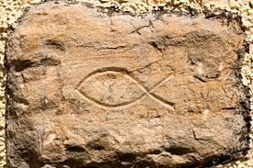
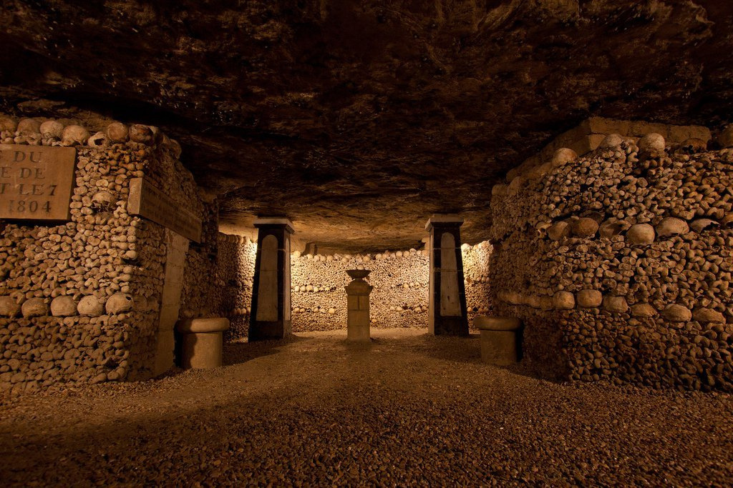
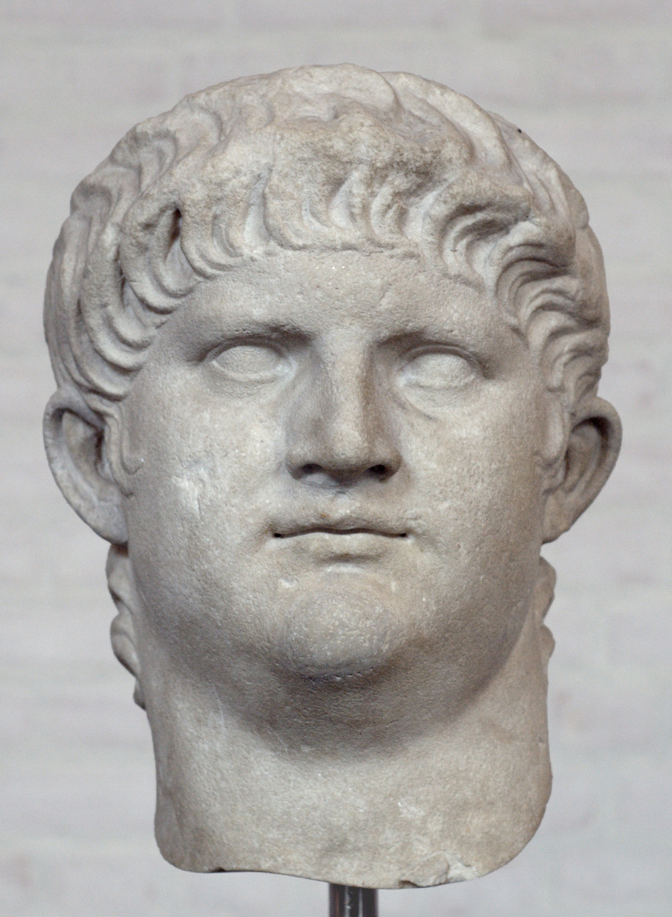
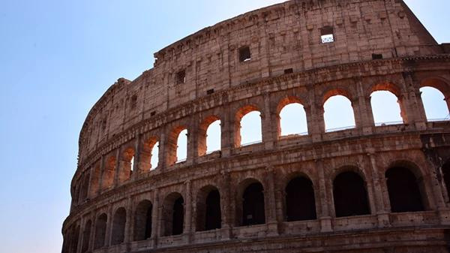

CHURCH HISTORY
25TH SEPTEMBER 2022
Presented by: Keith Waweru

Slide 2

TOPIC OUTLINE
EARLY CHURCH (33-500)
MEDIEVAL CHURCH (500-1500)
REFORMATION (1500-1600)
ENGLISH REFORMATION AND PURITANISM (1600-1800)
GREAT CENTURY OF MISSIONS (1800-1900)
MODERN CHURCH (1900-2022)

Slide 3





EARLY CHURCH (33-500)

Slide 4

WHAT IS THE EARLY CHURCH?
  This is the period from Christ's ascencion to the fall of Rome.
  This period can be divided into two broad happenings:
  Persecution
  Heresy
These are the two plagues of the church (Revelation 12:1-2)

Slide 5
PERSECUTION
EARLY (33-100)
LATE (101-305)
  The Early church in Acts was primarily persecuted by the Jews out of pure jealousy.
  The Roman emperors were not really involved until 64AD during Nero's reign and 90AD during Domitian's reign.
  A period of relative peace followed in the 2nd Century.
  Persecution was local and sporadic. The Decian and Diocletian persecutions were organized and targeted in the 3rd century.

Slide 6
WHAT WAS THE ROMAN VIEW OF CHRISTIANITY?
  A dangerous superstition.
  Incestous - because Christians called each other brother and sister.
  Anti-social.
  Cannibalistic - Ate the body and drank the blood of Christ.

Slide 7
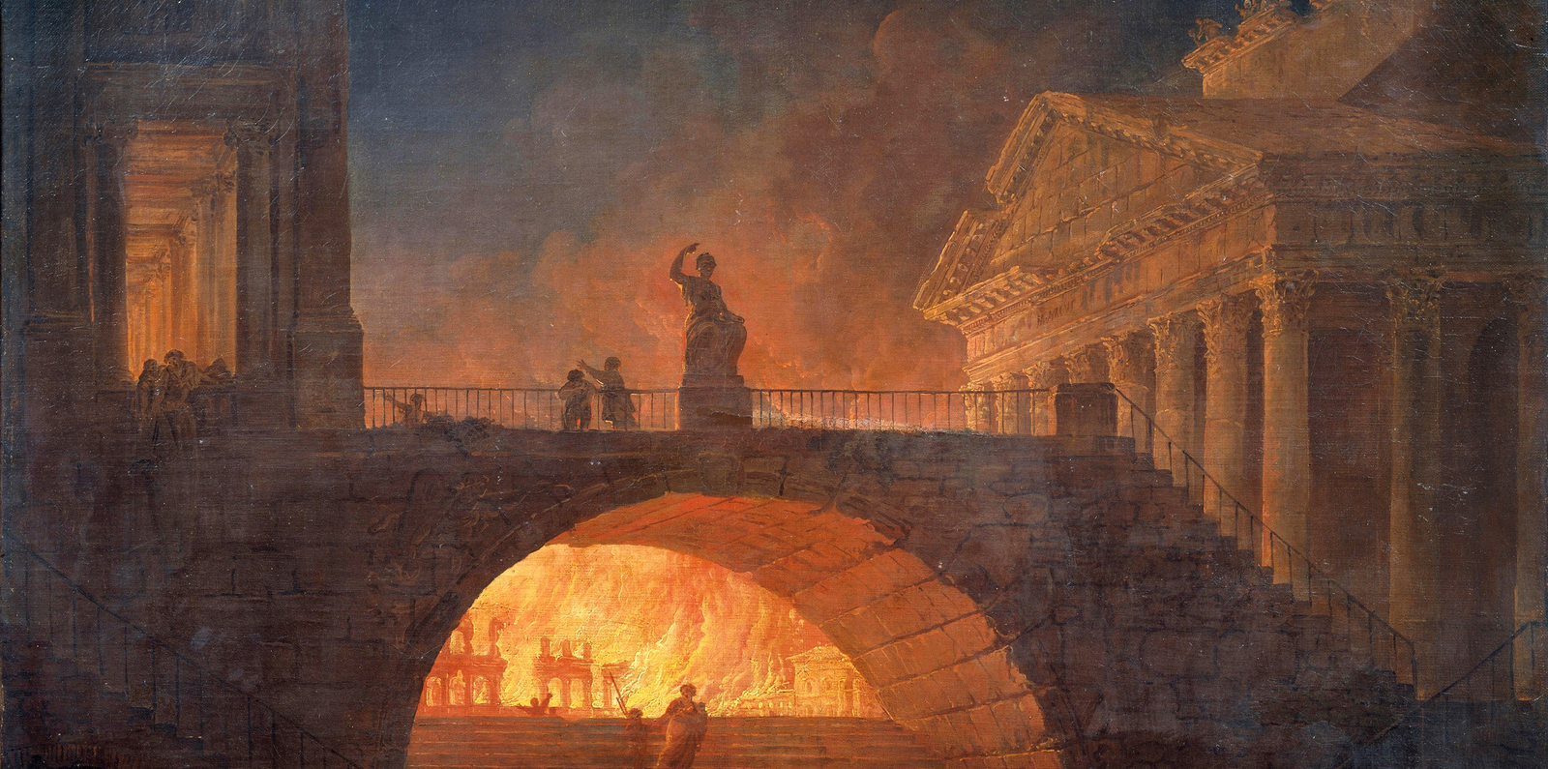
NERO (54-68 AD)
  He accussed Christians of starting the fire of Rome in 64 AD.
  Christians were persecuted because of this.
  Peter and Paul were probably martyred under him.

Slide 8
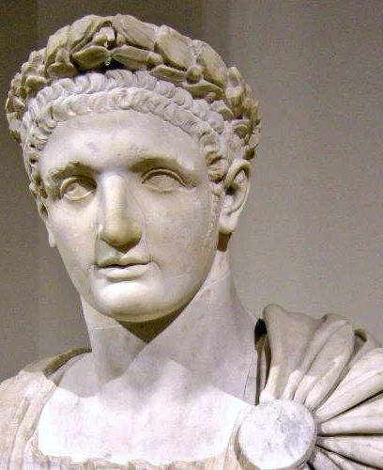
DOMITIAN (81-96 AD)
  Was a strong adherent to the Roman religion.
  Christians were heavily persecuted during his time.
  He called himself "Dominus et Deus" meaning Lord and God.
  Christians refused to participate in emperor worship bringing about their persecution.
  The Apostle John wrote Revelation during his time (probably exiled by him).

Slide 9
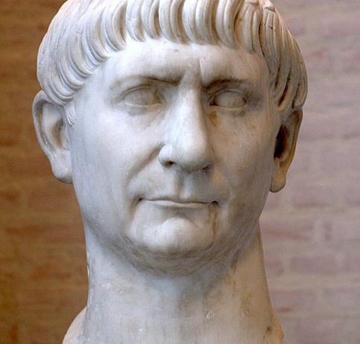
TRAJAN (98-117 AD)
  Trajan told Pliny to continue prosecutions of Christians if they merited that, but not to accept anonymous or malicious denunciations.
  His policy was continued throughout the 2nd Century AD.
  This stable and peaceful time in Rome meant Christians were relatively unharmed.

Slide 10
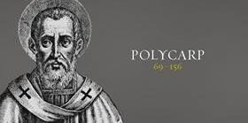
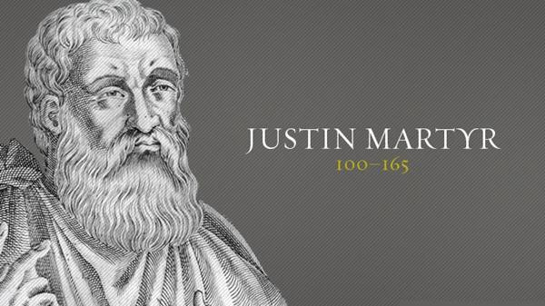
  Though these persecutions were sporadic and local, they claimed many believers who refused to sacrifice to the Roman gods or denounce Jesus.
  The Romans had no problem if you had your gods provided you recognized their's as well.

Slide 11

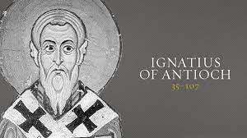
  The persecutions of these prominent people were meant to scare other Christians from either practicing their faith or accepting to sacrifice to the Roman gods.

Slide 12
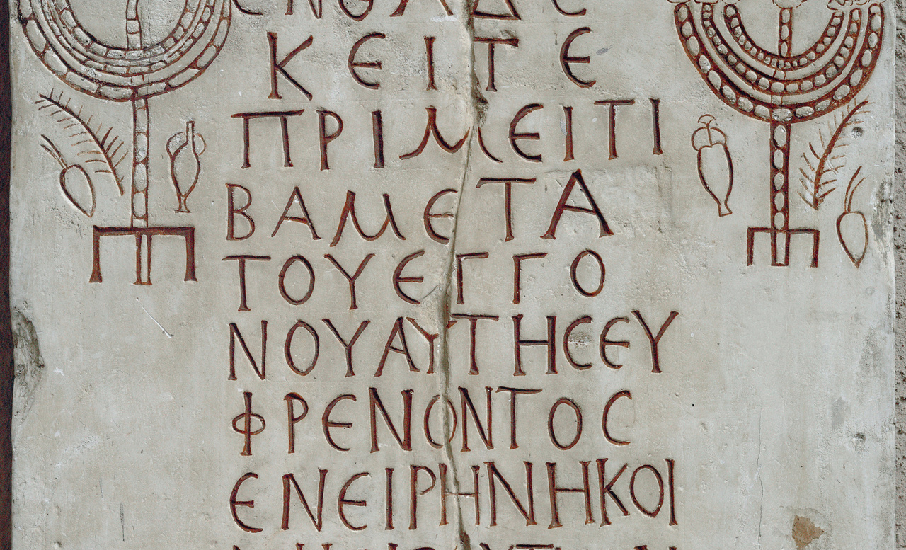
HOW DID CHRISTIANS RESPOND TO PERSECEUTION?
  Many Christians resorted to meet in homes while some met in CATACOMBS which were found under the Ancient Roman city.

Slide 13
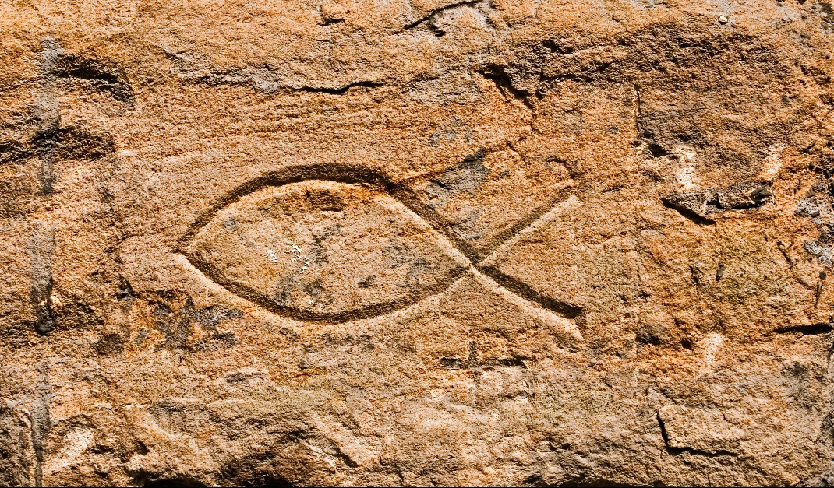
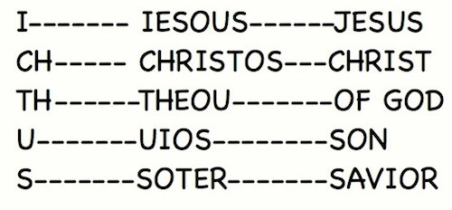
HOW DID CHRISTIANS RESPOND TO PERSECEUTION?
  They also developed an Acrostic to communicate. This was by making a sign of a fish which would help one Christian identify another.

Slide 14
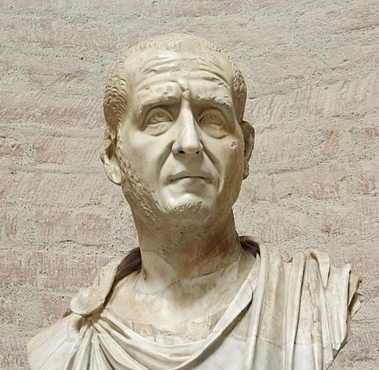
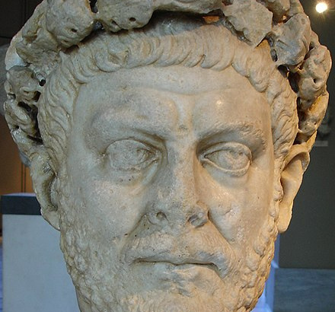
LATER PERSECUTION
DECIUS (249-251)
DIOCLETIAN (284-305)
  This was the first targetted Christian persecution.
  Christians were to sacrifice to the Roman gods and be issued with a Libellus (certificate).
  Rome was celebrating 1000 years. This was a publicity stunt.
  In 303 Diocletian issued a decree that made it illegal to practice Christianity.
  This was the longest, worst and last persecution.
  It was a universal persecution.

Slide 15
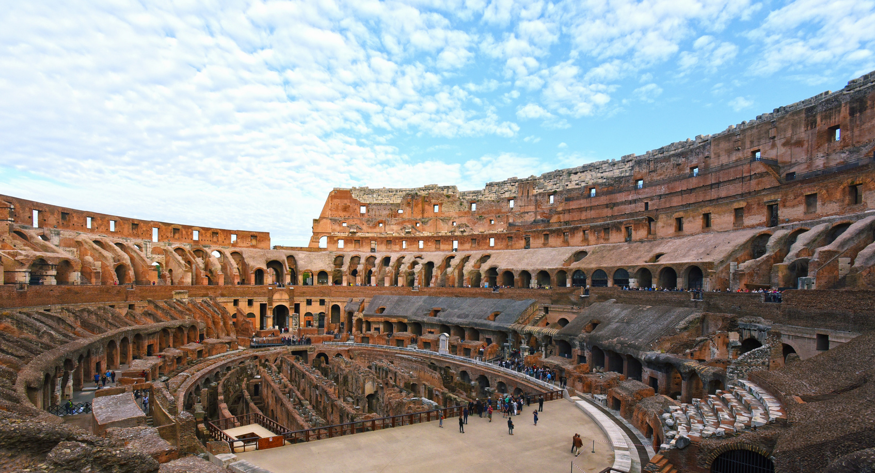
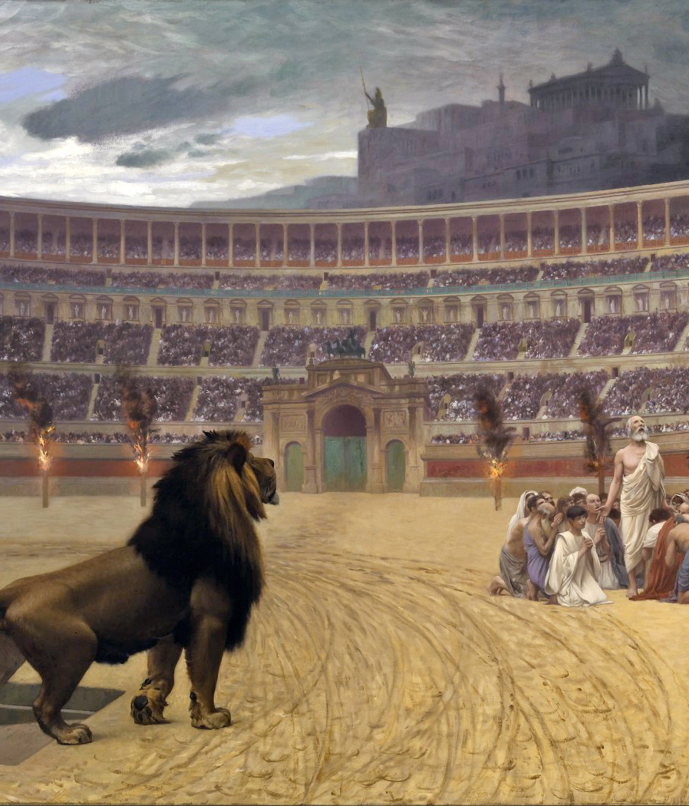

Slide 16


WHEN CHRISTIANS GAVE IN
NOVATIANISM: During the Decian Persecution some Christians offered sacrifices to the gods. They were called Lapsi. Novatianism taught that such people could not be welcomed back into the church.
DONATISM: In North Africa, Donatus rejected the appointment of a bishop who was consecrated by a traditores (one who had given up the Bible to be burnt).

Slide 17
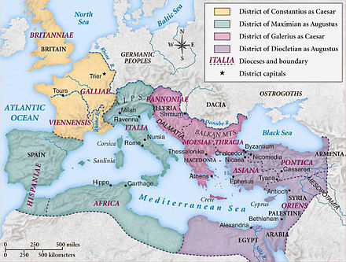

Slide 18
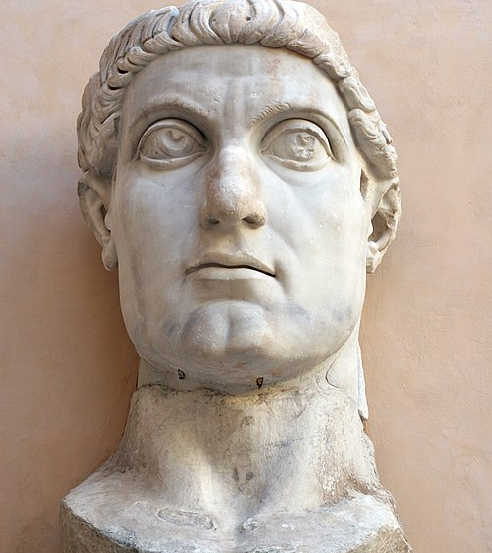
CONSTANTINE
324-337 AD

Slide 19
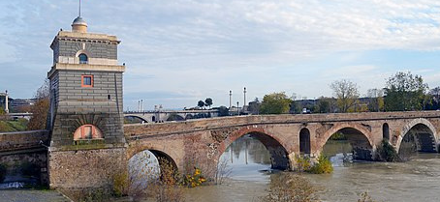
MILVIAN BRIDGE (312 AD)

Slide 20
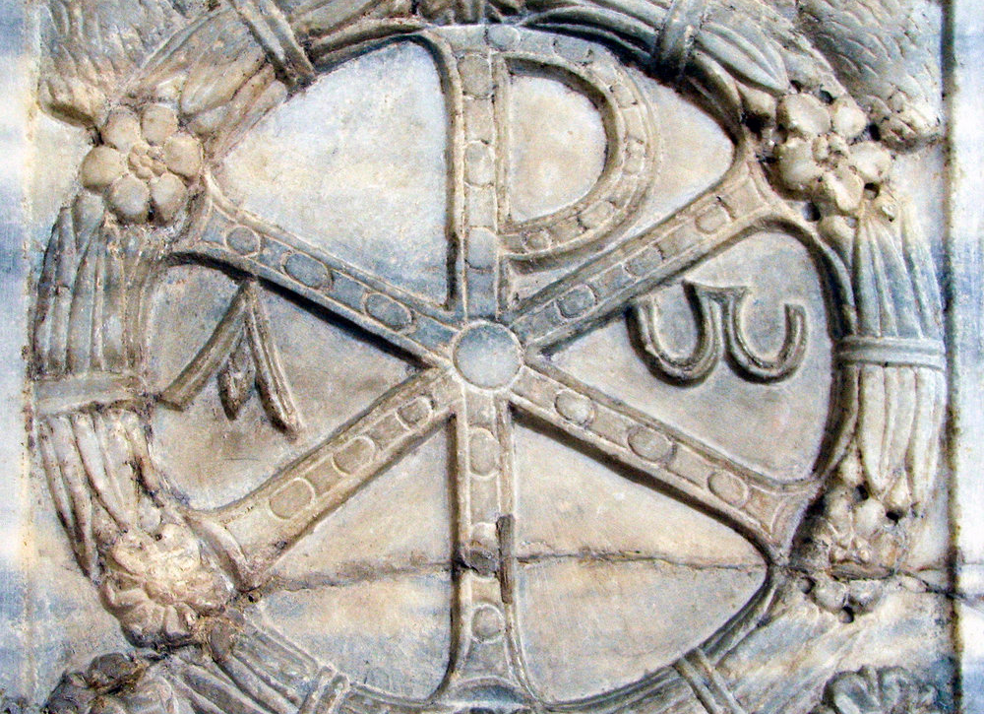

CHI-RHO
THE FIRST TWO LETTERS OF CHRISTOS

Slide 21

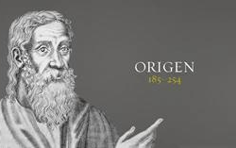
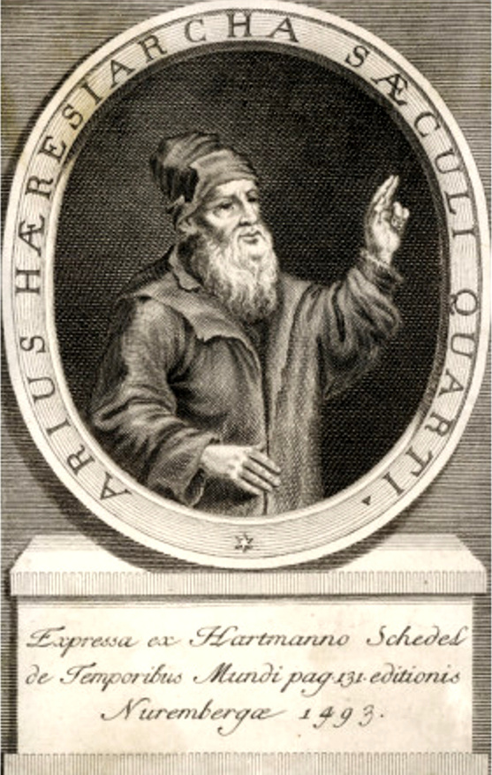

HERESY

Slide 22

EARLY HERESIES
  GNOSTICISM
  MONTANISM
  MARCIONISM
  SABELLIANISM (MODALISM)
  UNIVERSALISM (ORIGENISTS)
  DONATISM
  Constantine came to power at a time when the empire was ripe with various heresies.
  In 325 he had to contend with one of the worst crisis in the church.

Slide 23
ARIAN CONTROVERSY (318)
ARIANISM
SABELLIANISM
ORIGENISTS
  Jesus is a creature.
  There was a time he didn't exist.
  Only the Father is divine.
  Jesus is an exalted creature.
  The Father = The Son = The Holy Spirit
  Each is the mode of the other.
  The Son is divine but is a degree less in divinity than the Father.

Slide 24
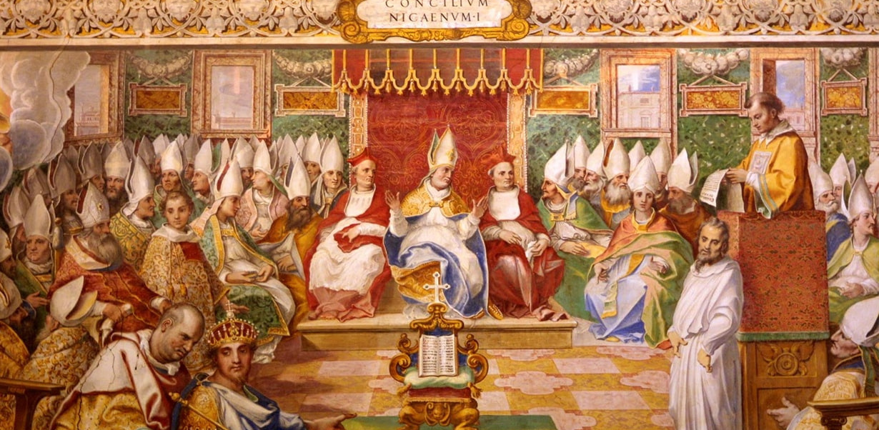
COUNCIL OF NICEA (325 AD)

Slide 25
We believe in one God, the Father almighty, Creator of all things visible and invisible;and in one Lord Jesus Christ, the Son of God, begotten of the Father, only-begotten, that is, from the essence of the Father, God from God, light from light, true God from true God, begotten, not created, of the same essence as the Father, through Whom [i.e., through Christ] all things were created both in heaven and on earth;Who for us human beings and for our salvation came down and was incarnate, was made man, suffered and rose again on the third day, ascended into heaven, and is coming again to judge the living and the dead;and [we believe] in the Holy Spirit.

Slide 26
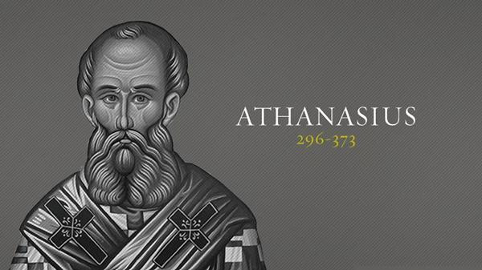
TROUBLE?
HOMOOUSIOS - SAME ESSENCE (NICENES) - WEST
HOMOIOUSIOS - SIMILAR ESSENCE (ORIGENISTS) - EAST
ATHANASIUS CONTRA MUNDUM (AGAINST THE WORLD)

Slide 27
No one else but the savior who in the beginning made everything out of nothing, could bring what had been corrupted into a state free from corruption. No one else but the image of the father could recreate human beings in god’s image. NO ONE ELSE BUT OUR LORD JESUS CHRIST, WHO IS LIFE ITSELF, COULD GIVE IMMORTALITY TO MORTAL HUMANS. NONE ELSE BUT THE LOGOS, WHO IMPARTS ORDER TO EVERYTHING AND IS THE ONE TRUE AND ONLY BEGOTTEN SON OF THE FATHER, COULD TEACH US ABOUT THE FATHER AND DESTROY IDOLATRY. HE BECAME HUMAN THAT WE MIGHT BECOME DIVINE; HE REVEALED HIMSELF IN A BODY THAT WE MIGHT SEE THE INVISIBLE FATHER;HE SUFFERED OUR INSULTS THAT WE MIGHT INHERIT IMMORTALITY.

Slide 28
POST-NICENE CONTROVERSIES
APOLLINARIANISM – CHRIST DID NOT HAVE A HUMAN MIND (CONDEMNED AT CONSTANTINOPLE – 381).
NESTORIANISM – SEPARATED THE DIVINE AND HUMAN NATURES OF CHRIST (DEPOSED AT EPHESUS – 431).
EUTYCHIANISM – CHRIST’S DIVINITY SWALLOWED UP HIS HUMANITY (REJECTED AT CHALCEDON – 451).
PELagianism – humans are born into the world as sinless as adam was before the fall & we can maintain sinless perfection. TO HIM GRACE WAS GOD’S GIFT OF A FREE WILL, MORAL LAW & CHRIST’S EXAMPLE (REJECTED AT ephesus – 431).

Slide 29
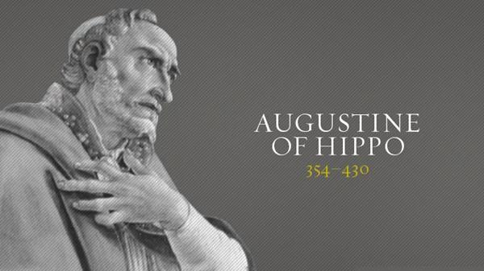
HE WROTE ON NATURE AND GRACE, ON THE GRACE OF CHRIST AND ORIGINAL SIN, CONFESSIONS & CITY OF GOD.
HUMANS FELL IN ADAM.
WE ARE BORN WITH ORIGINAL SIN.
WE ARE FREE TO DO WHAT WE WANT TO DO BUT WHAT WE EVER WANT TO DO IS SIN.
UNLESS GOD’S GRACE STEPS IN TO SAVE US AND ENABLE US TO DO WHAT WE OUGHT TO DO, WE WILL ALWAYS CHOOSE SIN.
GOD DOES SO SOVEREIGNLY.
HIS GO TO TEXT WAS JOHN 15:16. SALVATION IS A WORK OF GOD ALONE (POPULARLY KNOWN AS MONERGISM).

Slide 30
KEY DATES
  337 - CONSTANTINE DIES AND THE EMPIRE IS PLIT BETWEEN CONSTANS AND CONSTANTIUS
  343 - THE CHURCH IN THE EAST AND WEST SPLIT AT COUNCIL OF SARDICA
  376 - THE EAST BECOMES OFFICIALLY ARIAN
  395 - THE EMPIRE PERMANENTLY SPLITS TO EAST AND WEST
  410 - ROME IS SACKED
  476 - ROME FALLS TO ODOVACER THE GERMAN

Slide 31
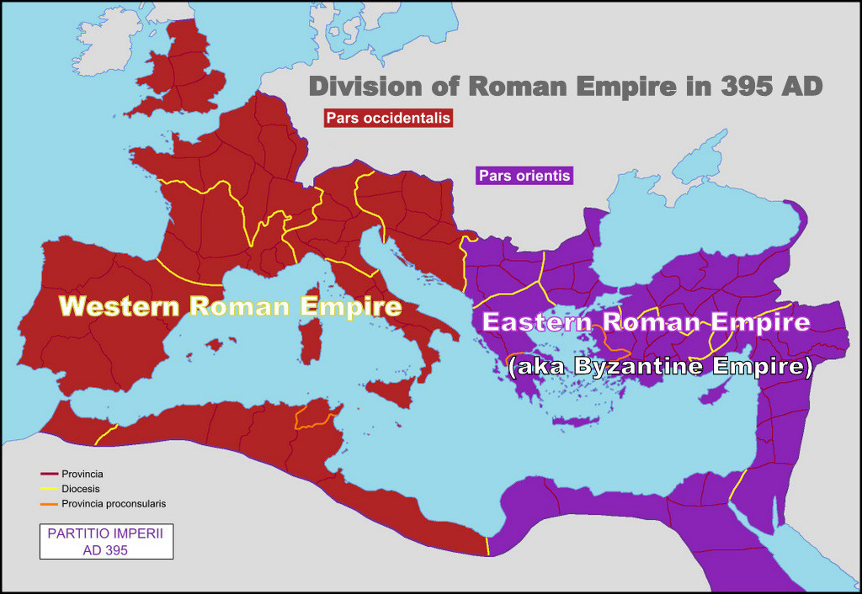

Slide 32
