Slide 1
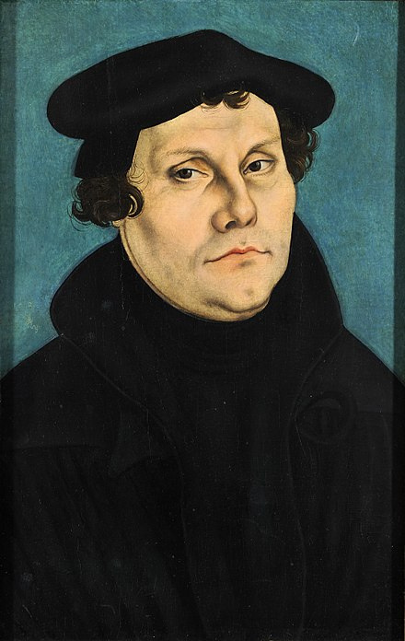
CHURCH HISTORY WITH KEITH WAWERU
9/10/22
REFORMATION
1500-1600 AD

Slide 2
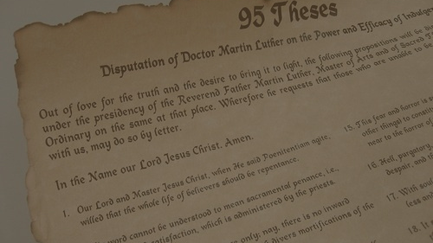
WHAT WE'LL DISCUSS
MARTIN LUTHER
ULRICH ZWINGLI
JOHN CALVIN
COUNTER-REFORMATION
TODAY'S TOPICS

Slide 3
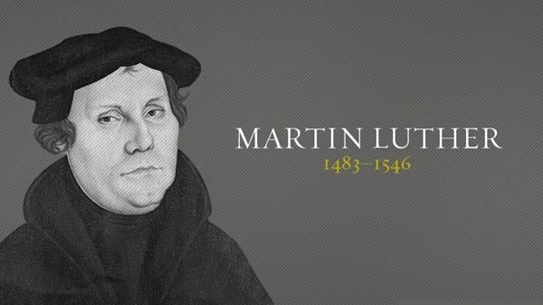
“I felt that I had been born again, and that I had entered paradise itself through open gates.”
MARTIN LUTHER

Slide 4
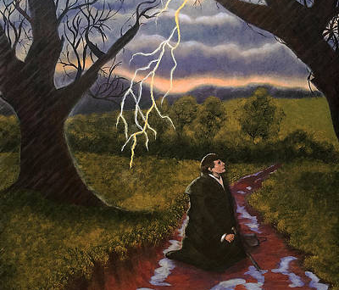
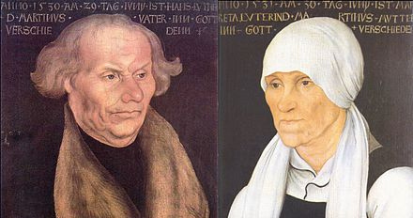
BACKGROUND
  Born in Eisleben.
  The Second Son of Hans Luther (out of six children)
  In 1501, aged eighteen, he went to the University of Erfurt (central Germany), intending to become a lawyer in obedience to his father’s wishes
  After one month he quit law school and joined the Augustinian order much to his father's displeasure.
  He was ordained to the priesthood in 1507, and in 1508 became a junior lecturer at the new University in Wittenberg.

Slide 5
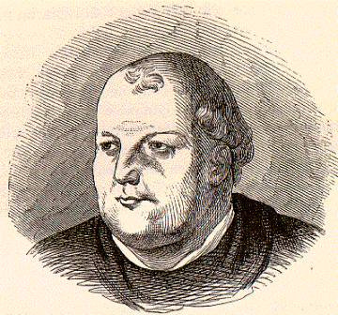
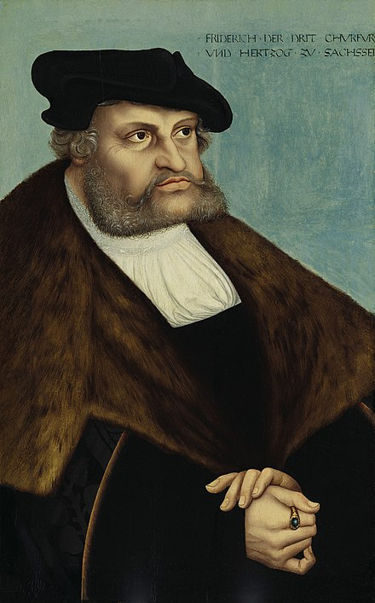
FREDRICK THE WISE
JOHANESS VON STAUPITZ

Slide 6
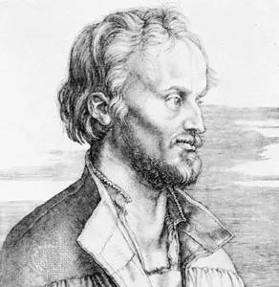
ROAD TO REFORM
  In 1511, Von Staupitz sent him to Rome.
  In 1513 he came to the realization that He came to understand that the apostle Paul’s phrase “the righteousness of God” (Rom. 1:17) does not mean the righteousness by which God punishes sinners, but the righteousness which He graciously gives to sinners as a free gift of salvation.
  In 1518-1519 Luther came to see God's righteousness as being inputed upon one who has faith in Christ alone. He separated this from making the believer righteous. This was the doctrine of justification by faith alone.
PHILIP MELANCHTON

Slide 7
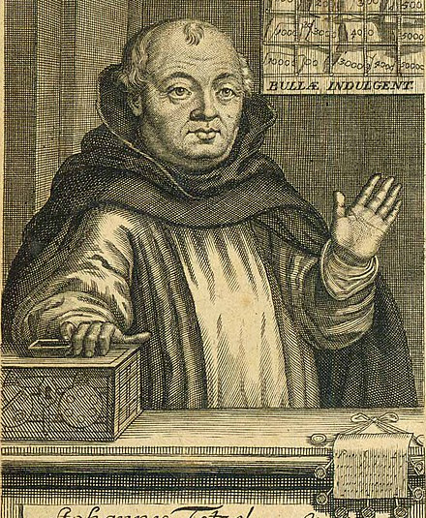
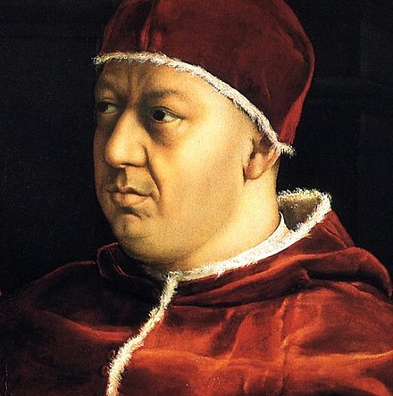
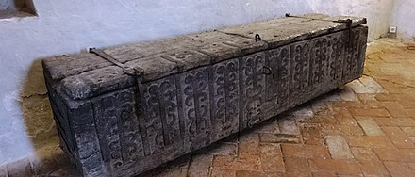
  In 1515 Pope Leo X authroized the sale of papal indulgences to finance the building of St. Peter's Basilica.
  By April 1517, Tetzel was teaching on indugences in Wittenberg.
  “As soon as the coin in the money-box rings, the soul from purgatory springs!”
  On 31 October 1517 he announced that he was going to debate the subject in public in Wittenberg University on the following day.
JOHANN TETZEL
POPE LEO X

Slide 8
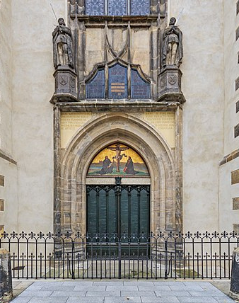
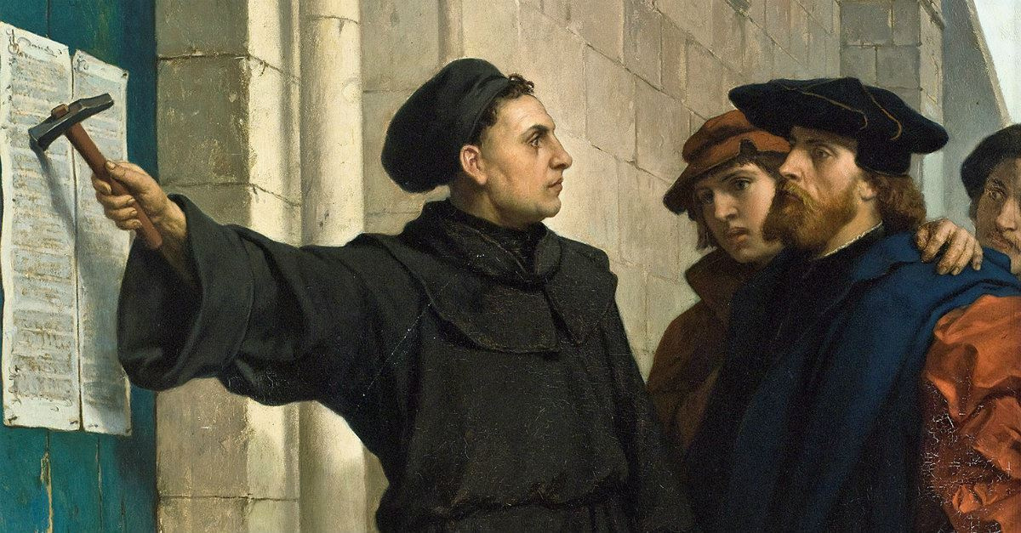
  Humanists like Erasmus, who despised indulgences.
  German nationalists who saw indulgences as one of the papacy’s instruments for draining away German cash to Rome.
  Many ordinary German Christians, who longed for the Church to be purified from its abuses.

Slide 9
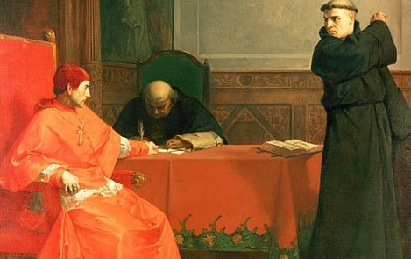
  In April 1518 Luther was summoned at a disputation at Heidelberg.
  He defended Augustine’s doctrines of sin and grace.
  Luther’s performance at the disputation won over two young friars, Martin Bucer (1491-1551) and Johannes Brenz (1499-1570).
  In August, Pope Leo summoned Luther to appear in Rome within sixty days to answer for his errors.
  He also ordered Luther’s prince, Frederick the Wise of Saxony, to hand Luther over to the papal legate Cardinal Cajetan (1469-1534).
  In June and July 1519, Luther took part in a disputation at Leipzig with Johann Eck (1486-1543).
  Luther stated that ecumenical councils could be wrong e.g condemning Huss.
  Here was the birth of the reformed slogan, "SOLA SCRIPTURA."

Slide 10
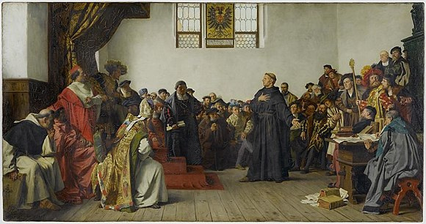
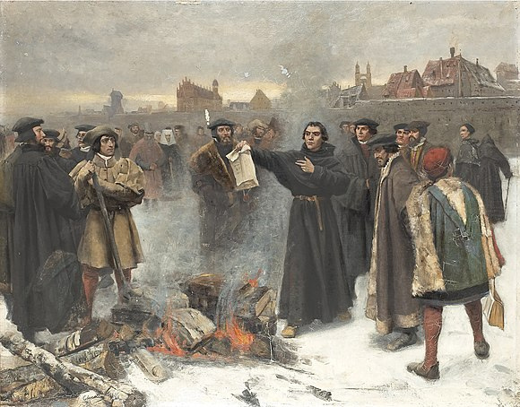
  On 15 June 1520, Leo issued a papal bull entitled Exsurge domine (“Rise up, O Lord”), ordering Luther to submit within sixty days or be excommunicated and burnt as a heretic.
  Emperor Charles summoned an imperial parliament or “diet” to meet at Worms in January 1521.
Luther wrote three other treatises before the Diet:
  Address to the Christian Nobility of the German Nation
  The Babylonian Captivity of the Church
  The Freedom of a Christian
One thing that Luther advocated for was the priesthood of all believers.
On 26 May, the diet officially condemned him as a heretic and outlaw.

Slide 11
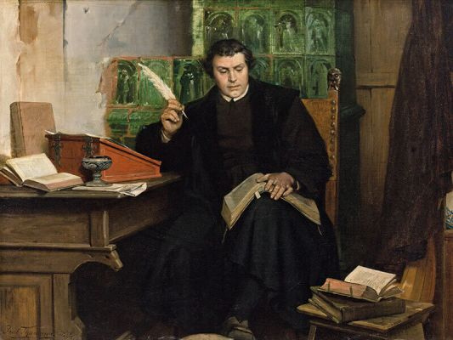
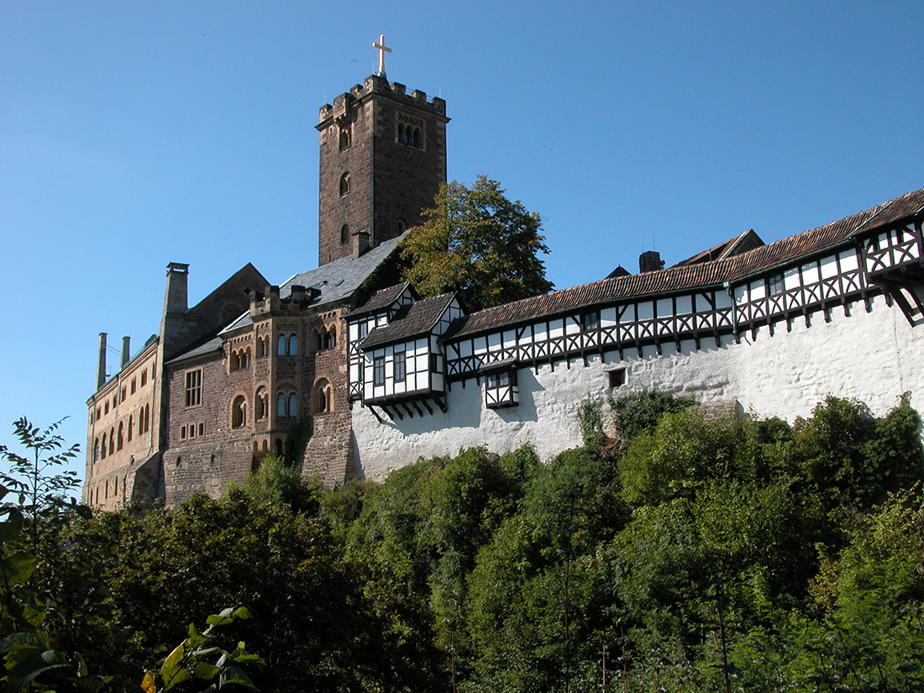
"Unless I am refuted and convicted by testimonies of Scripture or by clear reason – since I believe neither the popes nor the councils by themselves, for it is clear that they have often erred and contradicted themselves – I am conquered by the holy Scriptures I have quoted, and my conscience is captive to the Word of God. I cannot and will not withdraw anything, since it is neither safe nor right to do anything against one’s conscience. Here I stand. God help me. Amen."

Slide 12
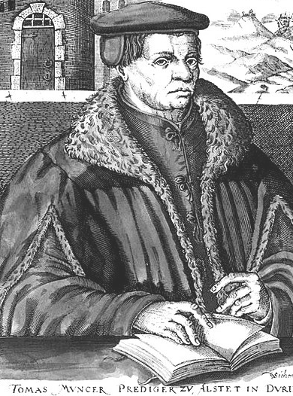
RADICAL REFORMERS
  Zwickau prophets arrived in Wittenberg in December 1521.
  Some of Luther's colleagues at Wittenberg followed them e.g Andreas Carlstadt.
  Against Infant Baptism
  Church-State Alliance
  Direct revelation
THOMAS MUNSTER

Slide 13
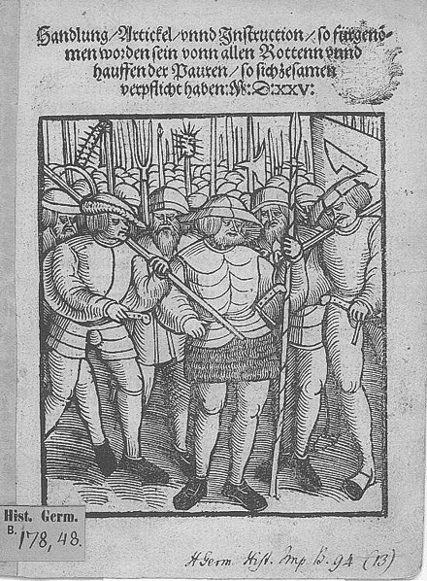
PEASANTS REBELLION
  1524-1525
  100,000 peasants lost their lives.
  It marked the end of the rapid spread of Lutheranism in Germany.
  The Lutheran princes became determined that they must strictly control the Reformation, as the only way to stop it turning into a popular social movement which could challenge their authority.

Slide 14
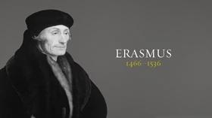
THE FREEDOM OF THE WILL
  IN SEPTEMBER 1524, URGED ON BY ROMAN CATHOLIC FRIENDS, ERASMUS PUBLISHED A BOOK AGAINST LUTHER CALLED THE FREEDOM OF THE WILL.
  HE ARGUED THAT CONVERSION AND SALVATION WERE A SHARED WORK OF HUMAN FREE WILL AND DIVINE GRACE.
  Luther replied to Erasmus in December 1525 with his The Bondage of the Will ,
  "HE HAS DONE WHAT HE WAS DESTINED TO DO; HE HAS INTRODUCED THE ANCIENT LANGUAGES IN PLACE OF HARMFUL SCHOLASTIC STUDIES. HE WILL PROBABLY DIE LIKE MOSES IN THE LAND OF MOAB. HE HAS DONE ENOUGH TO UNCOVER THE EVIL; BUT TO REVEAL THE GOOD, AND LEAD PEOPLE INTO THE PROMISED LAND, IS IN MY OPINION NOT HIS BUSINESS."

Slide 15


Slide 16
BREAK WITH ROME
  By 1522, Zwingli had made the first moves towards breaking openly with Rome.
  Zwingli rejected the infallible authority of the papacy, ecumenical Councils, and Church tradition.
  Faith must be based on God’s teaching in Scripture, not on the teachings of the papacy or its traditions.
  In a public disputation in Zurich on 29 January 1523, Zwingli affirmed in sixty-seven theses that salvation came exclusively through faith in Christ, good works had no merit in justifying sinners, purgatory did not exist, the Lord’s Supper was not a sacrifice, and Christ alone (not the pope) was the head of the Church.
  Luther held that traditional Catholic worship should be left as it was, unless Scripture absolutely required that it be changed; Zwingli argued that nothing should be done in worship unless God positively authorised it in the New Testament.
  By April 1525, the Zurich Reformer had secured the removal from Zurich’s churches of all religious pictures, statues, crucifixes, candles, altars, and relics, and the abolition of the organ, the choir, priestly robes, religious processions, and the monasteries.

Slide 17
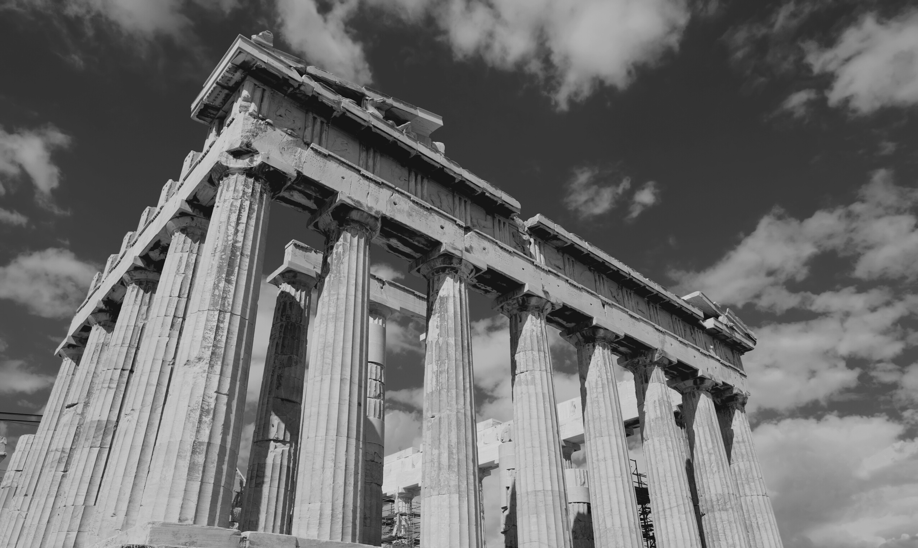
The Communion Controversy
  They both rejected transubstantiation and the special power of the priest to perform this so-called miracle.
  They both rejected the idea that the eucharist was a sacrifice which had the power to secure God’s grace for those for whom it was offered, even when they did not take part (e.g. souls in purgatory).
  They both rejected the medieval Catholic practice of adoring the sacramental bread after the priest had pronounced the words “This is My body.”
  They both demanded that the cup be given to the laity.
Luther and Zwingli divided over the question of how exactly Christ was present in the eucharist.
  Luther held that the body and blood of Christ were mysteriously present “in, with, and under” the bread and wine.
  Christ’s flesh and blood, Zwingli argued, were in no sense physically present in the bread and wine; His risen body was in heaven, not on earth.

Slide 18
  The union between Christ’s divine and human natures was so close, Luther said, that each nature communicated its properties to the other. Christ’s humanity imparted to His deity the capacity for suffering and death; His deity bestowed on His humanity its “omnipresence” – the divine quality of being everywhere. For this Zwngli accused Luther of the heresy of Eutyches.
  A human body, Zwingli argued, cannot be everywhere without ceasing to be a real human body, because it is the nature of a human body to occupy a particular place. Luther accused him of Nestorianism.
  "I cannot regard Zwingli or any of his teaching as Christian at all. He neither holds nor teaches any part of the Christian faith rightly, and is now seven times more dangerous than when he was a papist."
  "Since he has lost all control of himself, he now believes that the greatest sin and the unfairest act in the world is to criticise him. We have here a miserable creature who smashes up heaven and earth merely because we have told him that he too, as a man, might go wrong, and that those who put their faith in him might miss the mark. Thus, according to him, we overthrow the entire faith! Not so, my brother; but we must not get it into our heads that the Holy Spirit is bound to Jerusalem, Rome, Wittenberg, or Basel, to yourself or to any other man."

Slide 19
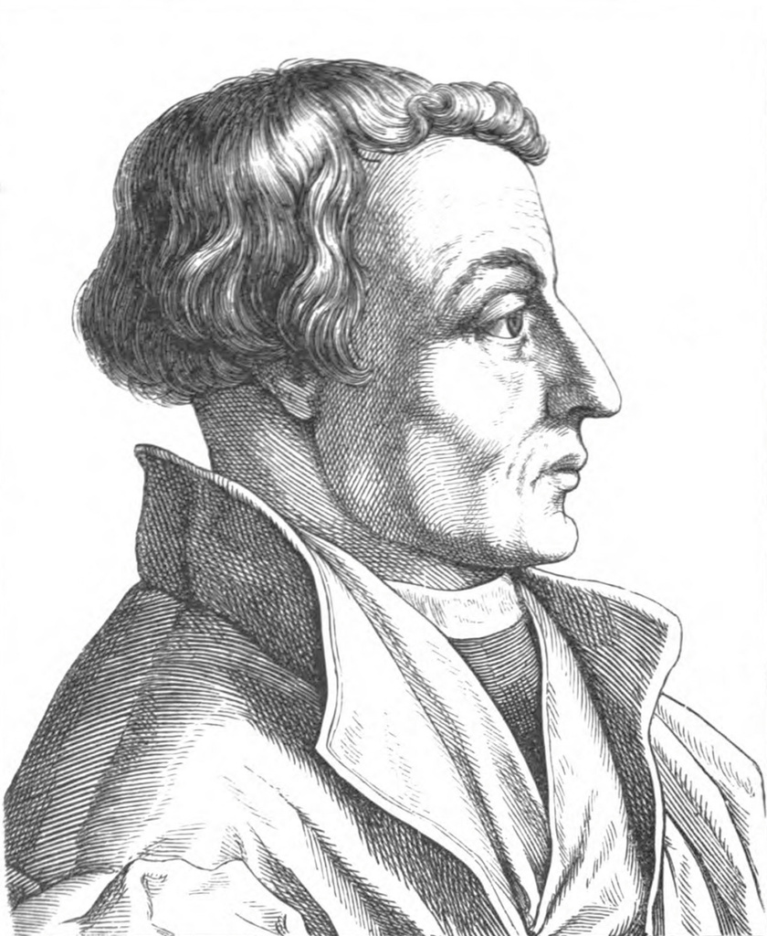
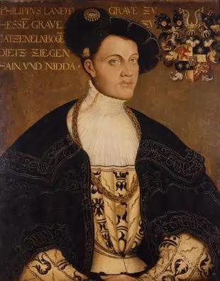
Colloquy of Marburg
1-4 October 1529
  Lutherans and the Swiss Reformed separated.
  However, the Swiss reformed managed to convince Luther's friend Melanchton to their view of the Lord's Supper.
Martin Bucer
Philip of Hesse

Slide 20
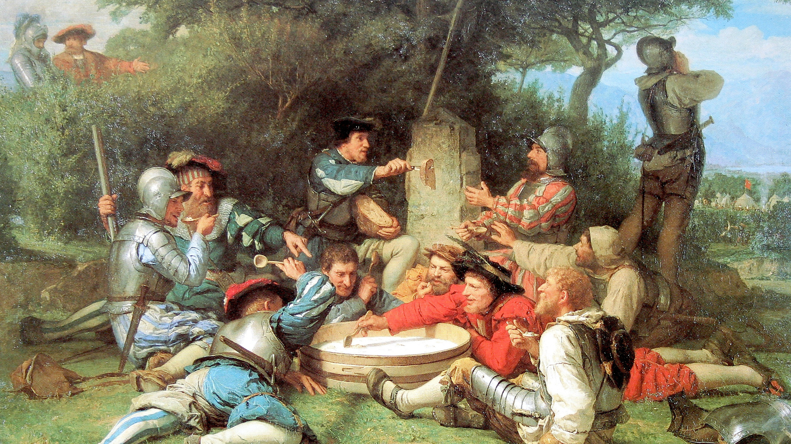

Slide 21
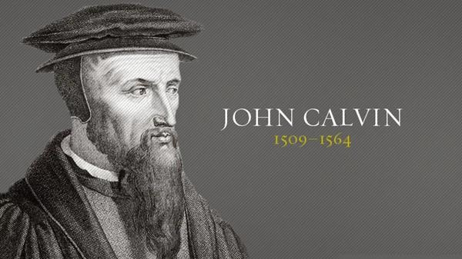

Slide 22
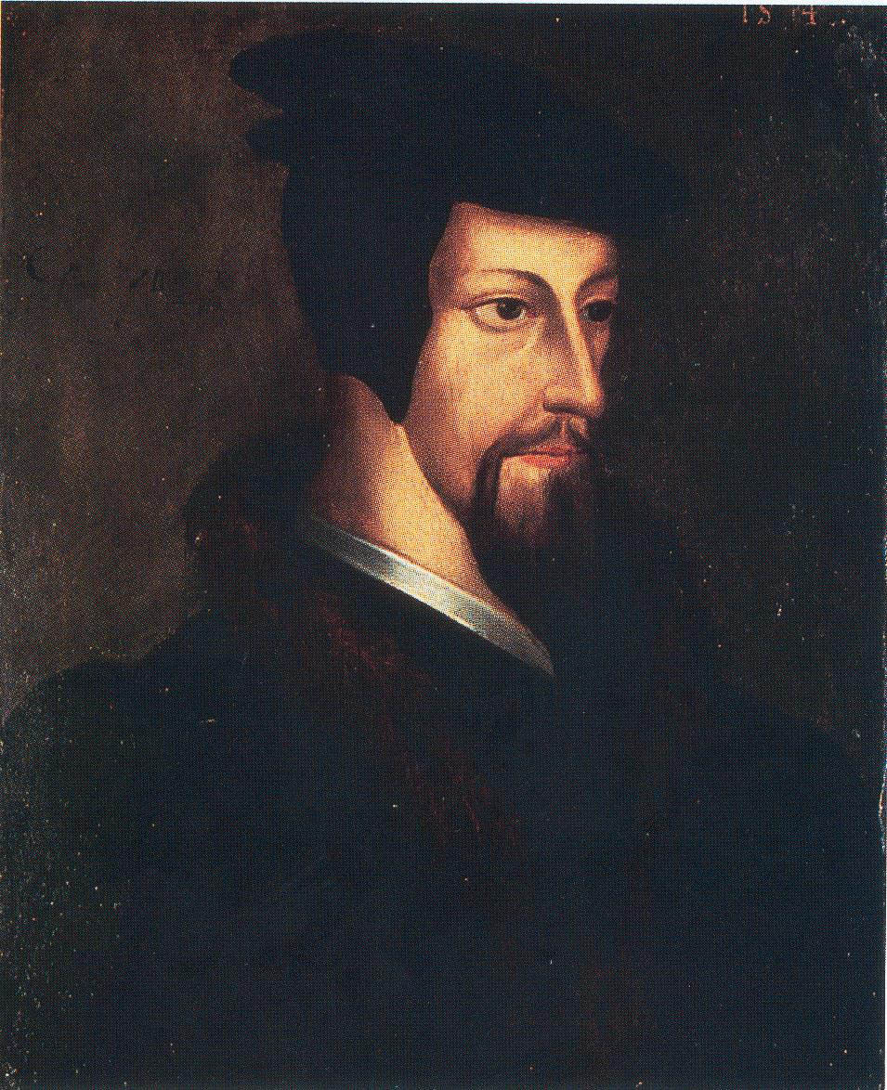
  John Calvin was born at Noyon in Picardy, north-eastern France, in 1509.
  When his father died unexpectedly in 1531, this left Calvin free to abandon law and dedicate himself to Christian humanism at the College de France in Paris.
  However, some time between 1532 and 1534, Calvin passed over (like so many others) from Christian humanism into avowed Protestantism.
  France became an even more dangerous country for Protestant sympathisers in 1534.
  Now clearly a Protestant himself, Calvin fled to Basel, arriving there in January 1535.

Slide 23
  Calvin felt he must defend his persecuted brothers and sisters and in March 1536 he published a short book called Institutes of the Christian Religion, prefaced by an open letter to Francis I.
Apostles’ Creed | Calvin’s Institutes
“I believe in God the Father almighty, Creator of heaven and earth” “And in Jesus Christ, His only Son, our Lord” “I believe in the Holy Spirit” “I believe in the holy Catholic Church” | Book One – “The Knowledge of God the Creator” Book Two – “The Knowledge of God the Redeemer in Christ” Book Three – “The Way we Receive the Grace of Christ” Book Four – “The External Means or Aids by which God Invites us into the Society of Christ”

Slide 24
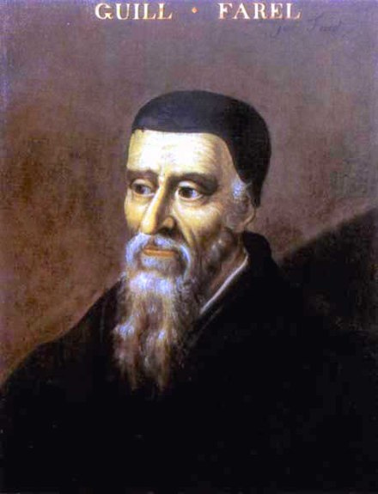
  For Calvin, Christ was present in the Lord’s Supper not physically in the bread and wine (as Luther said), nor in His divine nature alone (as Zwingli said), but in the power of the Holy Spirit. As the mouths of believers received the sacramental signs (bread and wine), the Spirit fed their souls with the things signified (the body and blood of the crucified and risen Christ).
  In July 1536 he made a stopover at Geneva.
  His attempt at reforming Geneva were a disaster.
  He went to Strasbourg and shepherded there from 1538-1541.
  In 1539, Jacob Sadoleto wrote a letter to convince Genevans to go back to Rome.
  In september of that year Calvin wrote his reply, impressing the Genevans who asked him to go back.
William Farel

Slide 25
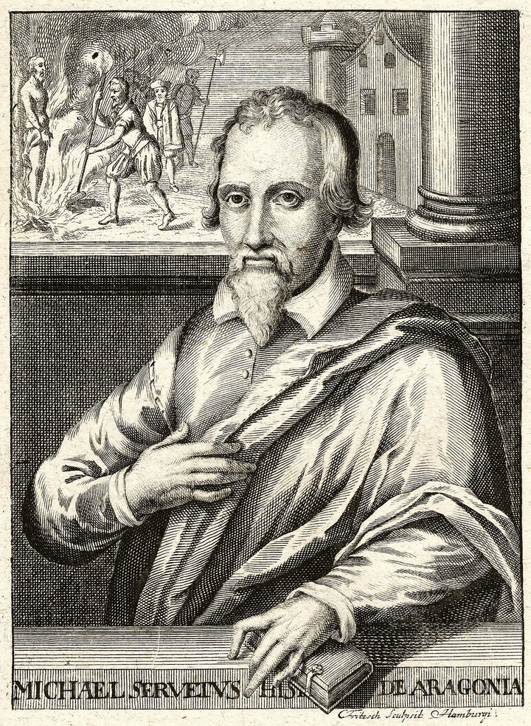
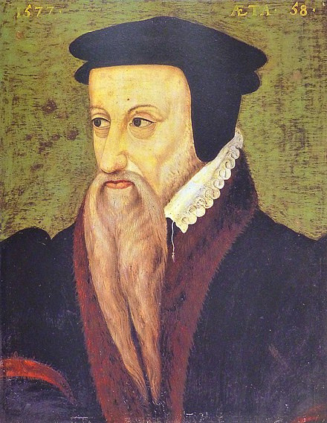
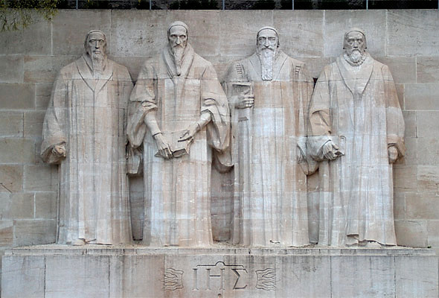
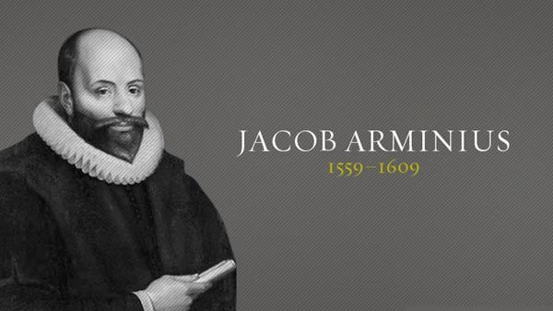
Michael Servetus
  Burnt for heresy.
  Anti-trinitarian.
Theodore Beza
  Succeeded Calvin at Geneva
SYNOD OF DORT (1618-1619)

Slide 26
CATHOLIC COUNTER-REFORMATION
Dealt with issues such as:
  Countering the Reformation wave.
  Reforming the Catholic church from within against immorality, corruption, bad worship, ignorance of clergy and a lack of spirituality.
  Restoring the papacy.
  Increasing missions.
  CATHOLIC EVANGELICALS
  IGNATIUS LOYOLA AND THE JESUITS
  COUNCIL OF TRENT
  MISSIONS TO NEW LANDS

Slide 27
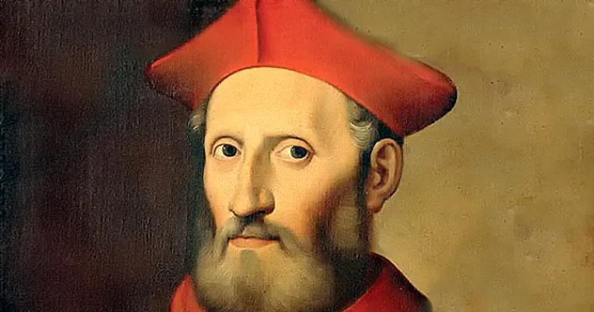
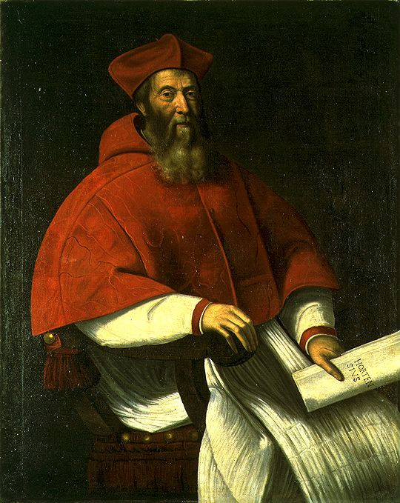
GASPARO CONTARINI
  Wanted to reform the RCC from within.
  Their works were thrown to the index of forbidden books.
  In 1541, the colloquy of Regesburg failed to bridge the gap between RCC and the protestants.
JACOB SADOLETO

Slide 28
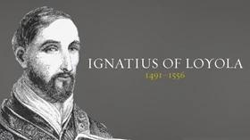
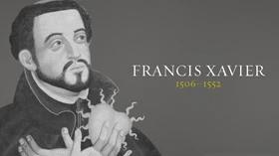
  Wrote his influential spiritual exercises.
  Begun the Jesuit order.
  Received Papal approval.
  Highly ascetic.
  Had four vows: poverty, celibacy, obedience to superiors and willingness to go wherever the pope will send.
  Did missions to Japan, Malaysia and India

Slide 29
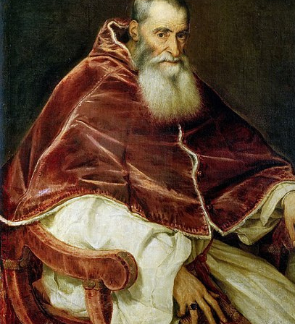
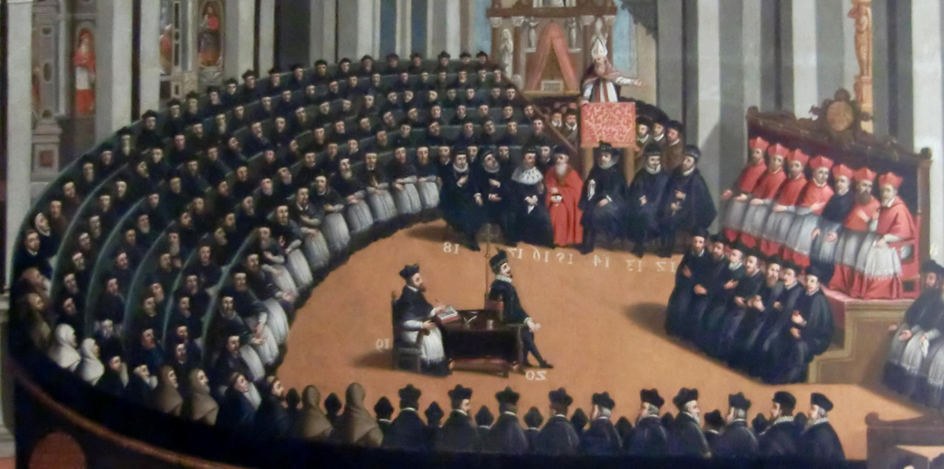
POPE PAUL III
Stage 1: 1545-1547 - Scripture and tradition (original sin and justification).
Stage 2: 1551-1552 - Sacraments and transubstantiation.
Stage 3: 1562-1563 - invocation of saints, the veneration of relics, purgatory, requiem masses, and indulgences

Slide 30
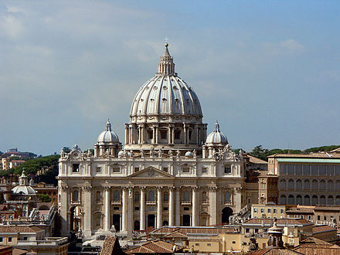
EFFECTS OF COUNTER- REFORMATION
  The triumph of the papacy
  The definition of doctrine
  The flourishing of spirituality
  The recovery of zeal.
  FIRST VATICAN COUNCIL (1869-1870)
  SECOND VATICAN COUNCIL (1962-1965)

Slide 31
