Slide 1

16/10/22
ENGLISH & SCOTTISH REFORMATIONS AND PURITANISM
WITH PASTOR KEITH WAWERU

Slide 2
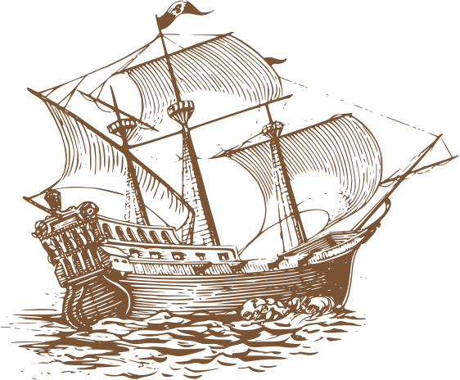
TOPICS
  ENGLISH REFORMATION
  SCOTTISH REFORMATION
  PURITANISM
  THE GREAT AWAKENING

Slide 3
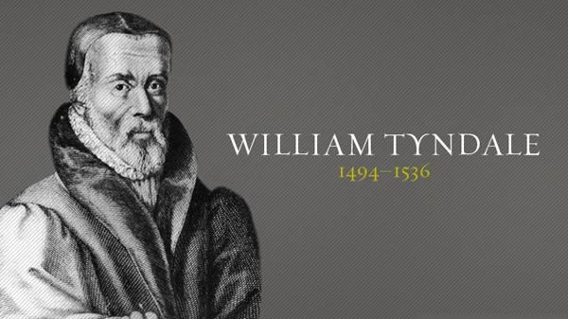
  Tyndale wanted to translate the Bible into English.
  He went to Europe where he became a fugitive running away from king Henry VIII's pursuit.
  He translated the New Testament, Pentateuch, Joshua-2 Chronicles and Jonah. Copies of his translations were smuggled into England by hiding them in cargo ships.
  The catholic church searched for such copies and burnt them in their masses.

Slide 4
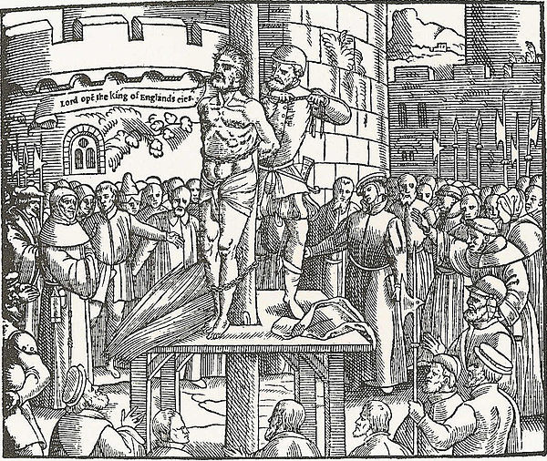
  Captured in 1535 in Antwerp after being betrayed by a supposed friend.
  He was strangled and then burnt at the stake in 1536.
  His dying words were, "O Lord, open the king of England's eyes.”
  Three years later, the Great Bible was published and committed to every parish. It was 90% Tyndale's work.
  His translation is credited with transforming the English Bible far surpassing the earlier translations made by the followers of John Wycliffe.

Slide 5
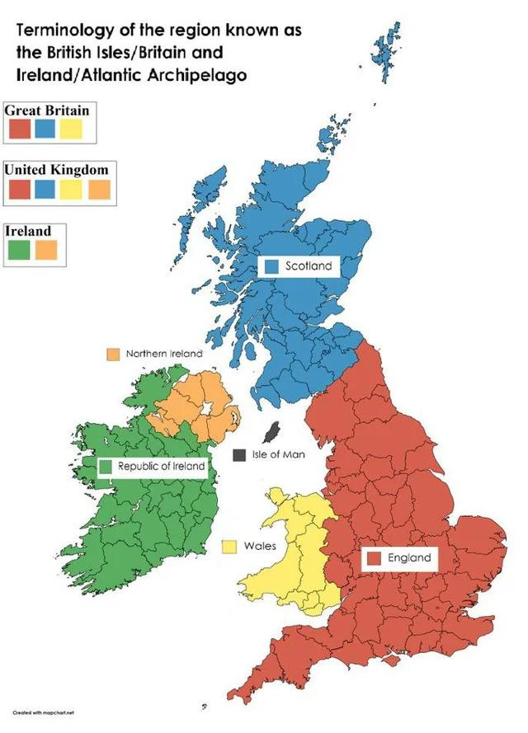
BRITISH ISLES
  POLITICAL
  SPIRITUAL
  God used the workings of men for the good of his people and the growth of the church.
  The English reformation was like a pendulum. Whichever side had the most support held sway.

Slide 6
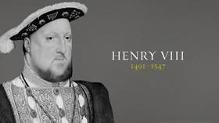

Slide 7
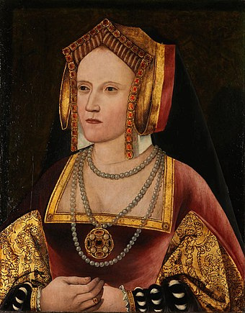
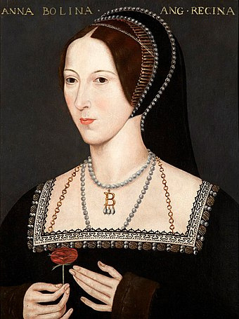
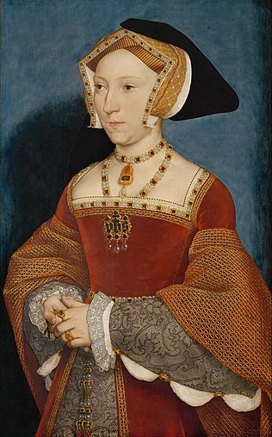
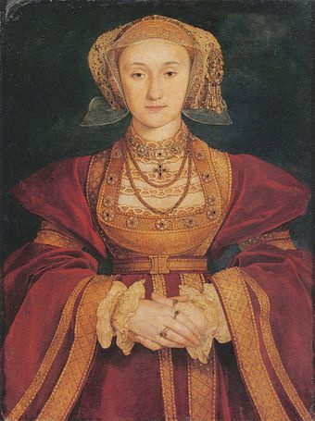
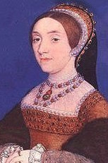
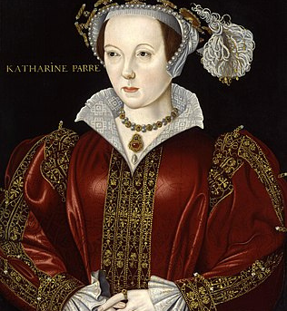
Katherine of Aragon
Anne Boleyn
Jane Seymour
Anne of Cleaves
Catherine Howard
  King Henry VIII had 6 wives to whom he was wedded. One died, one survived, two he divorced and two he beheaded.
  Divorced, beheaded, died; Divorced, beheaded, survived.
Catherine Parr

Slide 8
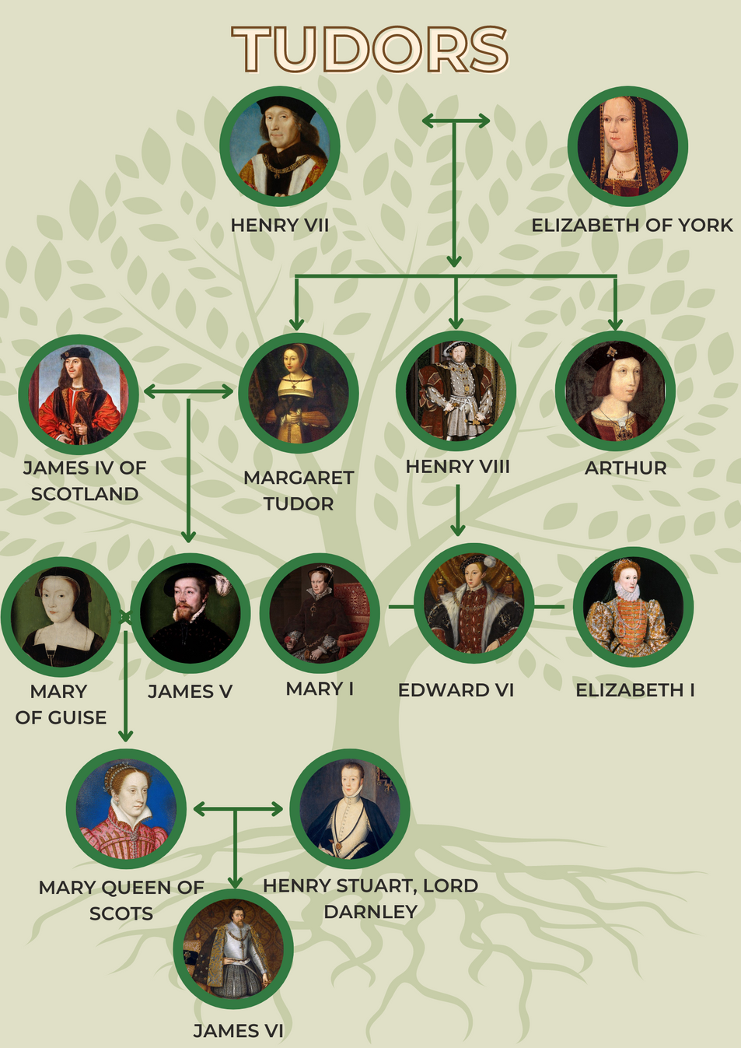

Slide 9
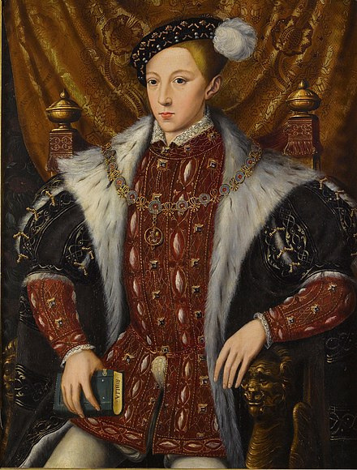
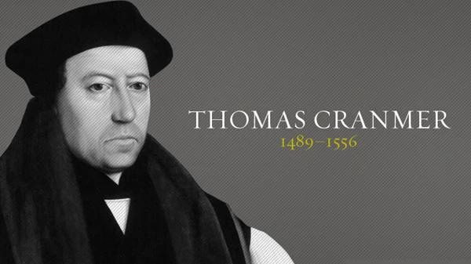
  Wrote the 42 articles and 1552 Book of Common prayer.
  Radical reform - removal of monasteries, all RCC superstition.
  The king still remained the head of the church.

Slide 10
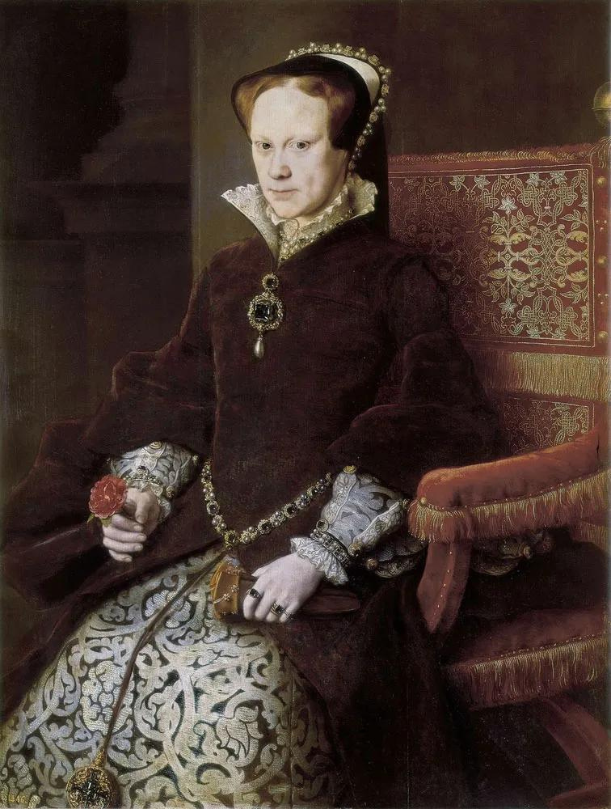
  Reverted the country back to Roman Catholicism.
  Persecuted protestants. About 300 people were executed.
  Many fled from England to continental Europe.
  Perhaps the most famous to die were Thomas Cranmer, Hugh Latimer and Nicholas Ridley.
  "Be of good comfort, Master Ridley, and play the man! We shall this day light such a candle, by God's grace, in England, as I trust shall never be put out."
  This spurred own the English people to a greater pursuit of Protestantism.

Slide 11
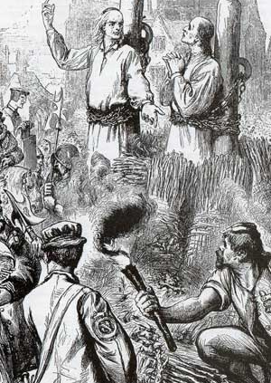
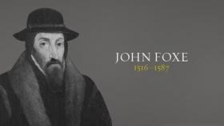
  Wrote Actes and Monuments of these Latter and Perillous Days, Touching Matters of the Church OR Foxe's Book of Martyrs.
  Published in 1568 and put in every church in 1571.

Slide 12
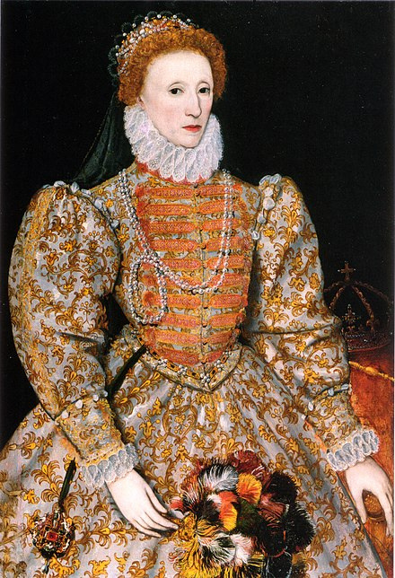
  Established the Elizabethan settlement. It was Parliamentary, Royal and compromising.
  Passed the Act of uniformity of 1559.
  reduced the 42 articles to 39.
  Made church attendance compulsory.
  Passed the Act of Uniformity which forced the clergy to recognize the queen as supreme head of the church and to wear vestments.
  One would be fined for non-attendance.
  She was excommunicated from RCC by Pope Pius IV.
  Protestantism flourished during her reign.

Slide 13
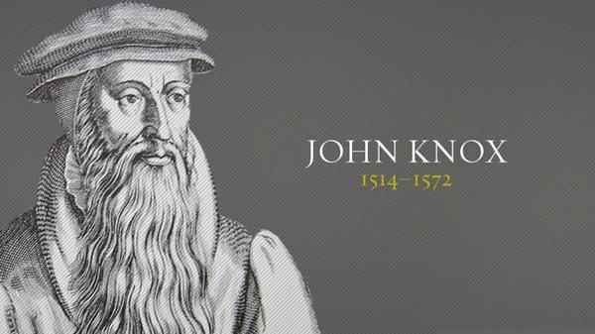
"HERE LIES ONE WHO NEITHER FEARED NOR FLATTERED ANY MAN."

Slide 14
  Captured in 1547 and served as a French Galley slave.
  Released in 1549 and served in the court of Edward VI.
  Fled to Frankfurt in 1553 at the start of Bloody Mary's reign.
  Lost his congregation after the Knox-Cox controversy of 1554-1555.
  Went to Geneva in 1556 and pastored an English congregation there.
  Wrote "The first blast of the trumpet against the monstrous regiment of women" in 1558.
  The book suffered bad reception.
  Returned to Scotland in 1559 after Bloody Mary died.
  Brought reform in the parliament and among the populace by July 1560 (Book of Common Order).

Slide 15
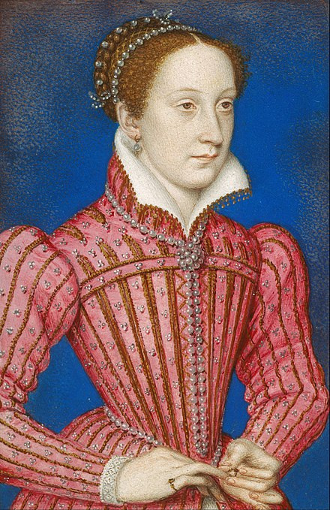
  Returned to Scotland in 1561 after her husband died.
  Had Roman Catholic supporters in England.
  Celebrated the mass at Holyrood Palace
  Got into a row with Knox over this.
  "I fear John Knox's prayers than all the assembled armies of Europe."
  Married Henry Stuart, Lord Darnley in 1565 in a Catholic ceremony.
  This upset the Protestants.
  Marriage was shaky and she spent an uncomfortable amount of time with her Italian adviser David Rizzio.
  Darnley got jealous and murdered Rizzio in March 1566.
  One year later (February 1567) Lord Darnley was strangled and killed in a church then the church was blown up.
  During this time she fell for James Hepburn.

Slide 16
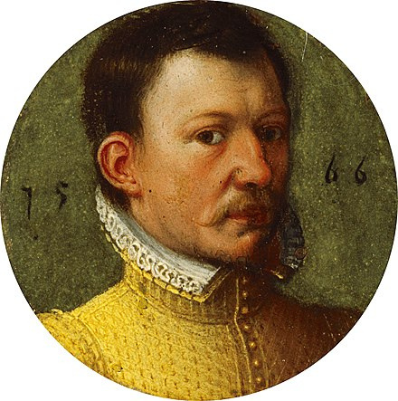
  Married James Hepburn who was protestant.
  This upset the Catholics.
  She lost and country and lost a battle to her brother fleeing to England where she was put under house arrest.
  Implicated in the Babbington plot and executed for treason in 1587.
  Her son James VI reigned in her place as king of Scotland (from 1567) then as king of England (1603-1625).

Slide 18
PURITANS

Slide 19
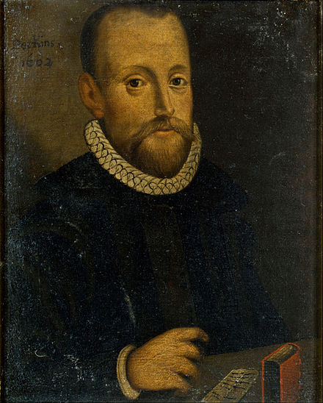
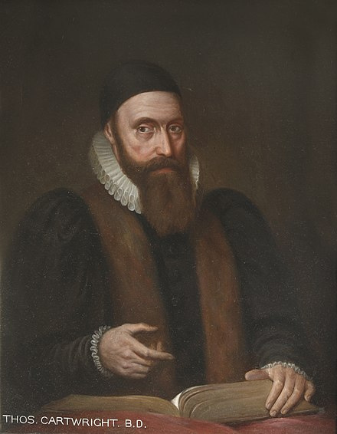
  Felt that the Anglican church was not reformed enough.
  Particularly had an issue with the vestments in the Act of Uniformity of 1559.
  The Puritans were those you would consider Holy Joes.
  Different types of puritans:
  There were those who were happy to conform and wanted to reform the church simply by preaching e.g John Foxe.
  There were those who wanted to reform it but felt that being active dissidents meant disobedience. They resorted to meetings or teaching people e.g William Perkins.
  There were those who wanted to reform the hierarchy of the church from Episcopelian to Presbyterian e.g Thomas Cartwright.

Slide 20
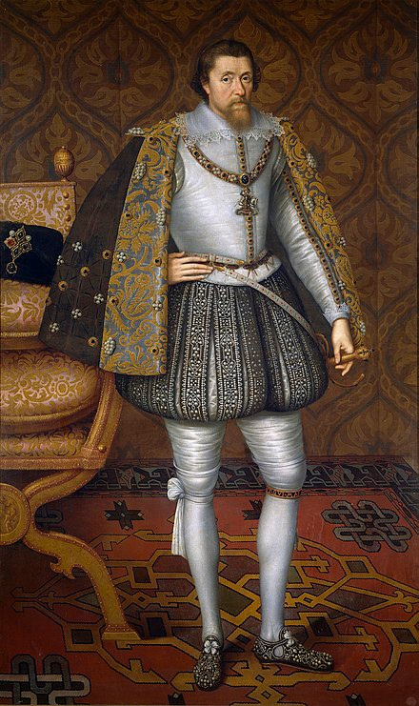
  Puritans were often persecuted.
  Some opted to leave the Anglican church altogether because they felt it was beyond redemption.
  These were called separatists e.g Robert Browne.
  James I was presented with the Millenary Petition which aired Puritan grievances.
  He convened a meeting at Hampton court in 1604 to discuss the issue of Puritan persecution and church government.
  "No bishop, no king."
  In 1611 the King James Bible was published. This was a Bible of complete English influence and was 80% Tyndale's work.

Slide 21
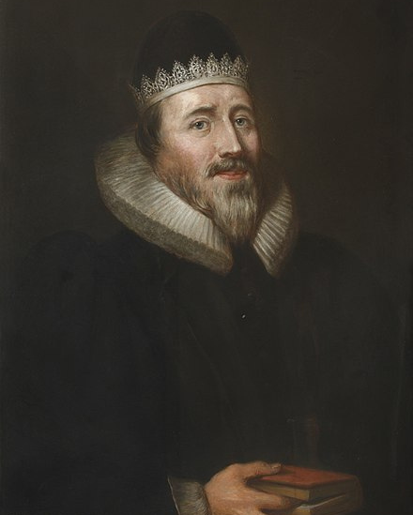
EARLY PURITANS
WILLIAM PERKINS
(1558-1602)
THOMAS CARTWRIGHT (1535-1603)
RICHARD SIBBES
(1577-1635)

Slide 22
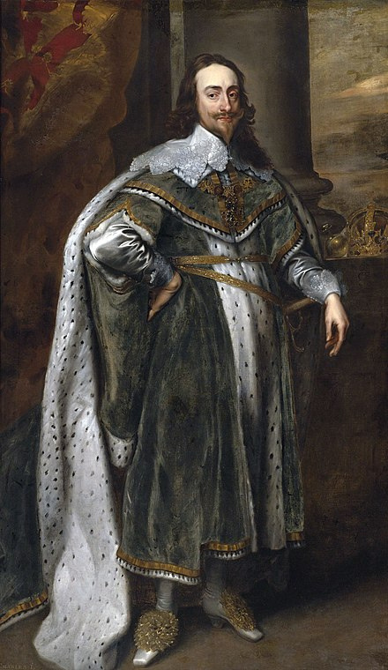
  Charles I hated parliaments and calvinism.
  From 1629-1640 he ruled without a parliament.
  He promoted the English high church which was interpreted as an assault on Puritanism (which had support from a majority in parliament).
  He appointment William Laud as the Archbishop of Canterbury.
  Laud was a supporter of Arminianism and carried out a massive persecution of Calvinists.
  Charles also married Henrietta Maria, a Roman Catholic from France.
  What was about to unfold would be mightily disastrous for Charles and Laud.

Slide 23
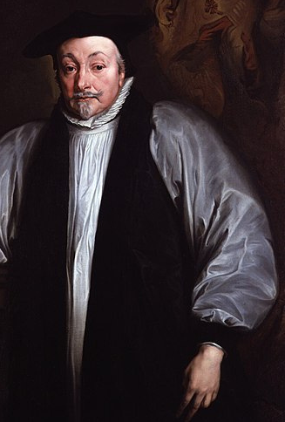
  William Laud tried to force the Book of Common Prayer as well as English Episcopal Church system on the Scottish churches.
  A revolt called the Covenanter Movement broke out in Scotland in 1638, forcing Charles to reconvene parliament in 1640
  The Long Parliament stripped Charles of his powers to convene whenever he wished.
  Parliament executed Charles' chief minister, Thomas Wentworth, in 1641, and Archbishop Laud in 1645 (arrested in 1642).
  England was split into two - Royalists and Parliamentarians.
  Civil war followed leading to Charles' capture and execution in 1649.

Slide 24
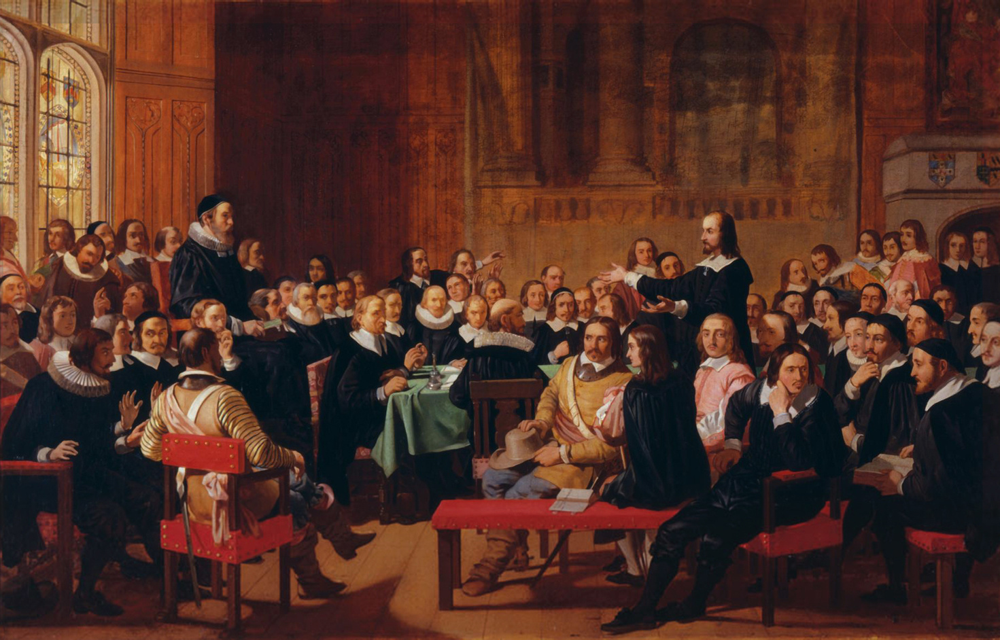
  An assembly was called in 1643 in Westminster Abbey to discuss church reform (most were Presbyterian).
  They came up with the Westminster Confession of faith in 1647.
  They also developed the Larger and Shorter Catechisms as well as the Directory of Public worship.
  Later adopted by London congregationalists as the Savoy Declaration of 1658 (Thomas Goodwin and John Owen were involved).
  In 1689, it was adopted by English Calvinistic Baptists to form the 1689 London Baptist Confession of faith.

Slide 25
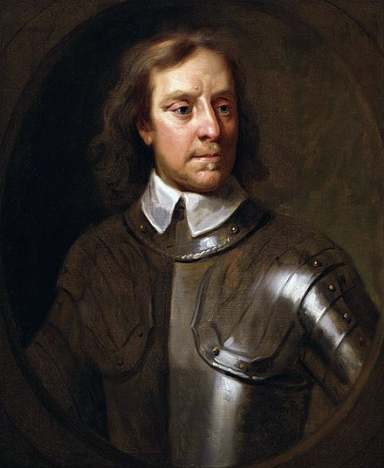
  After the execution of Charles in 1649, England became a Republic under the leadership of Oliver Cromwell.
  He was an independent puritan.
  His tenure brought about religious toleration where no one was forced to subscribe to Christianity of the Reformed type (catholics practiced privately).
  Calvinistic churches thrived and many puritan preachers emerged e.g Thomas Goodwin, William Brooks, Thomas Brooks, John Owen.

Slide 26
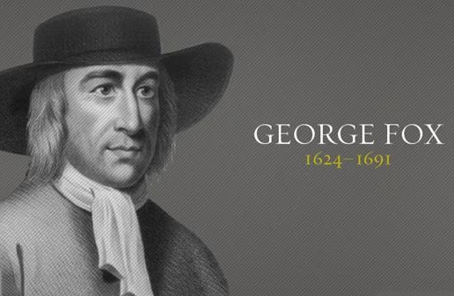
  Started the Quaker Movement.
  In 1650 at a trial for blasphemy Fox said, "Tremble at the word of the Lord!"
  The judge nicknamed them Quakers.
  Fox called the Movement "Friends of the Truth."
  They believed in following the inner light to obtain the Light of life.
  Downplayed the sufficiency of scripture. They had no sacraments or Bible exposition but believed in mysticism (silence during services).
  William Penn, a quaker, founded the American Colony of Pennsylvania in 1681 which acted as a refuge for persecuted quakers.

Slide 27
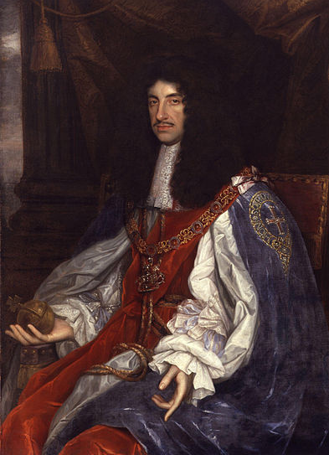
  Charles II restored the monarchy in 1660 after Cromwell died in 1658.
  The parliament was filled with Royalists who passed the 24th August 1662 Act of uniformity and 1665 Five Mile Act.
  Clergy were forced to submit to the worship of the Anglican church and its episcopal structures.
  Some 2500 clergymen either left willingly or were forcefully ejected from their congregations in a time called the Great ejection.
  Examples are John Bunyan, John Flavel, Richard Baxter, Thomas Watson, Thomas Manton, Thomas Brooks.

Slide 28
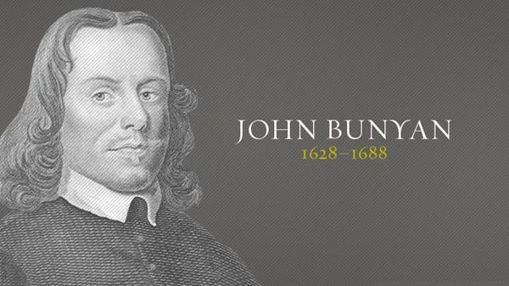
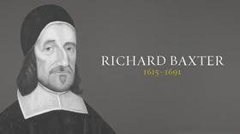
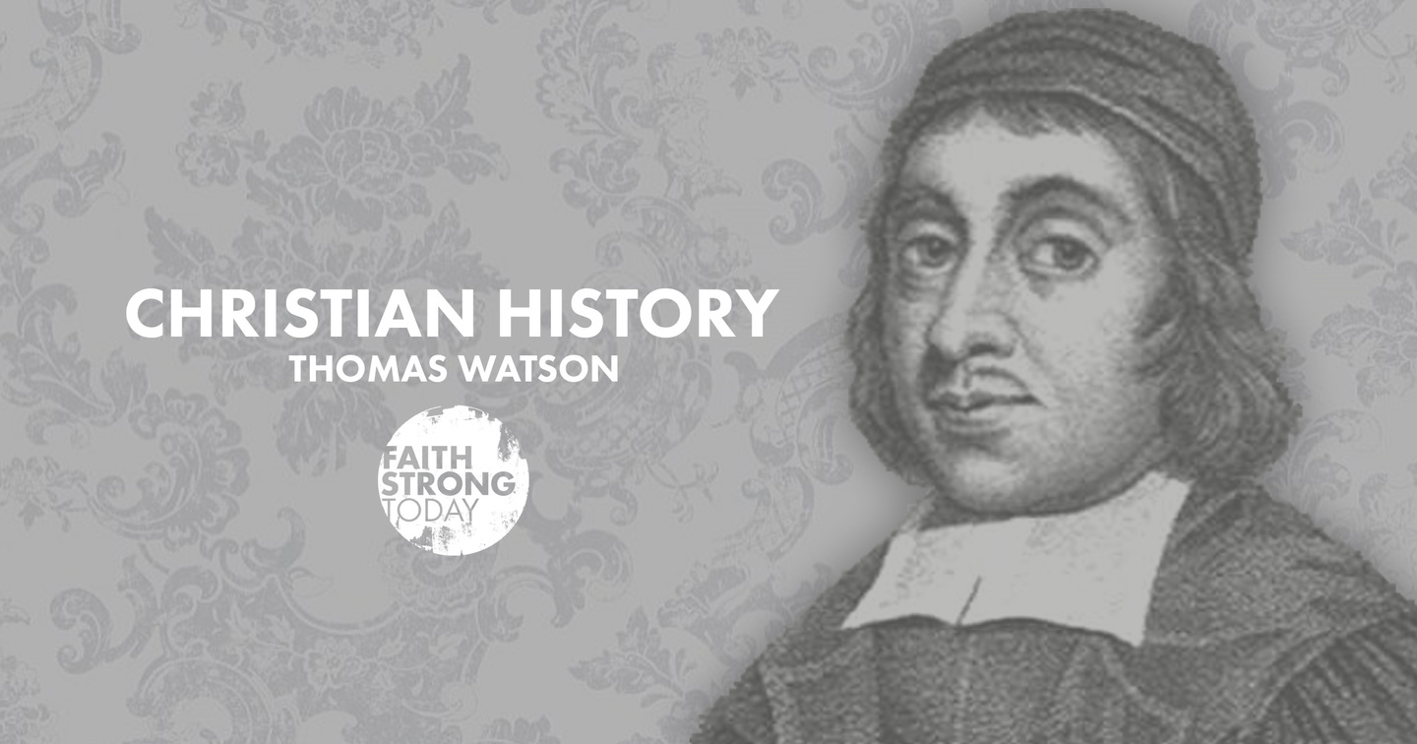
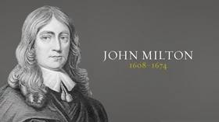

Slide 29
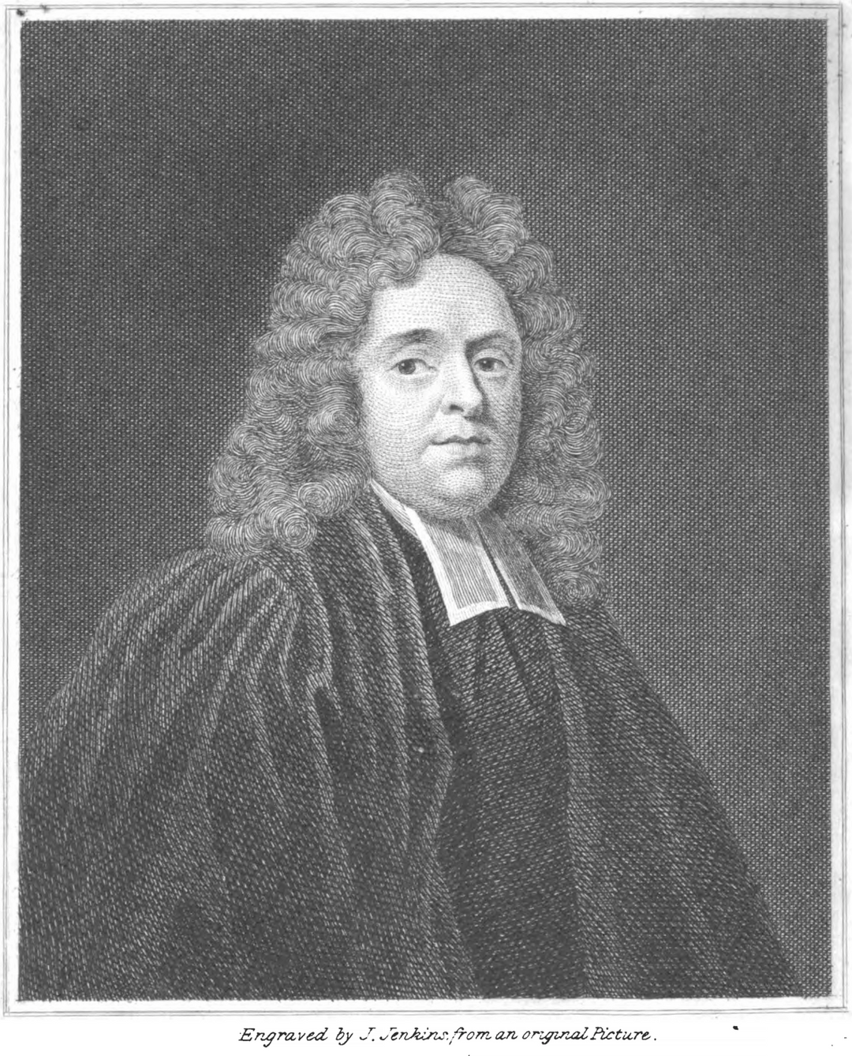
  The Great ejection had two great effects: Piety dwindled in England and nonconformists moved to America.
  England entered into a spiritual slump.
  Matthew Henry was a non-conformist.
  Wrote A method of prayer and published it in 1712.
  He also preached a series of sermons urging people to give themselves to times of prayer.
  Henry's book and sermons greatly affected many and in particular a special crop of young men whom the Lord would use to bring about Revival.

Slide 30
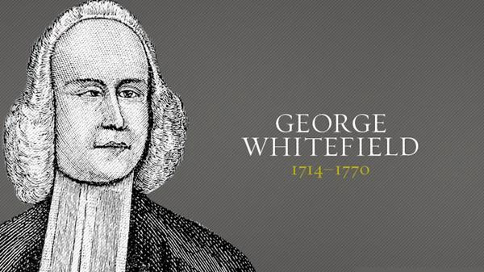
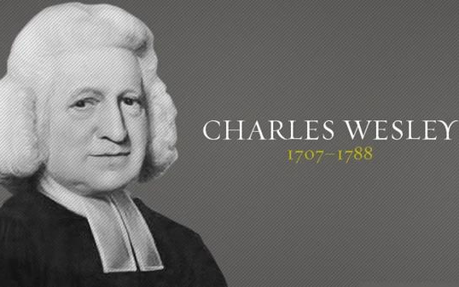
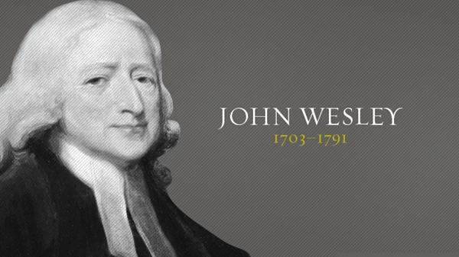
  The Holy Club.
  Gave themselves to a method devotion, prayer and fasting until 3 PM.
  However this was a mere duty for them.
  Their conversion experiences caused them to stress on a heartfelt conviction and assurance of faith.

Slide 31
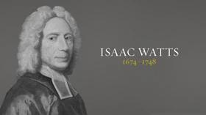
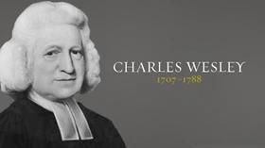
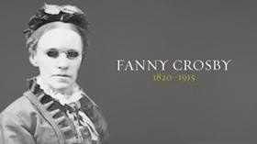
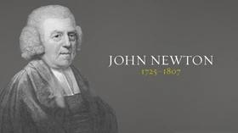

Slide 32
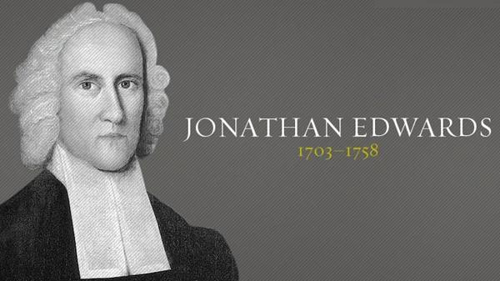
  Northampton, Massachussets.
  He oversaw the American great awakening in 1735-1737.
  This was characterized by conversions and an increase in piety.
  George Whitefield evangelized this area in 1739-1740 during his tour.
  This was also a time of increased open-air preaching.
  He preached his famous sermon, "Sinners in the hands of an angry God."
  He also wrote the memoirs of David Brainerd.
  In 1747, he wrote a Humble Attempt, urging Christians to pray for revivals among heathens.

Slide 33
