Slide 1


GREAT CENTURY OF MISSIONS (1800-1900)
WITH PASTOR KEITH WAWERU

Slide 2


TOPIC OUTLINE
MISSIONS BEFORE 19TH CENTURY
WILLIAM CAREY AND LONDON MISSIONS SOCIETY
MISSIONS IN SOUTHERN AFRICA
MISSIONS IN WEST AFRICA
MMISSIONS IN NORTH AFRICA
MISSIONS IN EAST AFRICA

Slide 3
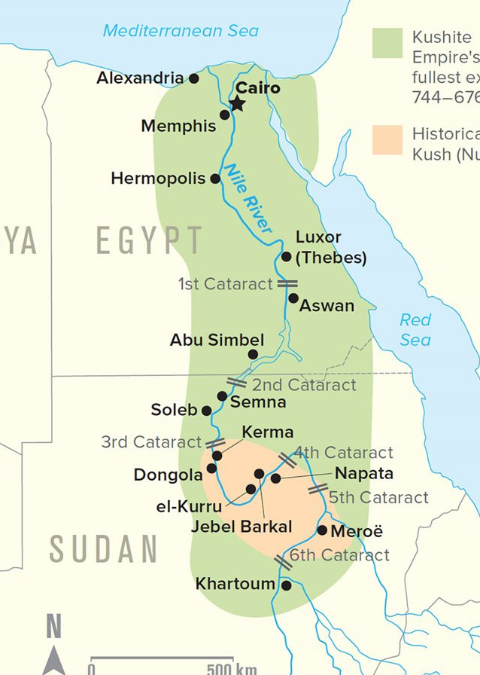
MISSIONS BEFORE 19TH CENTURY
  ACTS 8:26-40 - Philip and the Ethiopian Eunuch.
  Frumentius and Aedesius.
  Most likely the kandake of Acts 8 was the Nubian queen.
  Christianity here was wiped out because of Islam, poor leadership (untrained pastors).

Slide 4
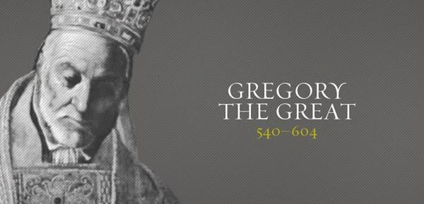
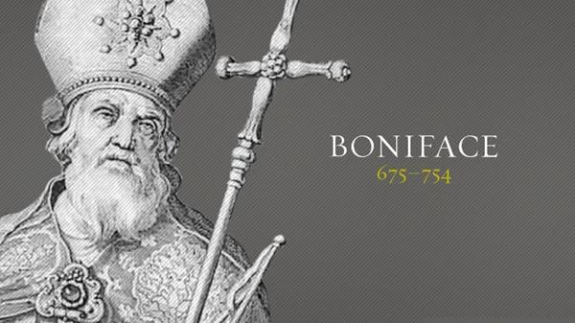
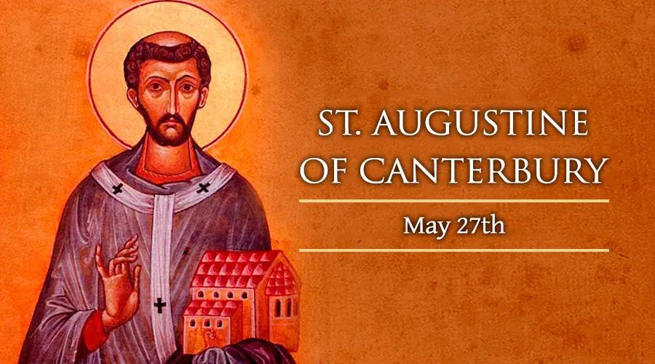
MISSIONS IN EUROPE
  Britain was at this early time unevangelized.
  Mixture of Roman paganism and Nordic paganism.
  Missions opened up by Popes.

Slide 5
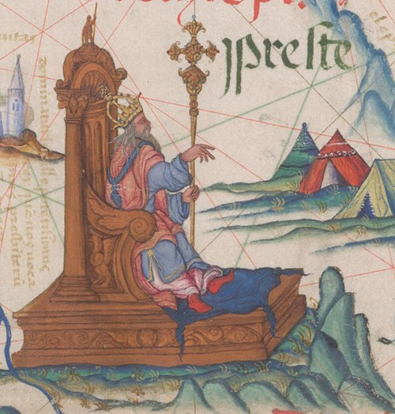
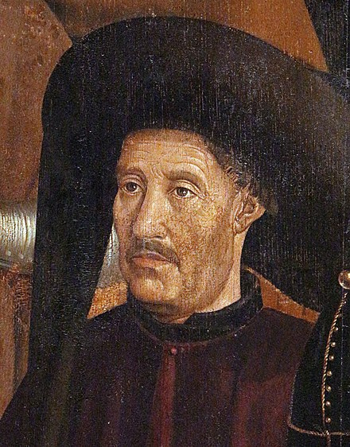
MISSIONS IN AFRICA (1400-1800)
  End of the 15th century saw the rise of Portugal as a power.
  The discovery of the New World (America) by Christopher Columbus created an impetus for missions in Europe.
  Bartholomew Diaz and Vasco da Gama were instrumental in charting a sea-route round the cape of good hope to India.
  This desire to trade and to find the mythical Prester John spurred African missions.
PRESTER JOHN
HENRY THE NAVIGATOR
  Roman Catholic orders were instrumental in African missions during this time.
  The Jesuits and Dominican orders were ferocious in missions.
  The use of priests (Padroado) and navy (Conquista) were instrumental in expansion of the faith.

Slide 6
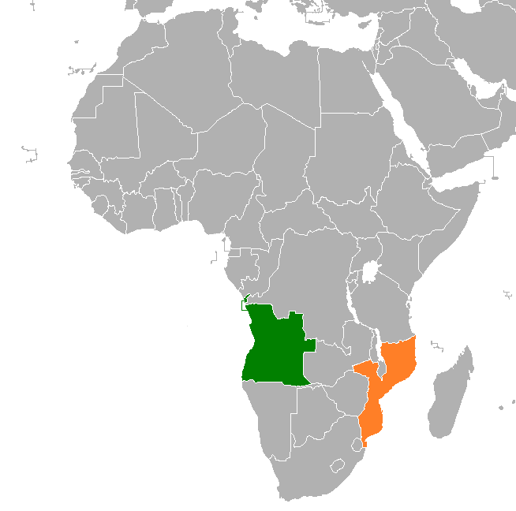
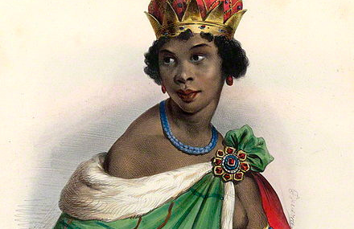
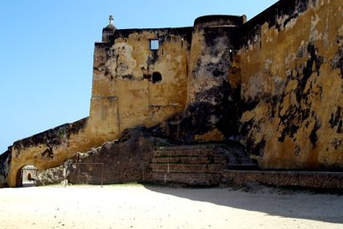

Slide 7
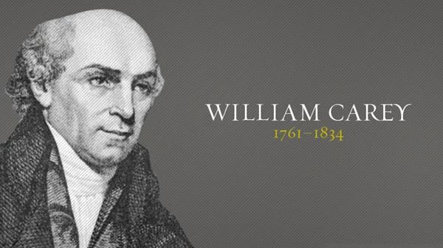

Slide 8
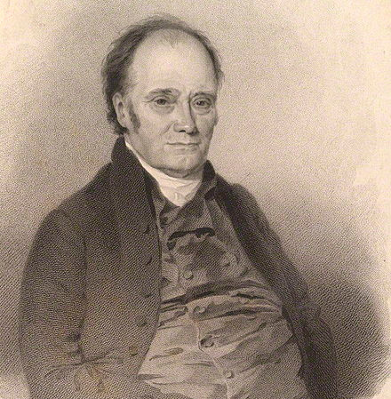
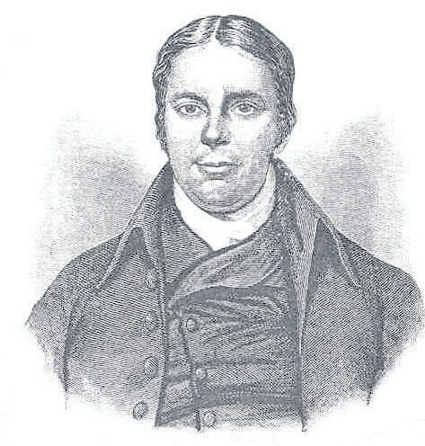
  Carey was a cobbler by profession.
  Made friends with John Ryland and Andrew Fuller.
  The Hyper-Calvinistic controversy was brewing around this time.
  One of its most famous proponent was commentator John Gill.
  It involved asking:
Did Jesus die for all men?
How efficient/sufficient was his atonement?
Do we have a duty to believe?
What is the place of missions?

Slide 9
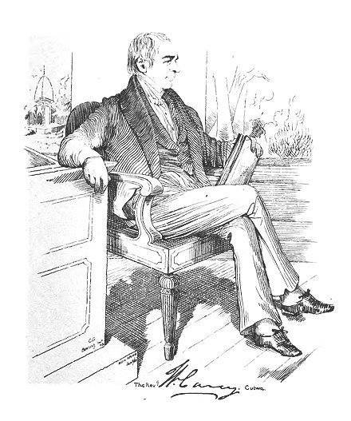
  Carey read two books that had a great impact on him: Account of the life of the late Rev. David Brainerd and the journal of James cook.
  In 1792 he wrote an enquiry into the obligations of Christians to use means for the conversion of heathens where he showed that Matthew 28:18-20 was binding to all Christians and made a call to form a baptist missionary society.
  He also preached his famous deathless sermon (Isaiah 54:2-3) where he made his most famous motto: Expect great things from, attempt great things for God.

Slide 10
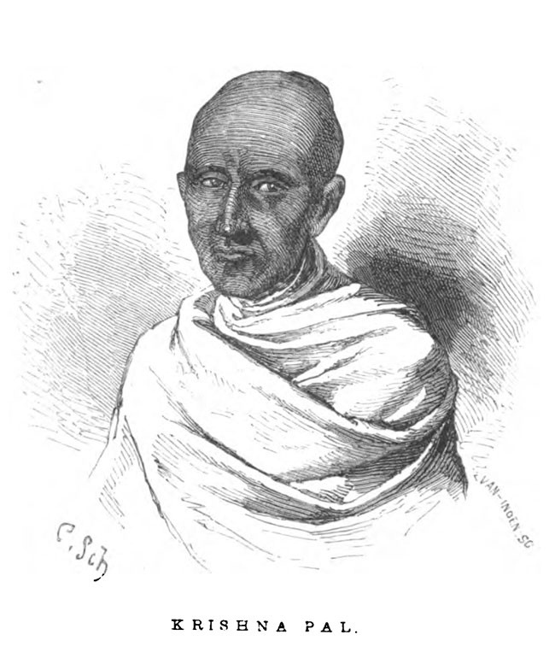
  Through this the Baptist missionary society was founded in 1792.
  He travelled to India in 1793 with his wife Dorothy and their three children.
  It was seven years until he made his first convert.
  His son died and his wife suffered a nervous breakdown from which she never recovered.
  He moved to Serampore in 1800 due to hostility from the East India company.
  Translated the Bible into Bengali.

Slide 11
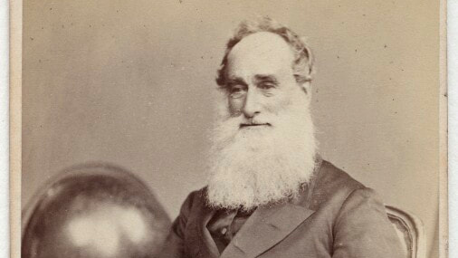
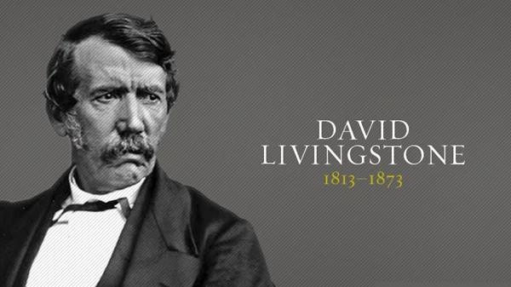
  In 1794 he wrote a letter to John Ryland urging him to form a non-denominational missionary society.
  The society was formed in 1795 and was called London Missionary Society.
  In 1816 they sent their first missionary to South Africa Robert Moffat.
  He translated the Bible into Setswana.
  In 1840 he sailed back to London and met a young man in whom he set ablaze with a passion for missions in Africa.

Slide 12
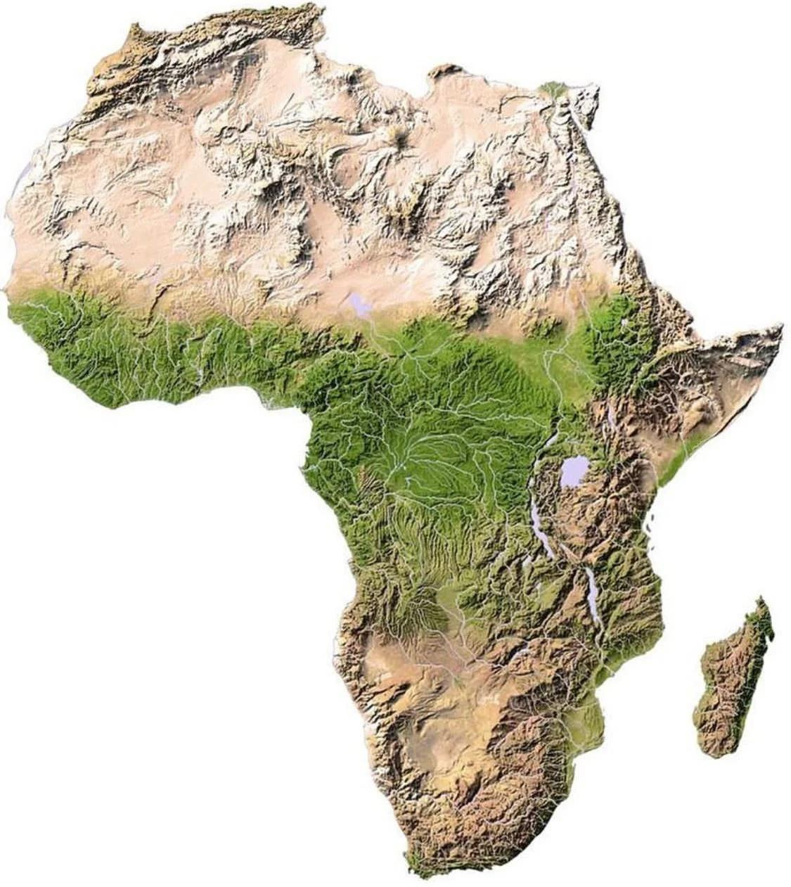
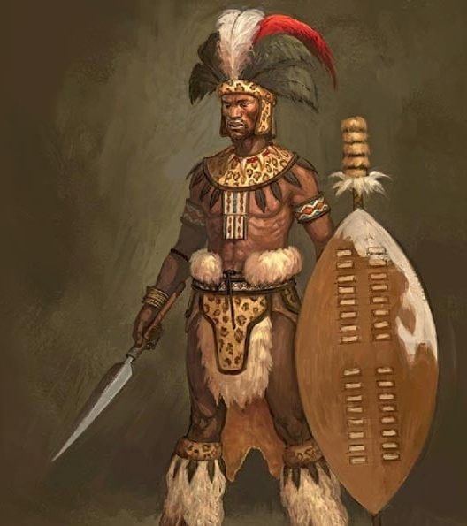

Slide 13
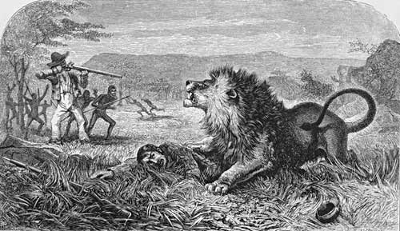
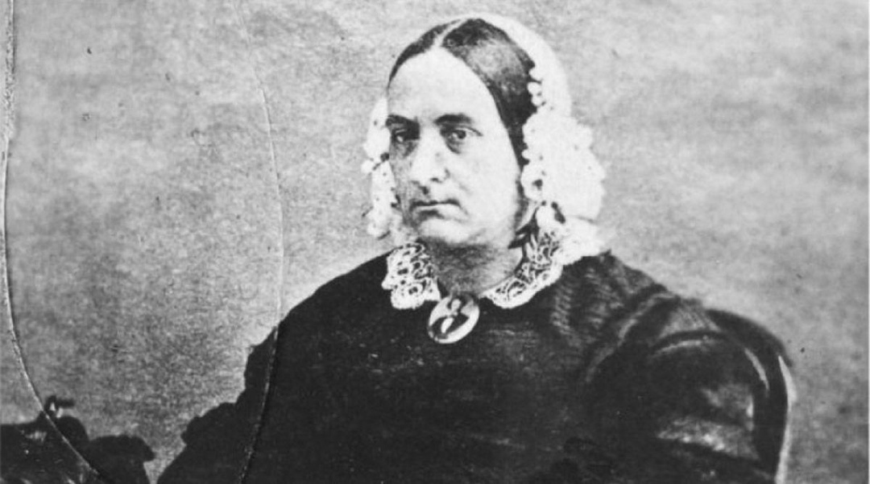
  Travelled to South Africa in 1840 and arrived in 1841.
  Set up mission work up north from where Moffat was.
  Attacked by a lion and then moved back to Moffat's centre where his daughter, Mary, nursed him.
  They were married in 1845.
  She was a great asset to him in ministry due to her fluency in the local languages.
  He had only one convert in all his missionary life - Chief Sechele of the Kololo (converted in 1849).
  Backslid within months.

Slide 14
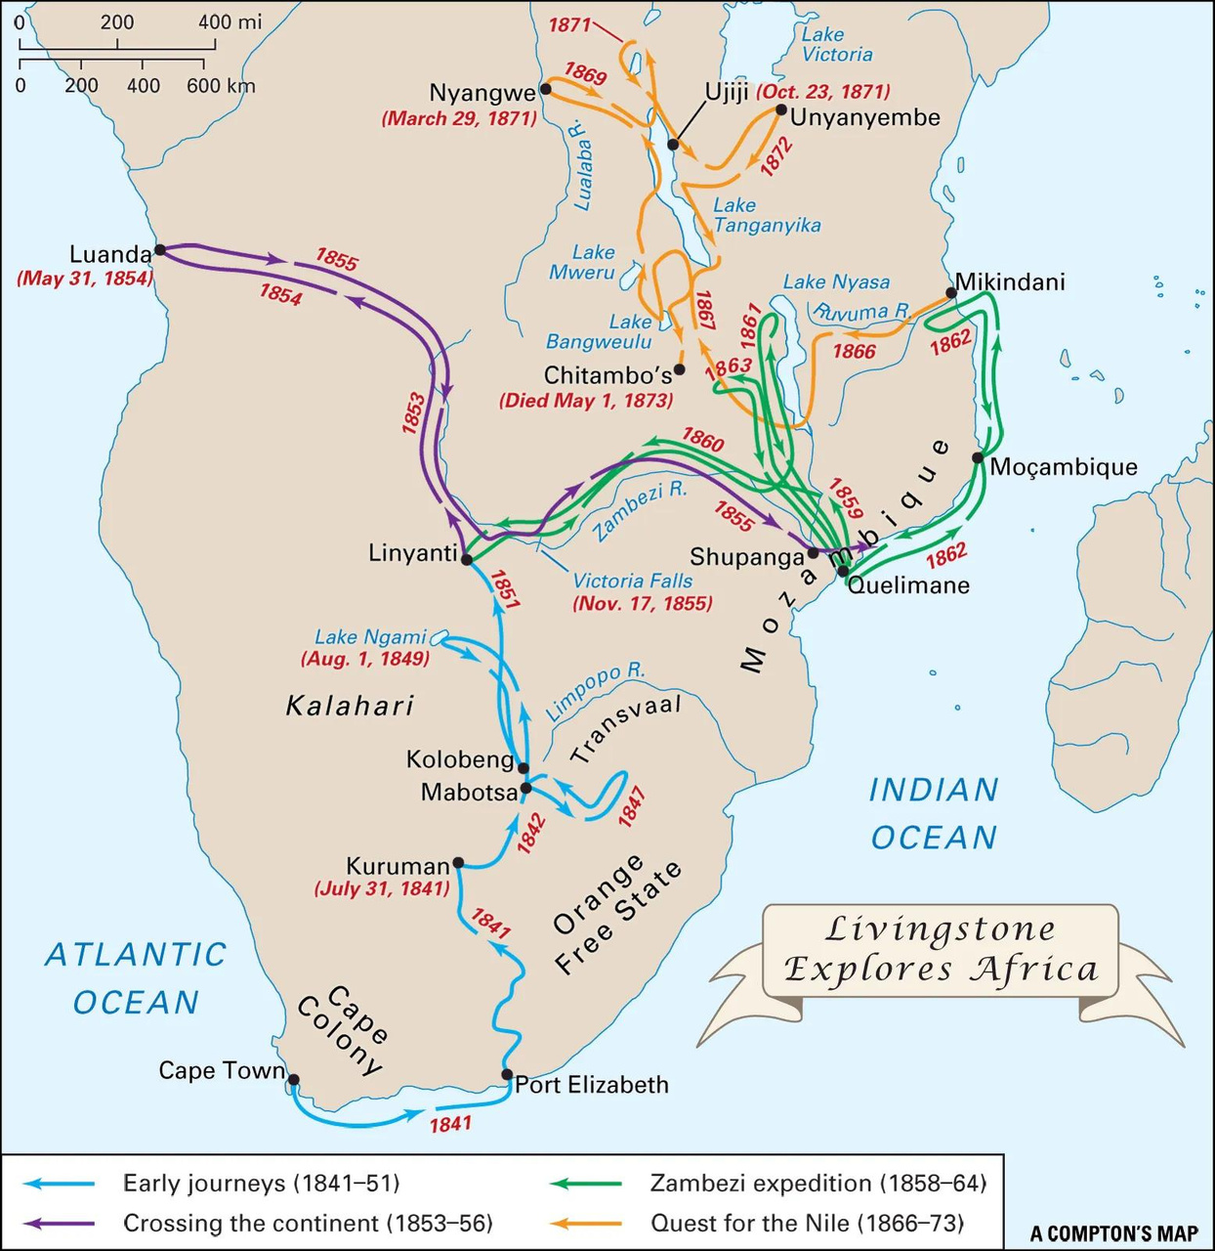
  Livingstone is perhaps known more for his desire to stop the slave trade by finding trade routes to the East African Coast.
  He moved up north trying to find the source of the Nile.
  His motto was "Christianity, Civilization, Commerce."
  Reached the Zambezi in 1851 where he did most of his work.
  Hugely affected by what he saw in the Tanzanian coast where slaves were treated inhumanely.

Slide 15
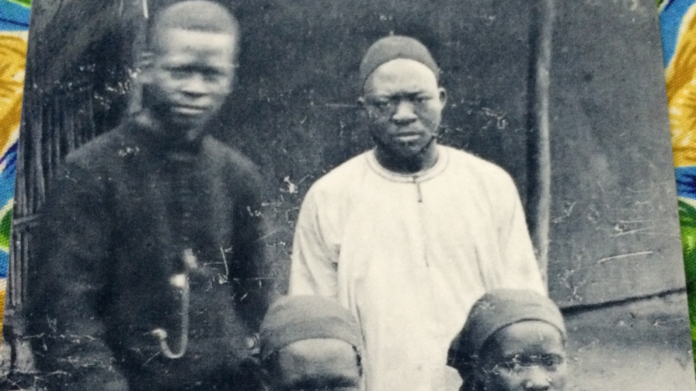
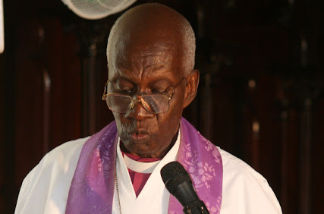
  He returned to England in 1857 and gave lectures on missions to Africa.
  Some members within the Anglican church were so affected by his lectures that they started the Universities Mission to Central Africa (UMCA).
  UMCA sent their first missionary, Charles Mackenzie, to Nyasaland (Malawi) in 1860 but this was a disaster. Most of the crew died of Malaria or blackwater fever.
  UMCA reloctaed to Zanzibar in 1864 where they had their most success.

Slide 16
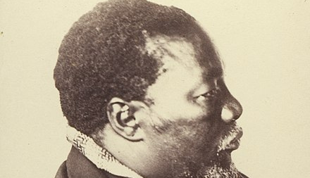
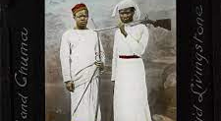
  Livingstone's convert, Sechele, was involved in missionary work.
  He wrote the Bible in his native language and converted his entire tribe as well as doing missions among neighboring tribes.
  Livingstone died in 1873. His heart was removed by two of his trusted servants and buried in Zambia.
  His body was shipped back to the UK and buried.

Slide 17
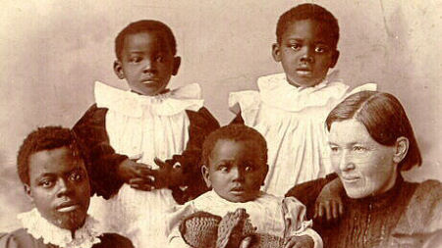
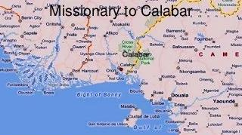
  When Livingstone died in 1873, a young girl of 25 years, desired to follow in his footsteps.
  Her name was Mary Slessor.
  In 1876, she sailed to Calabar, Nigeria and did missions among the Efik.
  She lived a life of poverty in Nigeria, living just like the local people while preaching the gospel.
  She is known for saving and adopting babies who were born as twins.

Slide 18
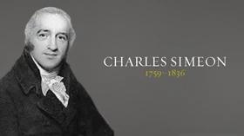
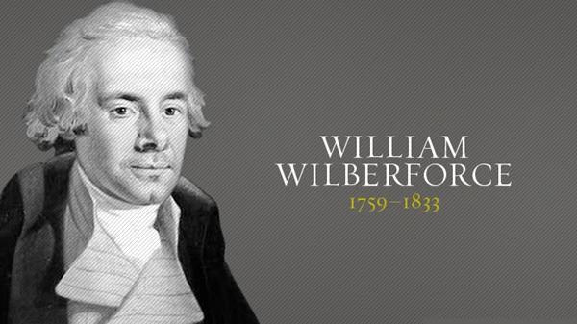
  While the Baptist missionary society was being formed in 1792, a new African country was being formed.
  Sierra Leone was formed in 1792 as an attempt to end slave trade.
  It was created through the efforts of the Clapham sect, a group of Abolitionists, chief among them being William Wilberforce.
  Together with Charles Simeon and under the leadership of the Clapham rector John Venn, they formed the Church Missionary Society (CMS) in 1799, an Anglican missionary society to Africa.

Slide 19
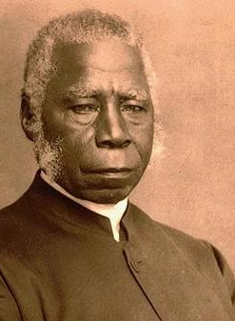
  Perhaps the most important CMS missionary in West Africa waas the local Samuel Ajayi Crowther.
  He was almost sold as a slave in 1821 but was saved by the British Royal navy.
  He was sent to Sierra Leone where he learnt English and was converted.
  He went to study in England in 1826.
  In 1841, he took part in the Niger Expedition with another CMS missionary, James Schon.
  In 1854 he founded the Niger mission.
  He was ordained as the first African bishop of the Anglican church in 1864.
  He translated the Anglican book of common prayer into Yoruba.

Slide 20
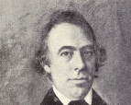
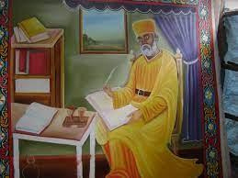
  CMS also did missions in Egypt and Ethiopia.
  Frederick Augustus Klein was a CMS missionary in Egypt who revived the missions there in 1882.
  He established public worship in Arabic as well as revising the Arabic version of the book of common prayer.
  William Jowett instigated the translation of the Bible into the widely spoken Amharic in Ethiopia.
  Abu Rumi translated it in 1819.
  His version was used as the principal translation until 1961.
  This led to the founding of the Ethiopian Evangelical church.

Slide 21
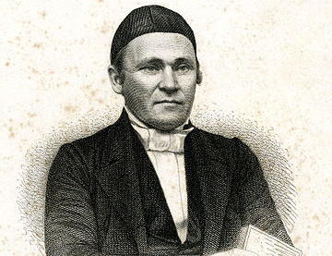
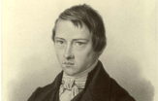
  Ludwig Krapf joined the CMS in Ethiopian missions in 1837.
  He did missions among the Oromo.
  Started translating the New Testament into their language.
  All protestant missionaries were expelled in 1844 for political reasons.
  Krapf hoped to reach the Oromo once again through the Kenyan Coast.
  He learnt Mijikenda and Swahili and translated the New Testament and the book of common prayer into Swahili.
  Did most of his work in Rabai.
  He was joined in 1846 by Johannes Rebmann who translated Luke into Swahili.

Slide 22
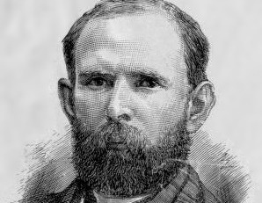
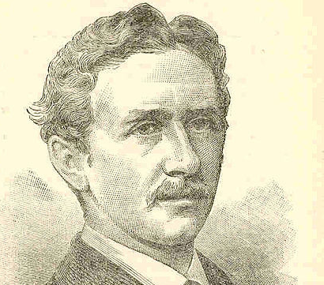
  Alexander Mackay was a missionary to Uganda in 1878.
  Kabaka Mutesa I issued a call for missionaries to come to Uganda.
  His son, Kabaka Mwanga expelled missionaries and assassinated Anglican Archbishop James Hannington in 1885.
  He is infamous for the Namugongo martyrs in 1886.
  Missions in Rwanda were established in in 1916 .
  The Rwanda missiosn were the birthplace for the East African Revival of the 1930s and 1940s (Tukutendereza).
  They were characterized by public confession of sin.

Slide 23
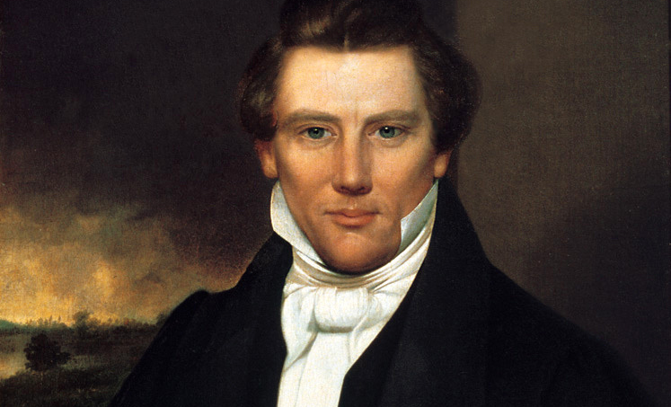
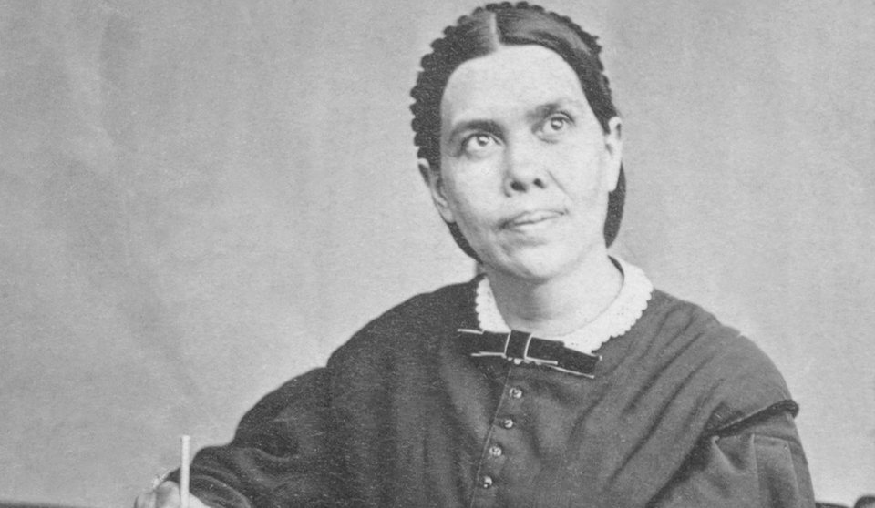
2ND AND 3RD GREAT AWAKENINGS
  The first Great awakening (1730-1755) led to missions particularly through the influence of John Wesley and Jonathan Edwards. It was characterized by increased piety and the rise of methodism.
  Wesleyan methodism was characterized by an emphasis on the possibility of complete sanctification.
  The Second Great Awakening (1790-1840) was characterized by an appeal to the supernatural and the rise of the holiness movement, an emphasized form of Wesleyan methodism.

Slide 24
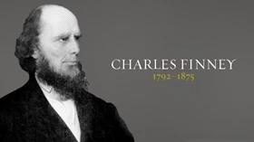
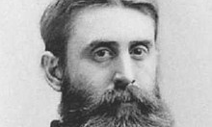
  Wesleyan methodism was also Arminian and denied Calvinistic teachings.
  They denied the doctrine of predestination and particular atonement.
  Through this a teaching started to take deep root during the second great awakening that man has complete free will to choose salvation.
  The teaching of the altar call started to hold sway during this time. Its major proponent was Charles Finney.
  One of his most famous opponents was Benjamin Warfield.

Slide 25
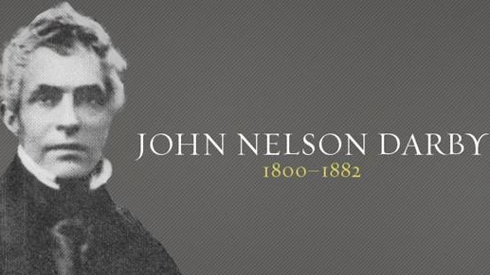
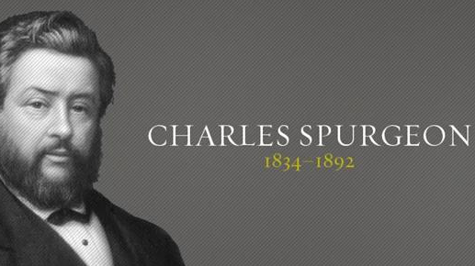
  The Premillenial view of eschatology also developed during this time.
  Its major propoenent was John Nelson Darby.
  One of its fiercest opponets was Charles Spurgeon.
  As a desire to end the slave trade, the postmillenial view of eschatology also took deep root in this time, since it held to the belief that social evils had to be removed before Jesus returned (after the golden age).
  Spurgeon was also part of the third great awakening (1855-1930).

Slide 26
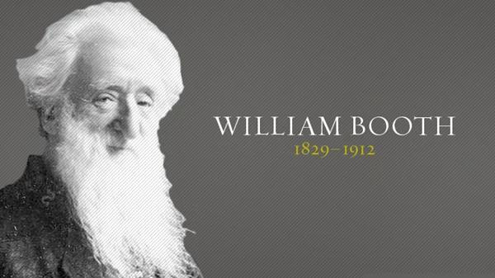
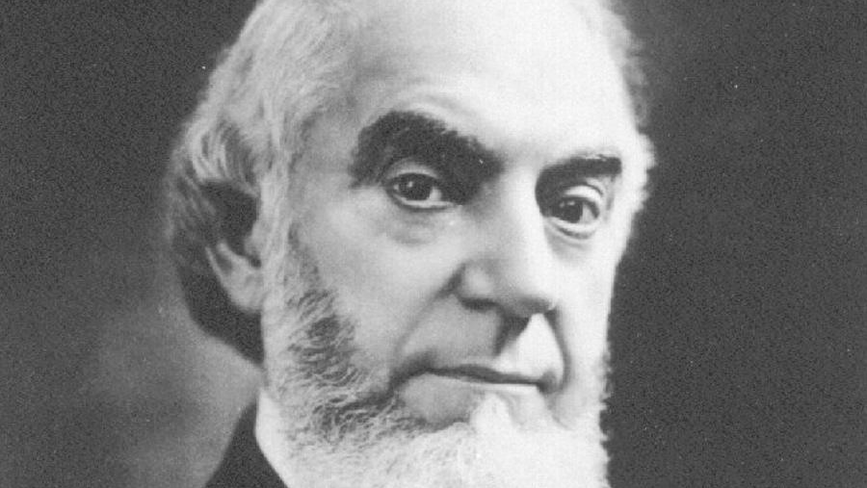
  The third great awakening saw the rise of the holiness movement, Jehovah's witnesses, Christian science and the salvation army.
  Notable names here are D.L Moody and Hudson Taylor (missionary to China).
  Because of the ongoing slavery, this was also the period of the social gospel e.g Salvation army.
  A very dangerous teaching emerged during the third great awakening.
  This movement emphasized on a third work of grace that is the baptism of the Holy Spirit.

Slide 27
