Slide 1

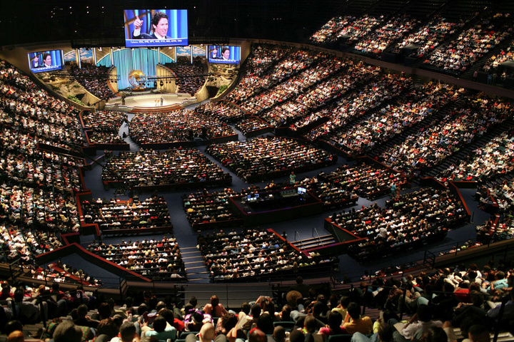
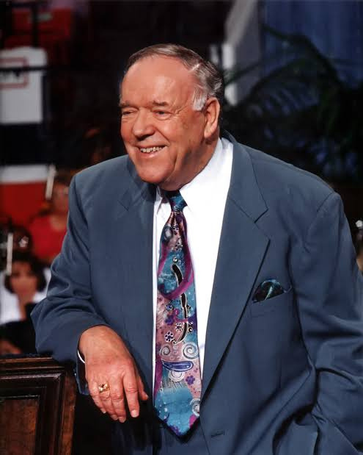
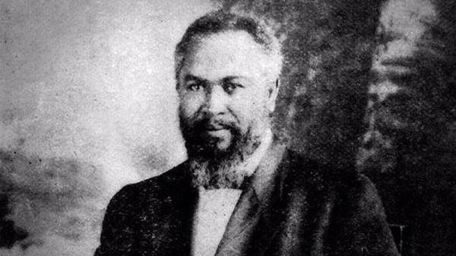

MODERN CHURCH AND PENTECOSTALISM
With Pastor Keith Waweru

Slide 2

TOPICS
1ST WAVE OF PENTECOSTALISM
2ND WAVE OF PENTECOSTALISM
3RD WAVE OF PENTECOSTALISM

Slide 3
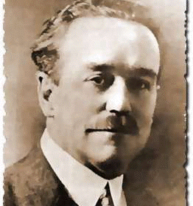
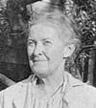
Where did Pentecostalism begin?
  Pentecostalism has its roots in Wesleyan theology.
  Charles Parham (1873-1929) rejected denominations and preached the tennets of the holiness movement.
  He taught that speaking in tongues was the initial evidence of baptism of the Holy Spirit.
  On January 1st, 1901, Agnes Ozman is said to have spoken in tongues.

Slide 4
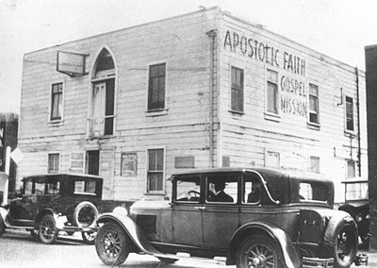

  In 1906, Seymour begun stressing Parham's teaching on speaking in tongues.
  He denied that tongues were for evangelism.
  He held meetings in a home where many followed him.
  Eventually they moved to Azusa street.
WILLIAM SEYMOUR

Slide 5
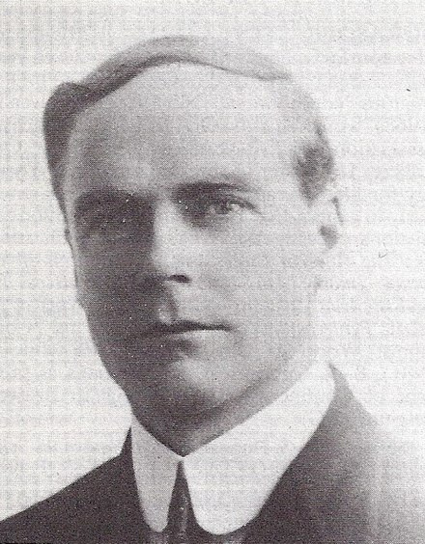
  In 1911, William Durham rejected the teaching of the 2nd work of grace, that is, entire sanctification.
  He taught the finished work of Christ thus beginning finished work pentecostalism.
  This caused a break with the then Church of God which had strong ties to the holiness movement.
  This break led to the rise of the Assemblies of God (led by F.F Bosworth) and the Four-Square churches (Led by Aimee McPherson).
WILLIAM DURHAM

Slide 6

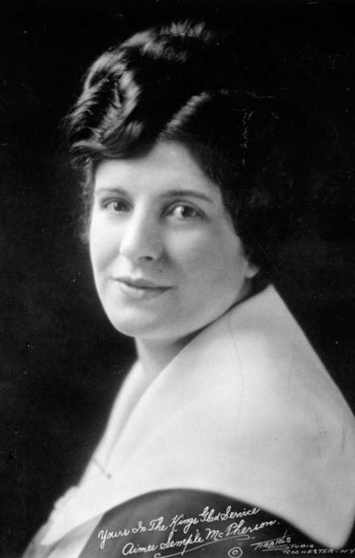
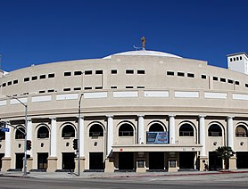
  The Four-square church was founded in 1923 by Aimee McPherson.
  Held up Ezekiel 1 as their base text from which they taught that Christ was savior, baptizer, healer and coming king.
  They called this the full gospel.

Slide 7
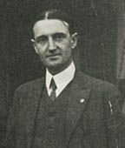
  The Assemblies of God were formed in 1914 as the first finished work Pentecostal denomination.
  The AG is Trinitarian.
  It believes that the Bible is divinely inspired and the infallible authoritative rule of faith and conduct.
  Baptism by immersion is practiced as an ordinance which was instituted by Christ for those who have been saved.
  Communion is also practiced as an ordinance.
  In 1988 the World Pentecostal assemblies of God fellowship was formed.
F.F BOSWORTH

Slide 8
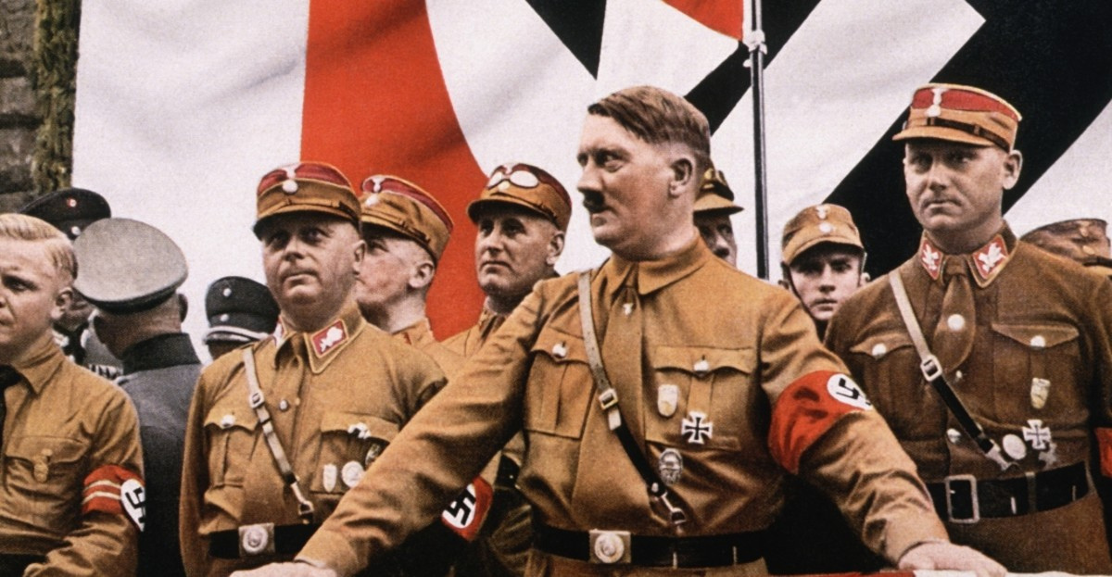
  During and after world war II (1939-1945), the pentecostal movement suffered a setback.
  The signs and miracles seemed to dry up causing some men to desire a revival of the Pentecostal movement.
  This was called the latter-day movement led by men such as Stanley Fordsham, Lewi Pethrus and Joseph-Mattson Boze.
  They believed in the restoration of the five-fold ministry.
  They also believed that the baptism of the Holy Spirit did not need to be waited for but could be imparted by the laying on of hands.

Slide 9
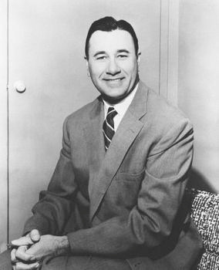
  Right about the same time as the Latter rain movement, there was also a healing revival.
  This was led by men such as Oral Roberts and William Branham.
  In 1947 Roberts started his Oral Roberts Evangelistic Association (OREA).
  His go to text was 3 John 2 - "I wish above all things that thou mayest prosper and be in health, even as thy soul prospereth."
  He was a pioneer televangelistic broadcasting his services through radio from 1947 and TV from 1954.
  In 1963 he started the Oral Roberts University with notable alumni being Joel Osteen and Kenneth Copeland.
ORAL ROBERTS

Slide 10
  Was a pastor of an assemblies of God church (1937-1949).
  He became an itinerant minister in 1949 after joining the voice of healing revival led by Oral Roberts.
  In 1963 he begun the Kenneth Hagin ministries.
  He is the father of the Word of Faith movement.
  The Word of Faith teaches complete healing, financial prosperity, faith and confession, "little gods" belief and the harrowing of hell (Jesus died spiritually).
  Kenneth Hagin has been noted to have learnt his doctrine from E.W Kenyon.
KENNETH HAGIN

Slide 11
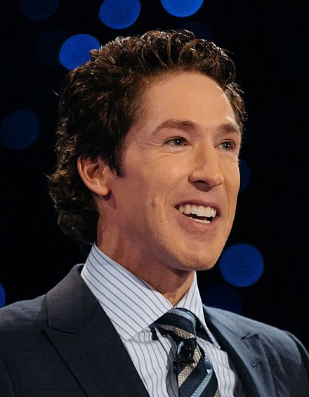
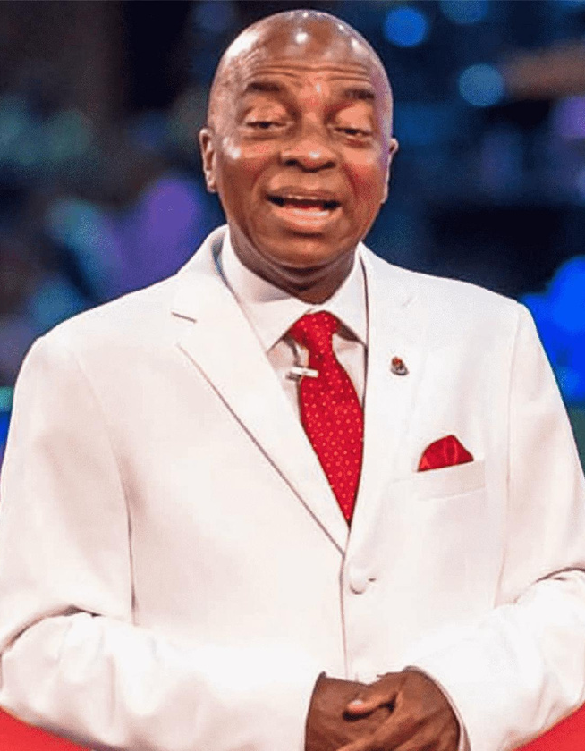
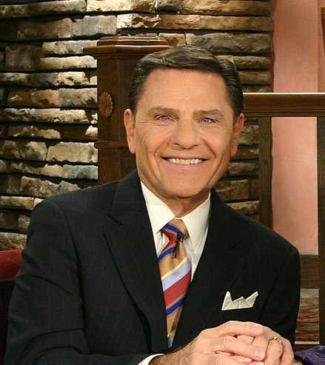
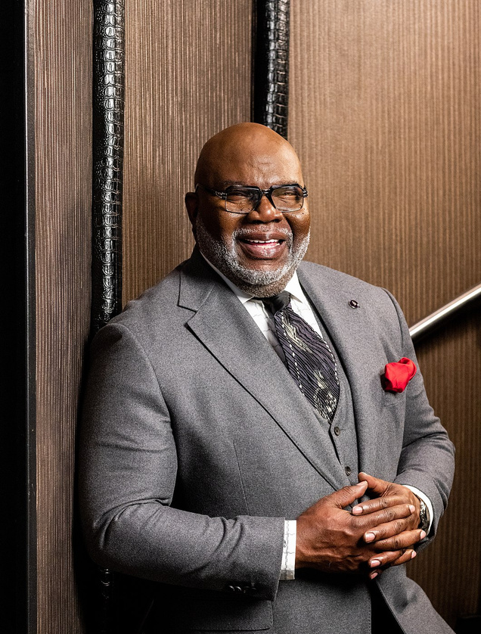
  Kenneth Copeland was a pilot and a chaffeur of Oral Roberts.
  He attended Hagin's Pastor seminars in 1967.
  Around the same time he founded the Kenneth Copeland ministries.
  He is credited with being one of the biggest proponents of the word of faith movement.

Slide 12
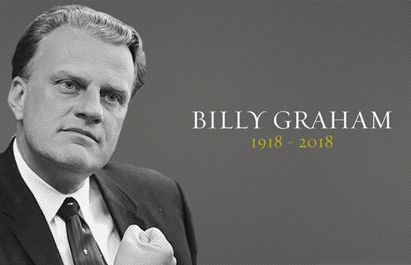
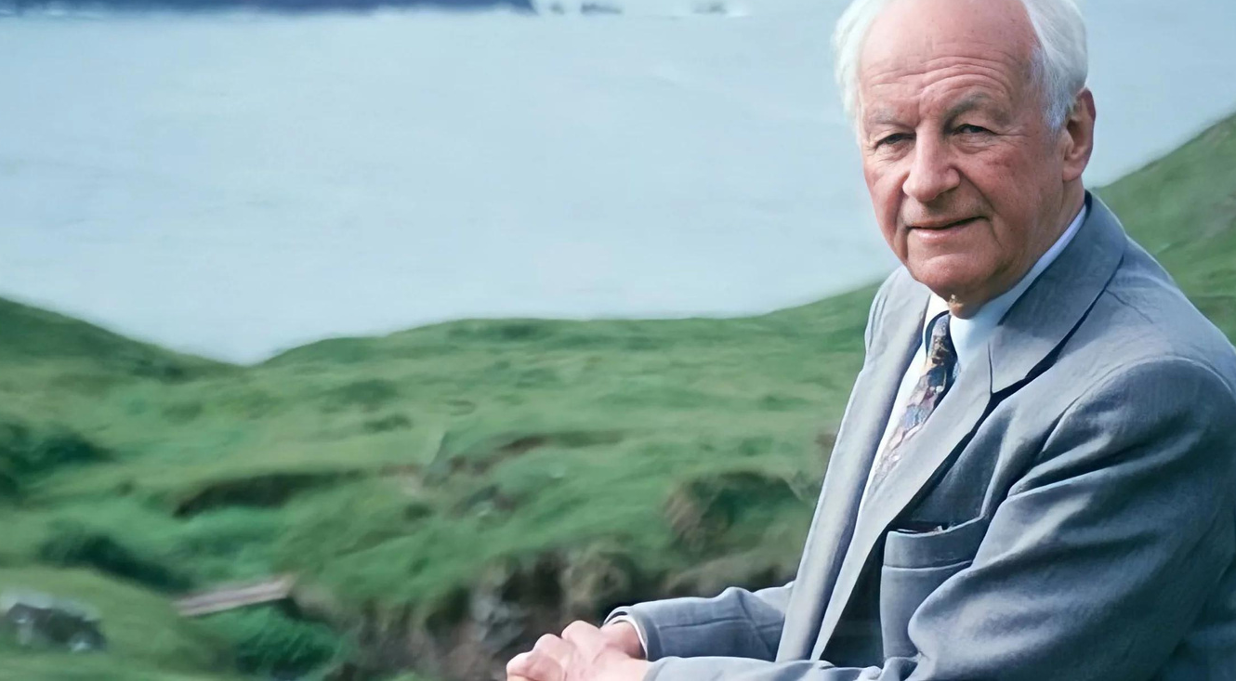
  Billy Graham is considered the father of the evangelical revival.
  He held many rallies that he claimed to have led many to saving faith.
  In 1974, he and John Stott led the signing of the Lausanne covenant which was a commitment to reinvigorate world missions.
  The Jesus movement also was rampant during this time.
  This involved crusades and camps for the youth.
  It led to the rise of Jesus music.

Slide 13
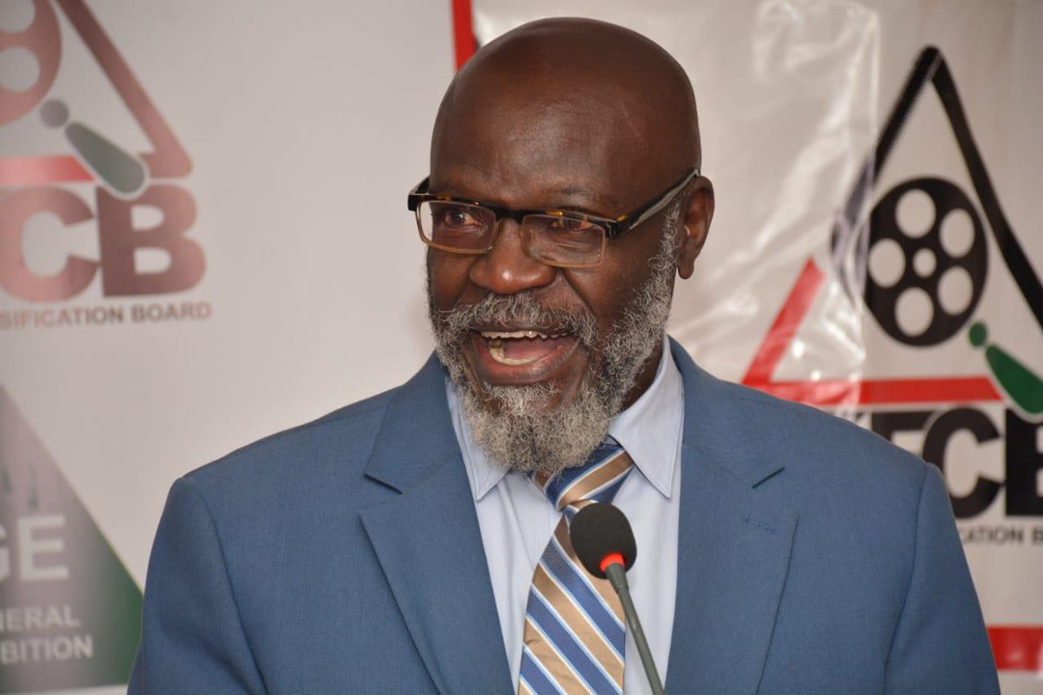
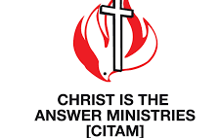
What About Kenya?
  In 1918 the Pentecostal Assemblies of Canada were formed.
  In 1952 they sent John McBride as their missionary to Kenya.
  In 1959 Nairobi Pentecostal church was planted.
  In the 1980s the church came under the leadership of Boniface Adoyo.
  In 2003 the church's name changed to become Christ is the Answer Ministries (CITAM).

Slide 14
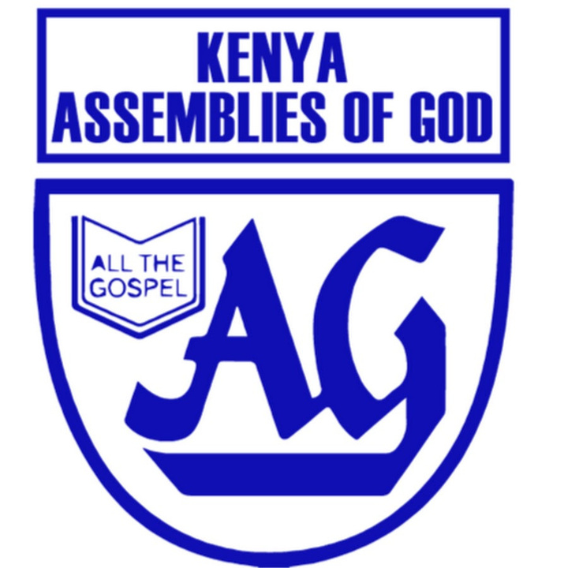
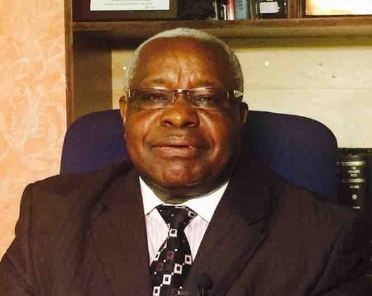
  In 1967, American pentecostal Dale Brown founds the Kenya Assemblies of God, which joins with the Assemblies of God U.S in 1972.
  The Full Gospel Churches of Kenya, started by Finnish missionaries in 1949.
  In 1918, North Americans establish a mission that later affiliates with the Pentecostal Assemblies of Canada. The churches resulting from this mission become independent in 1965 and are renamed the Pentecostal Assemblies of God.

Slide 15
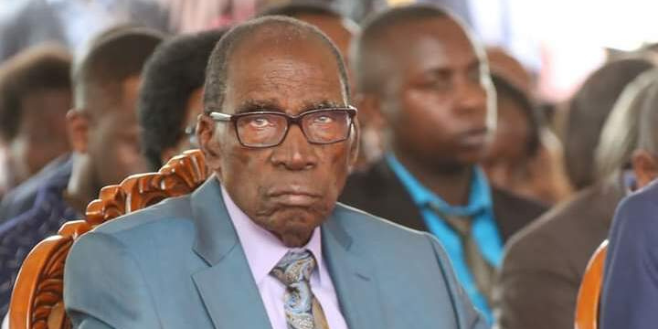

  In 1970, Joe Kayo establishes the pentecostal Deliverance Church of Kenya, an indigenous ministry that attracts urban youth.
  Joe believed that it is not enough to be saved from sin but that one needs to be delivered from the many demonic forces at work in Africa.
  He argued that in Luke 4:18-19 Jesus’ ministry included bringing deliverance to the captives as a result of His anointing.
  He calls himself an apostle.

Slide 16
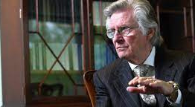
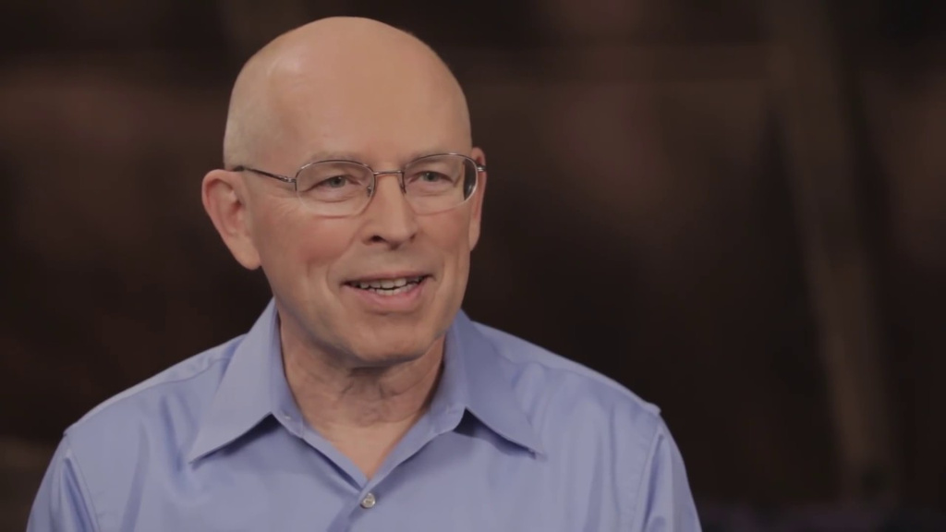
THE CHARISMATIC MOVEMENT
  The Charismatic movement started on Sunday, April 3, 1960 when Dennis Bennet recounted his charismatic experience to his church.
  The charismatic movement was majorly cited in the mainstream churches.
  David Wilkerson's the cross and the switchblade was a major catalyst of the movement.
  Charismatics tend to accept prophecy, miracles and healing as evidence of having been baptized or filled with the Holy Spirit.

Slide 17
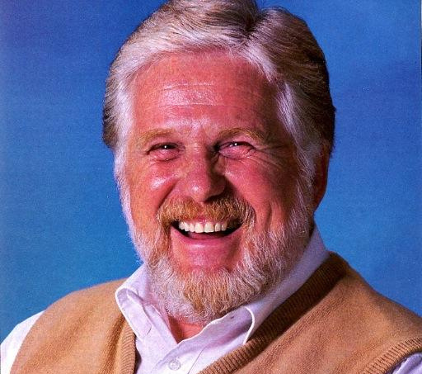
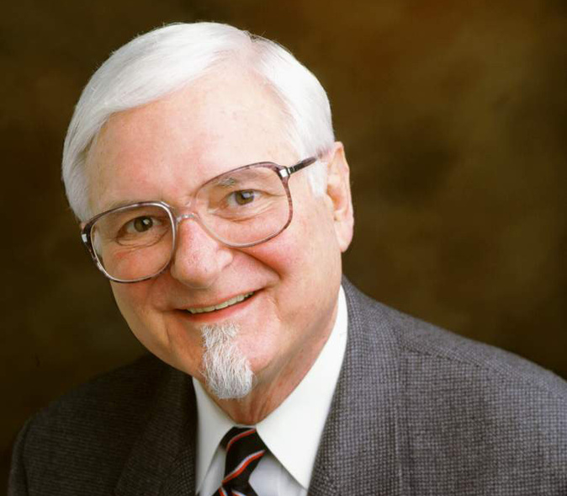
THE NEO-CHARISMATIC MOVEMENT
  Started in 1982 by John Wimber who started the Vineyard movement.
  This is the 3rd wave of Pentecostalism.
  Some of its major characteristics are:
Spiritual warfare: spiritual mapping and deliverence from demons.
Power evangelism: evangelism with gifts and miracles.
Structural renewal: reintroduction of the fivefold ministries.
Often identify as non-denominational.

Slide 18


BAPTIST CHURCHES IN AFRICA: SILENT WORK OF GOD
  TRINITY BAPTIST (1978)
  LUSAKA BAPTIST (1960)
  KABWATA BAPTIST (1981)
  EMMANUEL BAPTIST (2001)
  COVENANT BAPTIST (2018)
  REDEEMER BIBLE CHURCH (2018)

Slide 19
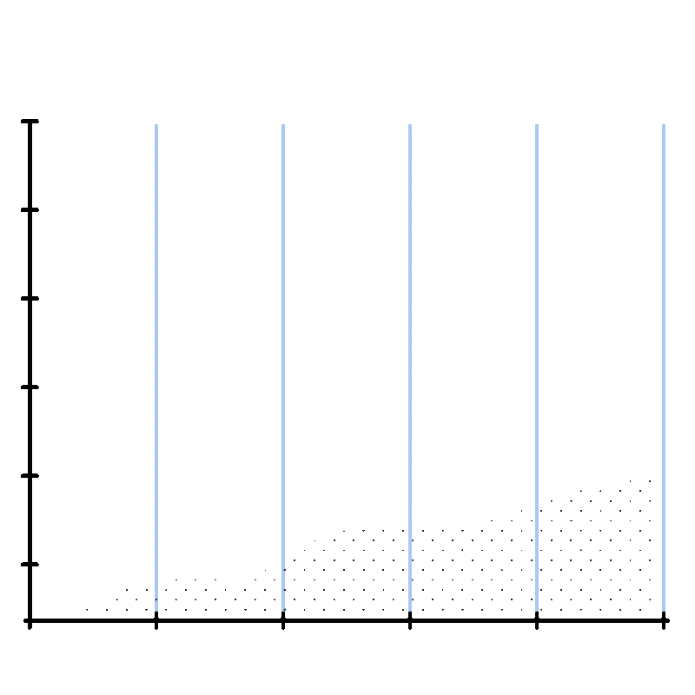

Slide 20

THE END

