Slide 1

MISSIONS
BY
PASTOR KEITH WAWERU

Slide 2

Definition, goal and reasons for missions
The supremacy of God in missions
Content of missions
History of modern missions
Challenge of missions and ways to overcome them
The role of local church in missions
2

Slide 3

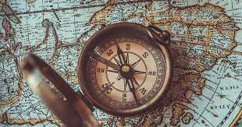
WEEK W
JANUARY 8TH, 2023
DEFINITION, GOAL AND REASONS FOR MISSIONS
3

Slide 4
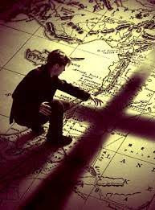
WHAT IS MISSIONS?
Missions is the God-centered endeavor of the church to make Christ known to all the peoples of the world.
4

Slide 5
BREAKING IT DOWN
God-centered endeavor: Missions is not man-centered but rather it is God-centered. It has its beginning and end in God. Matthew 28:18-20; Romans 15:8-9
Of the church: The church is the vehicle that the Lord uses in missions. The local church sends out missionaries and cares for missionaries after they are sent. Matthew 28:18-20; Acts 13:1-3; Philippians 4:15-16; 3 John 1:8
To make Christ known: The object is for people to come to saving knowledge of the Lord Jesus Christ. Romans 15:20
To all the peoples of the world: The scope of missions is not just restricted to your neighborhood but to the ends of the earth. Matthew 28:18-20; Revelation 7:9-10; Acts 1:8; John 10:16
5

Slide 6

“Some now treat the missions of the church as encompassing every good thing a Christian might do, from social action to environmental protection. Those are certainly good things to do….I intend to stick to the traditional and historic use of “missions,” meaning the unique, deliberate gospel mission of the church to make disciples of all nations. I mean evangelism that takes the gospel across ethnic, linguistic, and geographic boundaries, that gathers churches, and teaches them to obey everything Jesus commanded. In the same way when I refer to a missionary, I don’t mean every Christian who lives cross-culturally and shares the gospel…..But just as not every church member who loves Christ is a “pastor/elder,” and not every church member who talks about the Bible is a “teacher” in the sense of James 3:1, so not every cross-cultural gospel witness is a missionary in the sense we read about in 3 John or 1 Corinthians.”
Andy Johnson, Missions, Page 35-36
6

Slide 7

WHAT IS THE GOAL OF MISSIONS?
Proximate goal: The proximate goal of missions is of course to win converts (Matthew 28:19-20; Romans 15:9; Matthew 9:37-38) and for church planting (Acts 15:41; Titus 1:5; Ephesians 3:10).
Ultimate goal: The goal of missions is the glory of God (Isaiah 40:25-26; 48:9-11; Isaiah 45:5-6; Ephesians 1:6,12,14).
7

Slide 8
“Missions is not the ultimate goal of the church. Worship is. Missions exists because worship doesn’t. Worship is ultimate, not missions, because God is ultimate, not man…..Worship, therefore, is the fuel and goal of missions. It’s the goal of missions because in missions we simply aim to bring the nations into the white-hot enjoyment of God’s glory. The goal of missions is the gladness of the peoples in the greatness of God.”
John Piper, Let the nations be glad, Page 35.
8

Slide 9

Paul also appeals the same way to the Athenians (Acts 17:22-34). He says that “God commands (God-glorifying) all people everywhere (among all the peoples of the earth; cross-culturally) to repent because he has fixed a day on which he will judge the world in righteousness by a man he has appointed; and of this he has given assurance to all by raising him from the dead (Christ-centered).”
9

Slide 10
3D2N - Seoul
Day 3 - Destination
The ultimate foundation for our passion to see God glorified is his own passion to be glorified. God is central and supreme in his own affections. There are no rivals for the supremacy of God’s glory in his own heart. God is not an idolater. He does not disobey the first and great commandment. With all his heart and soul and strength and mind he delights in the glory of his manifold perfection. The most passionate heart for God in all the universe is God’s heart.
JOHN PIPER
10

Slide 11

REASONS FOR MISSIONS
• It is a command (Matthew 28:19-20).
·God promises to be with us (Matthew 28:19-20; Acts 2:14).
·God opens doors for missions (2 Corinthians 2:12; Revelation 3:8).
·Christ died for people from all nations (John 10:16; 1 John 2:2; Matthew 24:31; Revelation 5:9).
·Christ promises to build his church (Matthew 16:18).
·The church from all over the world will be gathered when Christ returns (Revelation 7:9)
·God is a model missionary (Genesis 3:15; Genesis 12:1-4; Deuteronomy 4:32-35; Habakkuk 2:14; John 1:1-18) – “go, went”
11

Slide 12

In our busyness with missions we forget that mission is God’s mission (Samuel Escobar, a time for mission, page 27).
Missions is God’s initiative (John 3:16). It is Christ who came to seek and save the lost (Luke 19:10). God is the only true God who made all, owns all, rules all (Christopher J.H Wright, the mission of God, page 71).
He makes himself known in Israel and to the whole world (Deuteronomy 10:14; 2 Kings 19:15; Jeremiah 32:27; Isaiah 54:5; Genesis 18:25; Psalms 47:7).
12

Slide 13
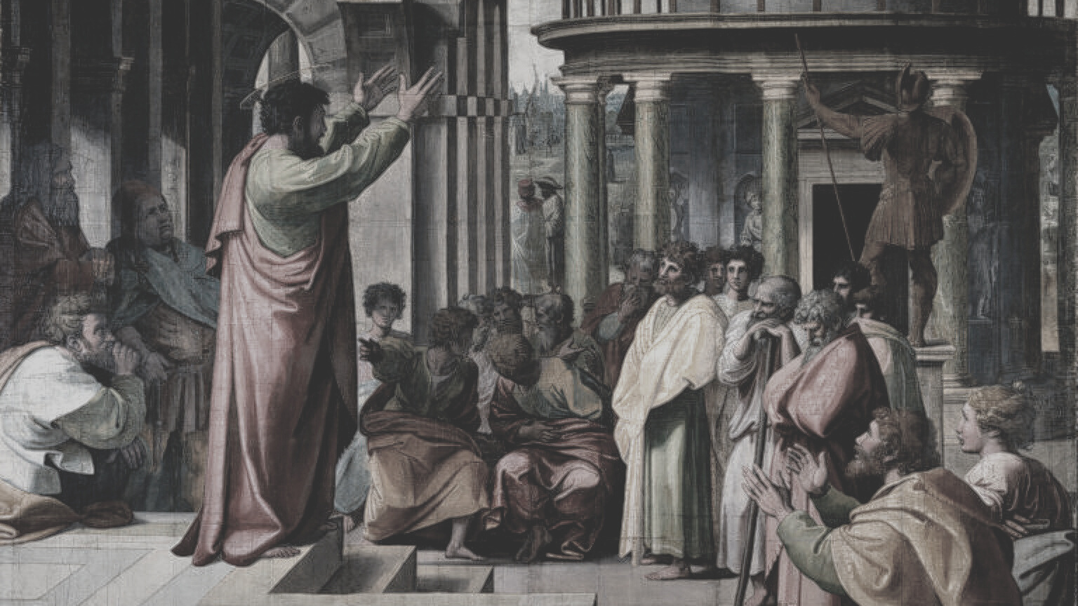
PAUL'S MISSIONARY MODEL
Paul went to a place where Christ has not been named, then he preached there (often visiting synagogues first) and then he would leave elders in those cities (Acts 20:17-38; Titus 1:5) and then he would return to that city at a later date in order to encourage it. Paul’s missionary model was Ecclesiological in nature. It was church-centered. He was sent by a church in order to plant more churches which would sent out their men to plant more churches (3 John 5-8; 2 Timothy 2:2).

Slide 14

BIBLICAL THEOLOGY OF MISSIONS
Old Testament Model of “Come and See” – 1 Kings 8:59-60; 10:1-13 (with the exception of Jonah); Acts 14:6
“Israel was not yet sent on a “Great Commission” to gather the nations; rather, she was glorified so that the nations would see her greatness and come to her.”
John Piper, Let the Nations be glad, Page 27

Slide 15
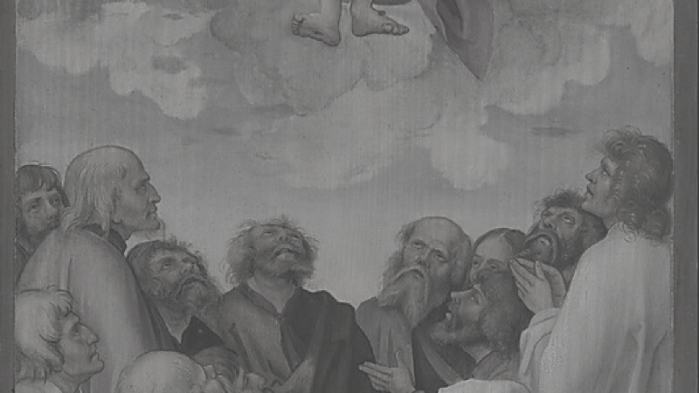
New Testament Model of “Go and Tell” (Matthew 20:19-20; John 10:16; Matthew 21:43; Romans 11:25; Acts 17:30).

Slide 16

Conclusion
Missions is built on the basis and promise of Christ building his church (Matthew 16:18). If his church is to have people from all nations (Matthew 20:19-20; Revelation 7:9) then we must take God seriously and make his mission our mission and go – or even send.

Slide 17


