Slide 1
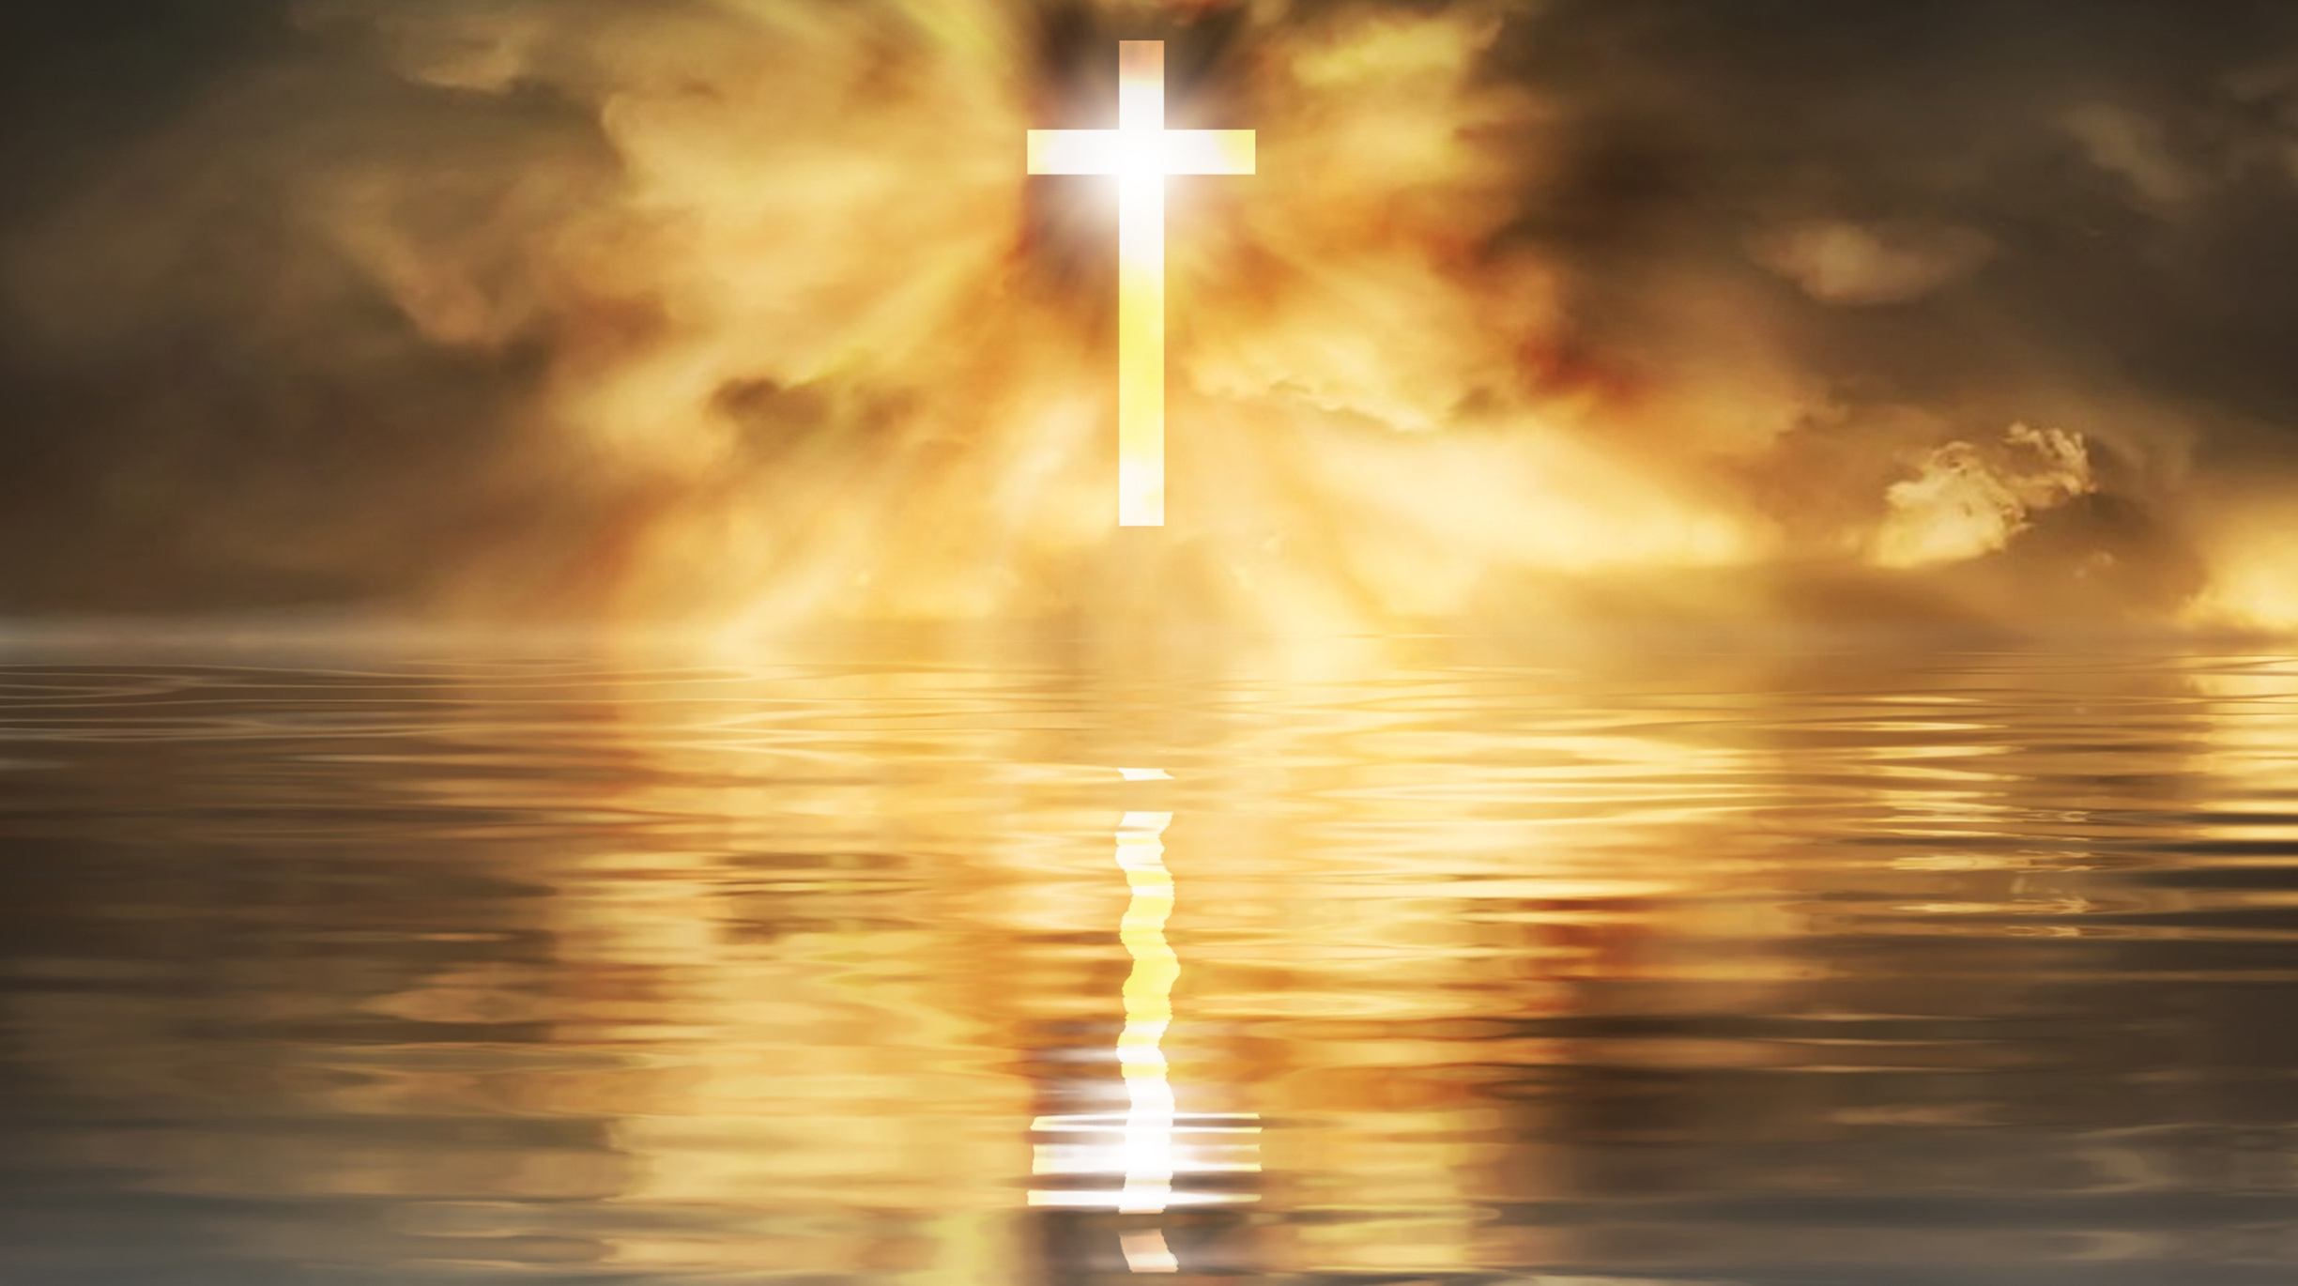
MISSIONS
13/1/2023
WITH PASTOR KEITH WAWERU

Slide 2

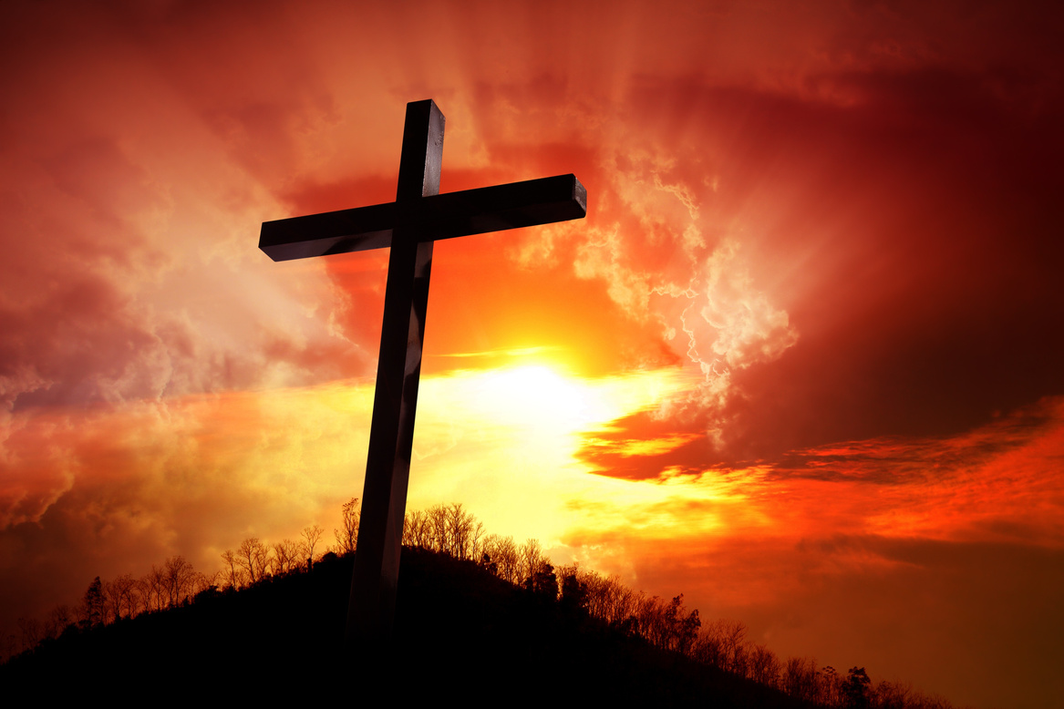


THE CONTENT OF MISSIONS
WHAT IS THE GOSPEL?
NECESSITY OF THE GOSPEL
APPROPRIATE RESPONSE TO THE GOSPEL

Slide 3

WHAT IS THE GOSPEL?
First of all, it is worth noting that the content of missions is the gospel. What this means is that when men set foot in areas where Jesus is not named then their aim is to preach the gospel that is to make Jesus known. That is the content of the gospel. Why is this necessary? It is so because man’s greatest need centers on the fact that he has sinned against God and thus he will incur his wrath. How can he escape that wrath? The gospel provides an answer for that (2 Corinthians 5:20-21; 1 Corinthians 2:2; 2 Corinthians 4:1-6; 2 Corinthians 5:14-15; Romans 15:20).

Slide 4

1
“The historic Christian message, the good news about what God has done for sinners through Christ.”
Andy Johnson, Missions, 32

Slide 5
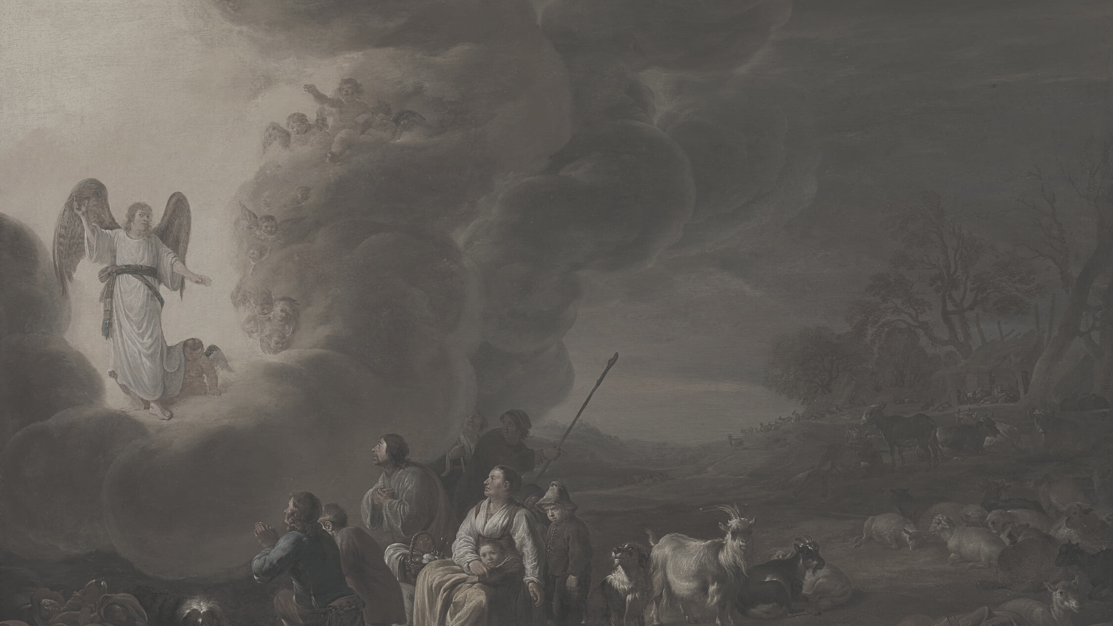
The gospel is the good news that God is holy, man is a sinner, Christ is the savior and that there is a response of repentance and faith that follows this.

Slide 6
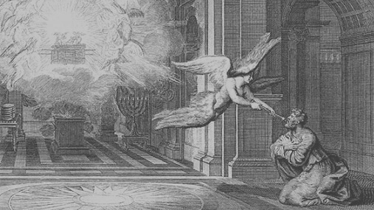
Good news: Luke 2:10
God is holy: Isaiah 6:1-7; Revelation 4:8
Man is a sinner: Romans 3:9-18; Romans 5:12-25; Ephesians 2:1-3
Christ is the savior: John 3:16; Romans 5:12-25; 1 Timothy 2:4-6; Mark 10:45; Isaiah 53: 6, 11-12; John 14:6
A response of faith and repentance: John 3:16; Acts 2:37-41; 16:30-31; Matthew 3:1-2; Mark 1:14-15

Slide 7
NECESSITY OF THE GOSPEL
“Hell is a real place. If hell is not as real as the Bible teaches, then God is not as glorious as the Bible teaches, then sin is not as serious as the Bible teaches, then Christ’s death is not as necessary as the Bible teaches, then missions is not as urgent as the Bible teaches.”
CHBC, Core Seminar on missions, Page 7

Slide 8
Luke 24:46-47:
“Repentance and forgiveness of sins should be preached in his name to all nations, beginning from Jerusalem.”
Since there is no distinction between Jew and Greek but all have sinned and fall short of the glory of God (Romans 3:23) then it follows that all need the gospel for their salvation (1 Timothy 2:4-6). Both Jew and Gentile need the gospel to be saved. Since all sinned and fell in one man, then all are saved and are made righteous through one man

Slide 9
What is the implication?
• There is exclusivity in the gospel. Only through Christ can one be saved. Paul’s logic in 1 Timothy 2:4-6 demands that we see Christ and no other as the savior of the whole world.
“…who desires all people to be saved and to come to the knowledge of the truth. For there is one God, and there is one mediator between God and men, the man Christ Jesus, who gave himself as a ransom for all, which is the testimony given at the proper time.”
See also Matthew 20:28; Mark 10:45; Isaiah 53:11b, 12b.

Slide 10
The spirit of inquiry . . . is spreading everywhere, through the whole length and breadth of the land. [We have distributed] nearly 10,000 tracts, giving to none but those who ask. I presume there have been 6,000 applications at the house. Some come two or three months’ journey, from the borders of Siam and China — “Sir, we hear that there is an eternal hell. We are afraid of it. Do give us a writing that will tell us how to escape it.” Others, from the frontiers of Kathay, 100 miles north of Ava — “Sir, we have seen a writing that tells about an eternal God. Are you the man that gives away such writings? If so, pray give us one, for we want to know the truth before we die.” Others, from the interior of the country, where the name of Jesus Christ is a little known — “Are you Jesus Christ’s man? Give us a writing that tells us about Jesus Christ.”
Adoniram Judson, To the Golden Shore, 398-399

Slide 11
• People must hear and make a conscious response of faith and repentance. Paul’s argument in Romans 10:10-17 stresses the need to hear and to respond by faith.
For the Scripture says, “Everyone who believes in him will not be put to shame.” For there is no distinction between Jew and Greek; for the same Lord is Lord of all, bestowing his riches on all who call on him. For “everyone who calls on the name of the Lord will be saved.” How then will they call on him in whom they have not believed? And how are they to believe in him of whom they have never heard? And how are they to hear without someone preaching? And how are they to preach unless they are sent? As it is written, “How beautiful are the feet of those who preach the good news!” But they have not all obeyed the gospel. For Isaiah says, “Lord, who has believed what he has heard from us?” So faith comes from hearing, and hearing through the word of Christ.

Slide 12
There is a logical flow to this argument:
  ➢ God is the God of all, Jew and Gentile (peoples of all the world).
  ➢ All who call on his name will be saved.
  ➢ It only makes sense if they call on him that they have believed in him.
  ➢ You can only believe in someone or something you know of, or heard.
  ➢ You can only hear something if you have been told, that is preached to.
  ➢ You can only preach if you are sent.

Slide 13
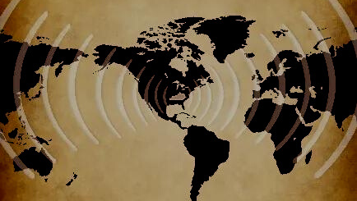
Working backwards the argument becomes:
✓ Sent
✓ Preached
✓ Hear
✓ Believe
✓ Call
So we see that at the very end of the missionary endeavor is for men to call on the name of the Lord. Why? Because they are lost and they are in need of salvation (2 Corinthians 5:18).

Slide 14
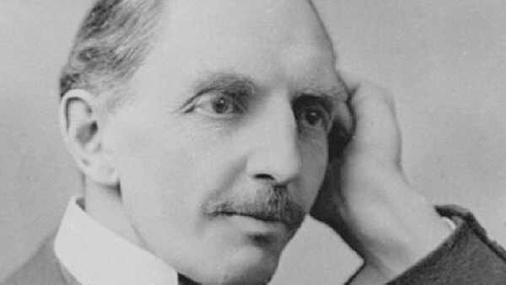
So, two things are motivators for missions. Two things make missions necessary:
1. The reality of judgment day (2 Corinthians 5:10).
2. The Love of Christ for all men (2 Corinthians 5:14-15).
“Some wish to live within the sound of church and chapel bell. I want to run a rescue shop within a yard of hell!”
(C.T. Studd)

Slide 15
“The spirit of Christ is the spirit of missions. The nearer we get to him, the more intensely missionary we become.”
(Henry Martyn)
We must be global Christians with a global vision because our God is a global God.”
(John R.W. Stott)
“There is not a square inch in the whole domain of our human existence over which Christ, who is Sovereign over all, does not cry, Mine!”
(Abraham Kuyper)

Slide 16
“If there be anything about which we cannot tolerate lukewarmness, it is in the matter of sending the gospel to a dying world.”
(Charles Spurgeon)
“If sinners will be damned, at least let them leap to Hell over our bodies.”
(Charles Spurgeon)
“Every saved person this side of heaven owes the gospel to every lost person this side of hell.”
(David Platt)

Slide 17
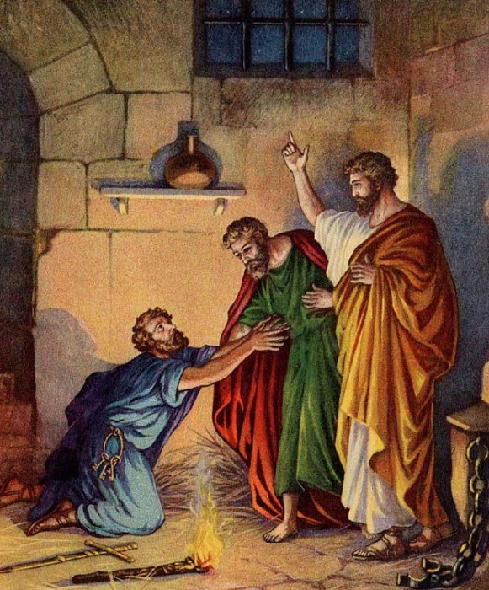
APPROPRIATE RESPONSE TO THE GOSPEL
The appropriate response to missions is faith and repentance (Romans 10:14-17; Acts 17: 29-31).

Slide 18
Being then God’s offspring, we ought not to think that the divine being is like gold or silver or stone, an image formed by the art and the imagination of man. The time of ignorance God overlooked, but now he commands all people everywhere to repent, because he has fixed a day on which he will judge the world in righteousness by a man whom he has appointed; and of this he has given assurance to all by raising him from the dead.
Acts 17:29-31

Slide 19
It is worth noting that the appropriate response is faith and repentance, not faith alone or repentance alone. Faith alone is the grounds of our salvation. It is the appropriation of God’s promises in Christ. It is trusting in Christ alone for salvation. It is turning to Christ. Repentance is turning from sin. It is renouncing our former works including self-trust for salvation and desiring to please God through our lives.

Slide 20

Therefore, logically speaking you turn away from something and turn to something. So we turn away from sin and turn to Christ. Repentance and faith go hand-in-hand. They are like two sides of the same coin (Mark 1:14-15; Matthew 3:2; Acts 2:38-39; Acts 16:31). If faith is apart from repentance then it becomes anti-nomianism, while repentance apart from faith is legalism (Ephesians 2:8-9; James 2:14-26; Romans 12:1-2; Galatians 5:6; 5:16-25).

Slide 21
