Slide 1

ROLE OF THE LOCAL CHURCH IN MISSIONS
MISSIONS BIBLE STUDY
WITH PASTOR KEITH WAWERU

Slide 2

OUTLINE
  What is the role of the local church in missions?
  Who should the church send out as missionaries?
  How should the church send and support missionaries?

Slide 3

TO ME, THOUGH I AM THE VERY LEAST OF ALL THE SAINTS, THIS GRACE WAS GIVEN, TO PREACH TO THE GENTILES THE UNSEARCHABLE RICHES OF CHRIST, 9 AND TO BRING TO LIGHT FOR EVERYONE WHAT IS THE PLAN OF THE MYSTERY HIDDEN FOR AGES IN GOD, WHO CREATED ALL THINGS, 10 SO THAT THROUGH THE CHURCH THE MANIFOLD WISDOM OF GOD MIGHT NOW BE MADE KNOWN TO THE RULERS AND AUTHORITIES IN THE HEAVENLY PLACES.
Ephesians 3:10

Slide 4
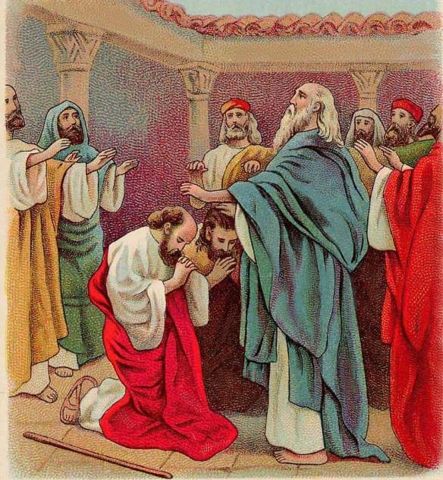
It is to the assembled church at Antioch that the Lord spoke in order to send Paul and Barnabas as missionaries.
Acts 13:1-4

Slide 5

  Teaching and training (2 Timothy 2:2)
  Sending (Acts 13:1-4; 15:24)
  Supporting (3 John 5-8; Philippians 4:14-16; Titus 3:13)
  Praying (Ephesians 6:19-20)
WHAT ARE THE ROLES OF THE LOCAL CHURCH IN MISSIONS?

Slide 6
Training and teaching
It is in the local church that missionary training happens.
“…and what you have heard from me in the presence of many witnesses entrust to faithful men who will be able to teach others also.”
2 Timothy 2:2

Slide 7
Sending
It is also the church that sends missionaries. This can be seen in Acts 13 where Paul and Barnabas are set apart by the church that had gathered to fast and pray. After that they laid their hands on them and sent them off. In Acts 1:6-8, the great commission is also given to the gathered church.
“So when they had come together.”

Slide 8
Sending
This then has an implication. It means that individualistic missionaries are not ideal. In 3 John 6, John says that the missionaries gave a report to them about Gaius’ church.
“…who testified to your love before the church.”
This means that these men were accountable to their sending church.

Slide 9
Sending
The Jerusalem council also sent a letter to the churches concerning men who were unsettling them.
“Since we have heard that some persons have gone out from us and troubled you with words, unsettling your minds, although we gave them no instructions.”
Acts 15:24

Slide 10
Supporting
The church also has a role to play with regard to supporting its missionaries. In 3 John 5-8 the Apostle John commends Gaius for his hospitality to the men from his church. He further tells them to send them on their journey in a manner worthy of God.

Slide 11
Praying
The mission field is a hard place. Therefore the church should pray for:
  Grace for the missionary to proclaim the gospel boldly (Ephesians 6:19-20).
  The safety of the missionary and his family.
  More laborers to help out the missionary (Matthew 9:38).
  Conversions where the missionary is serving.

Slide 12

WHO SHOULD THE LOCAL CHURCH SEND?

Slide 13

The local church should send someone whom they have:
  Assessed/Evaluated
  Affirmed
  Taught/Trained

Slide 14

The local church should first assess the “would be” missionary. They should assess their:
  Character: Who are they?
  Conviction: What do they believe?
  Competence: Can they do the job?
ASSESSMENT

Slide 15
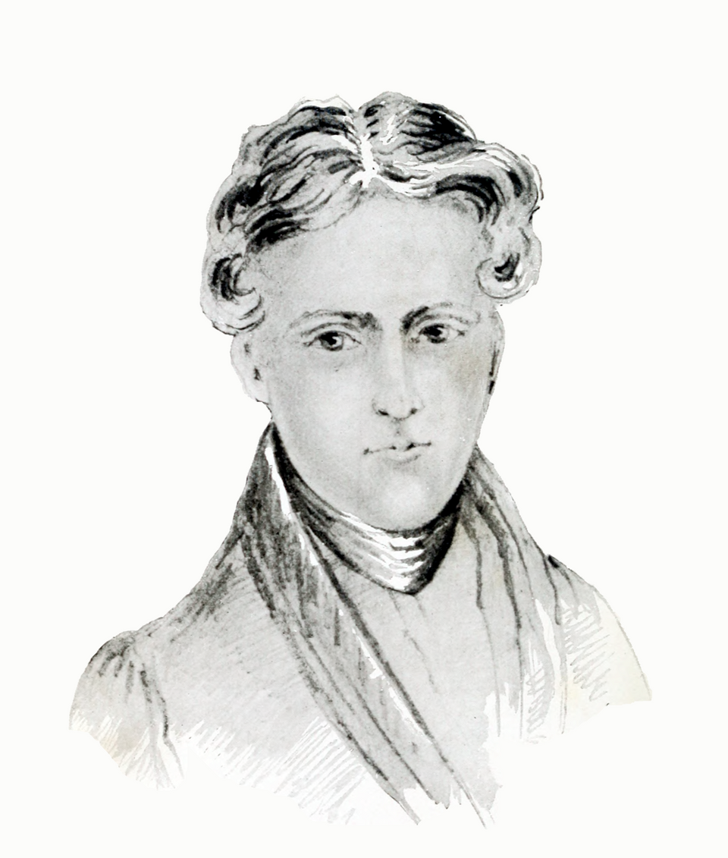
“It is not great talents God blesses so much as likeness to Jesus. A holy minister is an awful weapon in the hand of God.”
Robert Murray M’Cheyne

Slide 16
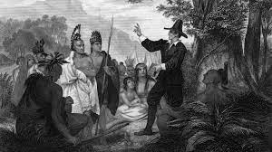
“We cannot know what prayer is for until we know life is war.”
John Piper, Let the nations be glad, 65
“Prayers and pains through faith in Christ Jesus will do anything.”
John Eliot

Slide 17

If a men has passed the test then he should be affirmed (1 Timothy 3:10).
They should be tested first. Where can we test if a man is able to be a missionary? It is in the church.
Mission fields should not be a dumping place where we send men whom we cannot trust with our people and our pulpits. If we think they can’t be elders here, why should we think they can be missionaries elsewhere?
If we can’t trust them with the pulpit here to proclaim the gospel, why send them elsewhere to do so?
Affirmation

Slide 18
Also, when we affirm a man, we not only affirm his desire, calling and gift, we also affirm his humility. When a man submits himself to the local church, he is saying that he needs others to confirm whether he is truly called.
“For by the grace given to me I say to everyone among you not to think of himself more highly than he ought to think, but to think with sober judgment, each according to the measure of faith that God has assigned.”
Romans 12:3

Slide 19

“He began to speak boldly in the synagogue, but when Priscilla and Aquila heard him, they took him aside and explained to him the way of God more accurately.”
Acts 18:26
Apollos was an eloquent man, competent in the scriptures (Acts 18:24). Yet he needed sharpening and training. What does this tell us?
Missionaries should not only be able to teach but should also be teachable.
TEACHING

Slide 20

So who should the church send? Elder-qualified men. Men who have been assessed, affirmed and taught. If their calling is genuine, the Lord will make it known to the church.
“Set apart for me Barnabas and Saul, for the work to which I have called them.”
Acts 13:2

Slide 21
“Hell is real and God’s wrath is certain for all outside of Christ. Yet God’s mission is not frantic or in danger of failing. The promise that Christ will lose none of those the Father has given him is not standing on a knife’s edge, with failure just a breath away. We can be both urgent and wise. Jesus told us to plead with the Lord of the harvest not for warm bodies but for ‘laborers.’ Those are the people we should send. Sending unqualified people may produce bad consequences that cascade far beyond the individual.”
Andy Johnson, Missions, 41-42

Slide 22
What about women? Can they be missionaries?
The simple answer is yes. Women can be missionaries. The ones who proclaimed Christ’s resurrection first were women (Luke 24:24; Luke 24:1-12; Matthew 28:1-8). There were women when Christ appeared to his disciples (Acts 1:14). Women were useful in the work of missions. Some offered their houses to missionaries (Acts 16:15) while others were letter-bearers in the mission work, who were worthy of help from the saints (Romans 16:1-2).
“I commend to you our sister Phoebe, a servant of the church at Cenchreae, that you may welcome her in the Lord in a way worthy of the saints, and help her in whatever she may need for she has been a patron of many and of myself as well.”
Acts 16:1-2

Slide 23

HOW SHOULD WE SUPPORT MISSIONARIES?

Slide 24

Support for missionaries should be abundant. John tells us in 3 John 5-8 that Gaius and his church were to send them on their journey in a manner worthy of God.
“Do your best to speed Zenas the lawyer and Apollos on their way; see that they lack nothing.”
Titus 3:13

Slide 25

Since these men teach and preach in new lands, they are worthy of double honor (1 Timothy 5:17-18). Since they have families, then they should be supported well that the gospel may suffer no hindrance and that they may be free to serve and to proclaim Christ in the mission field.

Slide 26

WHAT ABOUT PARACHURCH MISSION AGENCIES?

Slide 27
"Yet it was kind of you to share my trouble. And you Philippians yourselves know that in the beginning of the gospel, when I left Macedonia, no church entered into partnership with me in giving and receiving, except you only. Even in Thessalonica you sent me help for my needs once and again."
Philippians 4:14-16: 14
WHAT ARE THEY?
An optional, but permissible, means of organized cooperation among churches.

Slide 28

Only authority is that delegated to them by local churches (Acts 15:23-25).
Useful for strategic coordination, humility, and field oversight.
PARACHURCH
Servants of the local churches.

Slide 29

MAINTAINING LOCAL CHURCH RESPONSIBILITY
  Regular communication
"Let us return and visit the brothers in every city where we proclaimed the word of the Lord, and see how they are."
Acts 15:36
  Pastoral visits
  Sending short-term help
  Extending hospitality
  Providing additional teammates

Slide 30

SUPREMACY OF GOD IN MISSIONS GOD IN MISSIONS

