Slide 1
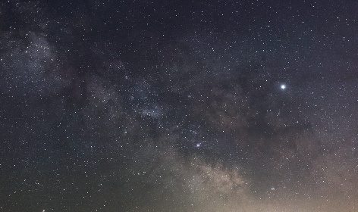
MISSIONS BIBLE STUDY
SUPREMACY OF GOD IN MISSIONS
WITH PASTOR KEITH WAWERU

Slide 2
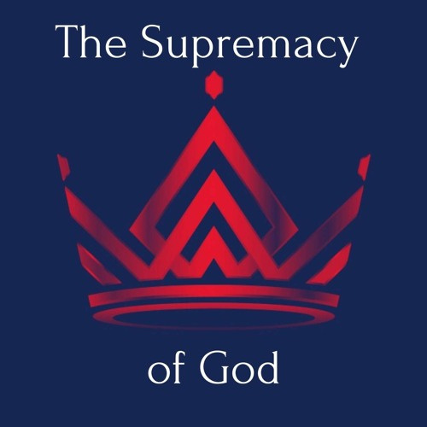
TOPICS
  Through Worship
  Through Prayer
  Through Suffering
29TH JANUARY 2023

Slide 3
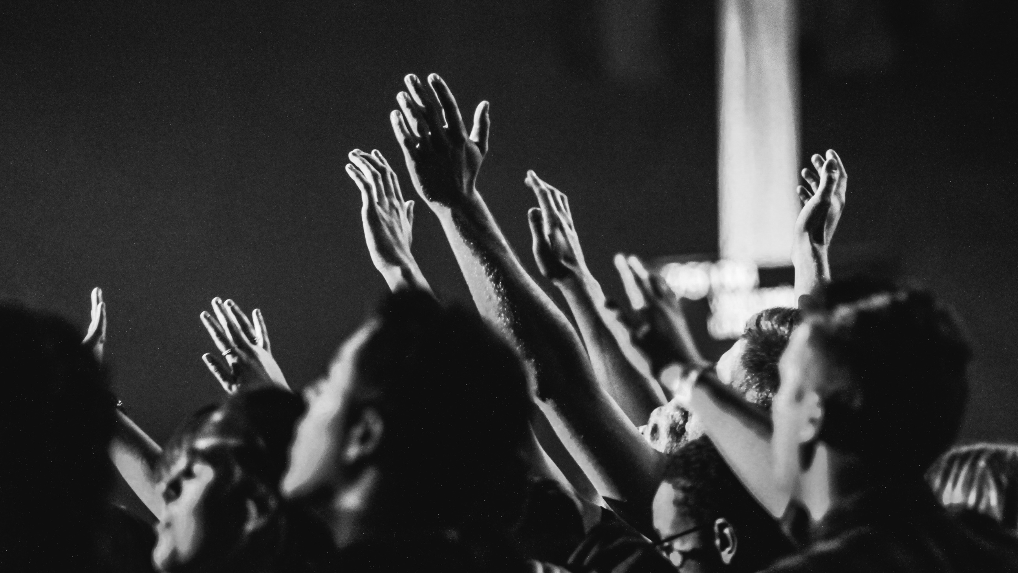
SUPREMACY OF GOD IN MISSIONS THROUGH WORSHIP

Slide 4
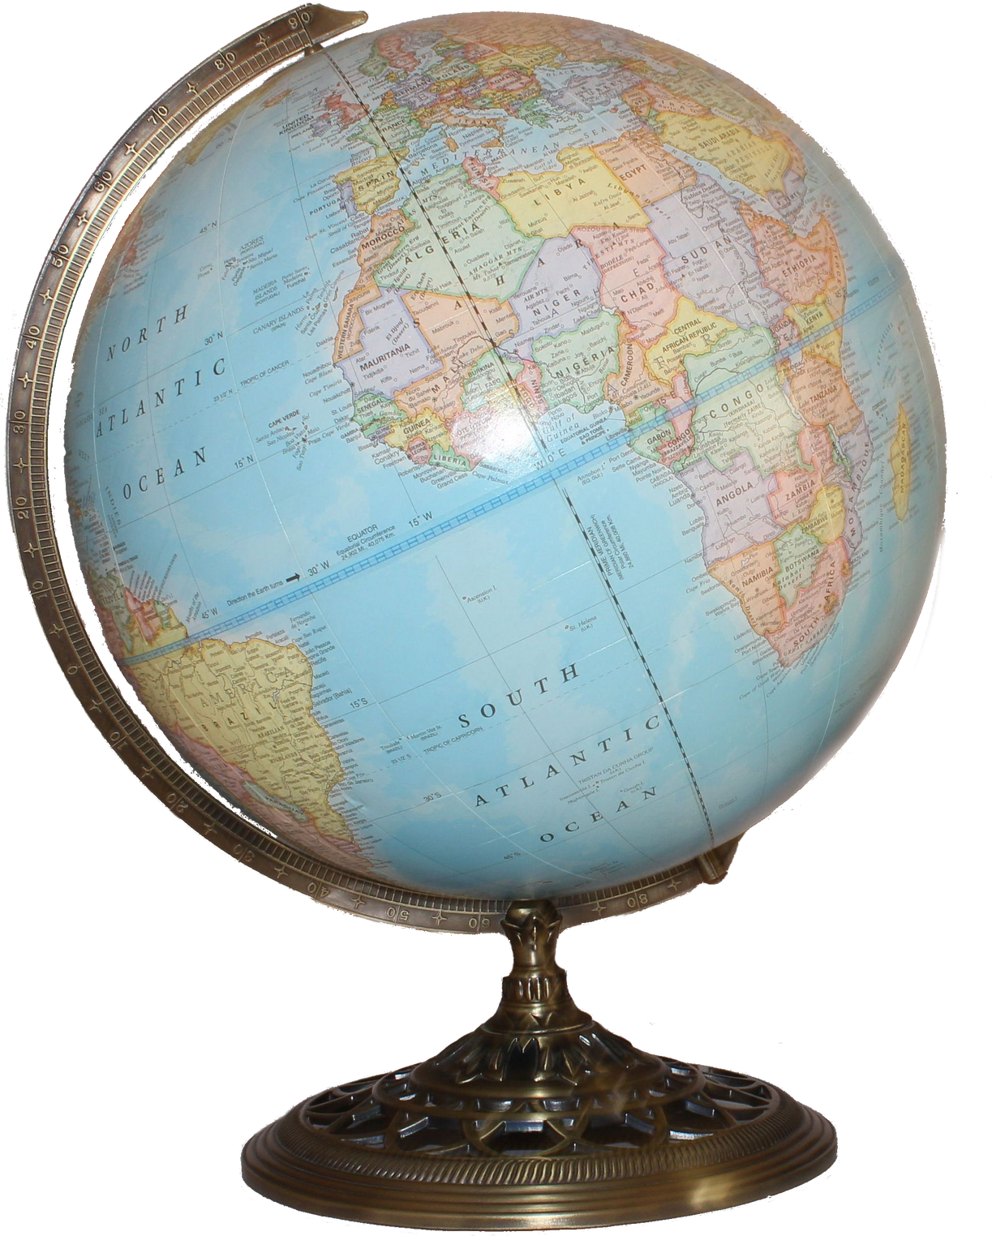
“MISSIONS IS NOT THE ULTIMATE GOAL OF THE CHURCH. WORSHIP IS. MISSIONS EXISTS BECAUSE WORSHIP DOESN’T. WORSHIP IS ULTIMATE NOT MISSIONS, BECAUSE GOD IS ULTIMATE, NOT MAN. WHEN THIS AGE IS OVER, AND THE COUNTLESS MILLIONS OF THE REDEEMED FALL ON THEIR FACES BEFORE THE THRONE OF GOD, MISSIONS WILL BE NO MORE. IT IS A TEMPORARY NECESSITY. BUT WORSHIP ABIDES FOREVER.”
JOHN PIPER, LET THE NATIONS BE GLAD, 35

Slide 5

THE REASON WHY MISSIONS IS NECESSARY IS BECAUSE THE LORD IS NOT WORSHIPPED OR GLORIFIED IN SOME PLACES. IT IS BECAUSE THE GENTILES MIGHT GLORIFY GOD THAT PAUL PREACHES TO THEM (ACTS 15:9). HABAKKUK SAYS IN 2:14 THAT “THE EARTH WILL BE FILLED WITH THE KNOWLEDGE OF THE GLORY OF THE LORD AS THE WATERS COVER THE SEA.”
GOD’S GLORY IS AT STAKE IN THE LIFE OF MAN. MISSIONS IS THE PRIMARY WAY THE LORD HAS SET FOR THAT GLORY TO BE RECOVERED.

Slide 6

THE ULTIMATE FOUNDATION FOR OUR PASSION TO SEE GOD GLORIFIED IS HIS OWN PASSION TO BE GLORIFIED. GOD IS CENTRAL AND SUPREME IN HIS OWN AFFECTIONS. THERE ARE NO RIVALS FOR THE SUPREMACY OF GOD’S GLORY IN HIS OWN HEART. GOD IS NOT AN IDOLATER. HE DOES NOT DISOBEY THE FIRST AND GREAT COMMANDMENT. WITH ALL HIS HEART AND SOUL AND STRENGTH AND MIND HE DELIGHTS IN THE GLORY OF HIS MANIFOLD PERFECTION. THE MOST PASSIONATE HEART FOR GOD IN ALL THE UNIVERSE IS GOD’S HEART.

Slide 7
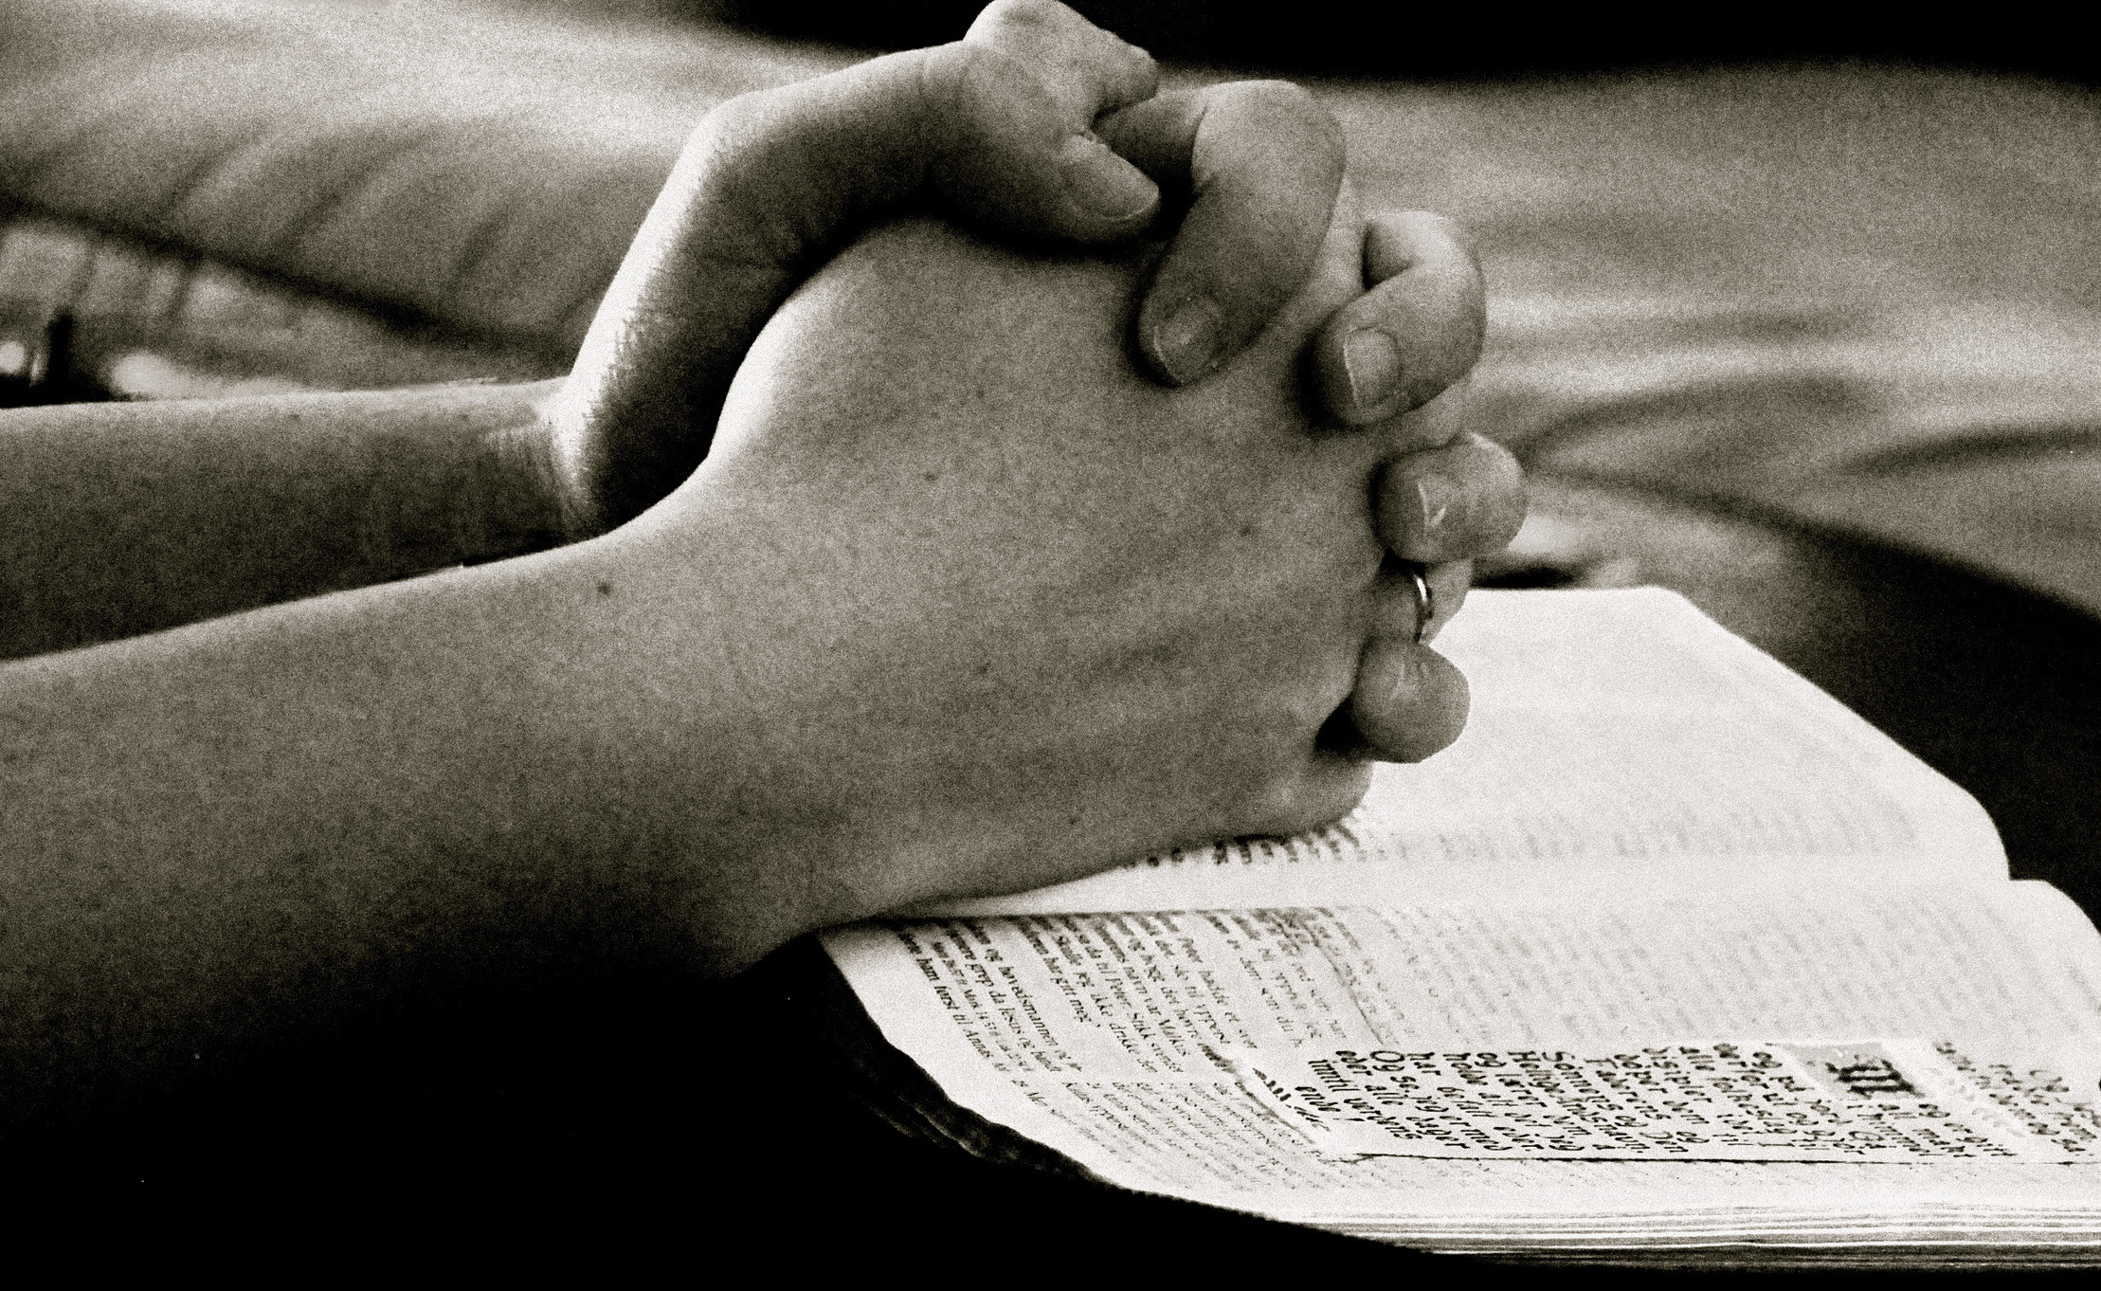
SUPREMACY OF GOD IN MISSIONS THROUGH PRAYER

Slide 8
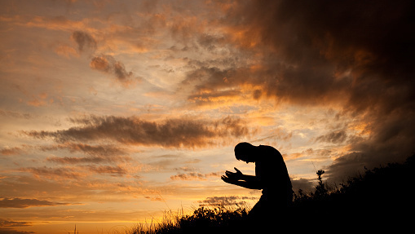
“WHAT A MAN IS ON HIS KNEES BEFORE GOD, THAT HE IS, AND NOTHING MORE.”
ROBERT MURRAY M’CHEYNE

Slide 9
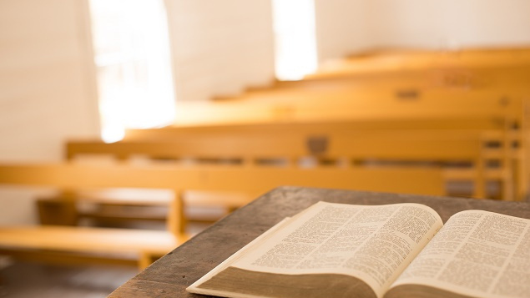
FIRST OF ALL, IT MUST BE CLEAR THAT MISSIONS IS GOD INITIATIVE. IT IS GOD WHO SAVES. HOW DOES HE DO THAT? HE DOES SO THROUGH THE PREACHING OF THE WORD (ROMANS 10:17). HOWEVER, PREACHING WITHOUT THE POWER OF PRAYER IS VAIN. BECAUSE GOD SAVES, OUR DEPENDENCE ON HIM IS SEEN IN OUR HUMILITY THROUGH PRAYER.

Slide 10

WHAT DO WE PRAY FOR?
WE PRAY FOR THE SALVATION OF SOULS THAT ARE LOST (1 TIMOTHY 2:1-6).
WE PRAY FOR MORE LABORERS IN THE MISSION FIELD (MATTHEW 9:38).
WE PRAY FOR BOLDNESS FOR PREACHERS OF THE GOSPEL (EPHESIANS 6:17-18).

Slide 11
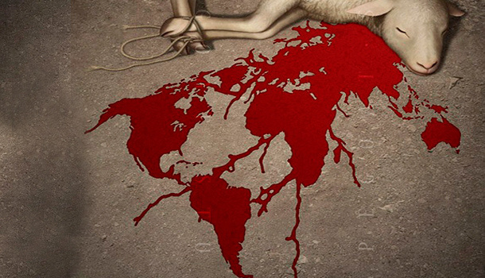
“AT THE BEGINNING OF MY MISSIONARY CAREER I SAID THAT IF PREDESTINATION WERE TRUE I COULD NOT BE A MISSIONARY. NOW AFTER TWENTY SOME YEARS OF STRUGGLING WITH THE HARDNESS OF THE HUMAN HEART, I SAY I COULD NEVER BE A MISSIONARY UNLESS I BELIEVED IN THE DOCTRINE OF PREDESTINATION.”
JOHN ALEXANDER

Slide 12
“CALL UPON ME IN THE DAY OF TROUBLE AND I WILL DELIVER YOU, AND YOU SHALL GLORIFY ME.”
PSALM 50:15
“GOD AND THE PRAYING MAN TAKE SHARES….FIRST, HERE IS YOUR SHARE: ‘CALL UPON ME IN THE DAY OF TROUBLE.’ SECONDLY, HERE IS GOD’S SHARE, ‘I WILL DELIVER THEE.’ AGAIN, YOU TAKE SHARE – FOR YOU SHALL BE DELIVERED. AND THEN AGAIN, IT IS THE LORD’S TURN – ‘THOU SHALT GLORIFY ME.’ HERE IS A COMPACT, A COVENANT THAT GOD ENTERS INTO WITH YOU WHO PRAY TO HIM, AND WHOM HE HELPS. HE SAYS, ‘YOU SHALL HAVE THE DELIVERANCE, BUT I MUST HAVE THE GLORY….’ HERE IS A DELIGHTFUL PARTNERSHIP: WE OBTAIN THAT WHICH WE SO GREATLY NEED, AND ALL THAT GOD GETTETH IS THE GLORY WHICH IS DUE UNTO HIS NAME.”
CHARLES SPURGEON, TWELVE SERMONS ON PRAYER, 105

Slide 13
“PRAYER IS NOT LEARNT IN A CLASSROOM BUT IN A CLOSET.”
E.M BOUNDS
“FINALLY, BROTHER, PRAY FOR US, THAT THE WORD OF GOD MAY SPEED AHEAD AND BE HONORED.”
2 THESSALONIANS 3:1
“PRAY ALSO FOR ME THAT WORDS MAY BE GIVEN TO ME IN THE OPENING OF MY MOUTH BOLDLY TO PROCLAIM THE MYSTERY OF THE GOSPEL.”
EPHESIANS 6:19
“PRAY ALSO FOR US, THAT GOD MAY OPEN TO US A DOOR FOR THE WORD.”
COLOSSIANS 4:3
JESUS SAYS IN LUKE 18:1 “ALWAYS….PRAY AND DO NOT LOSE HEART.”

Slide 14

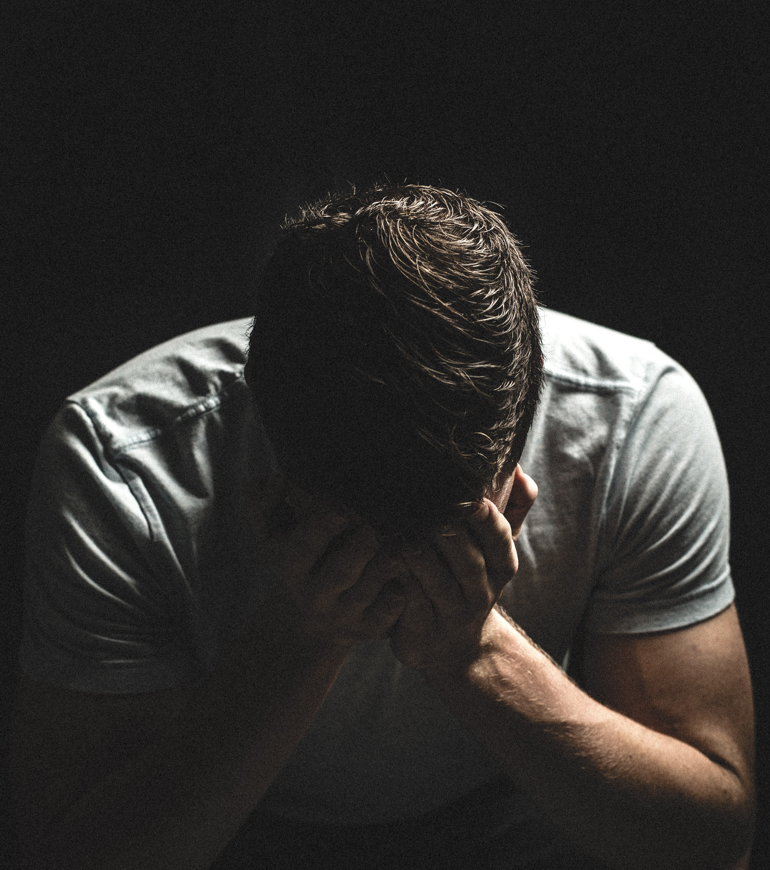
SUPREMACY OF GOD IN MISSIONS THROUGH SUFFERING

Slide 15
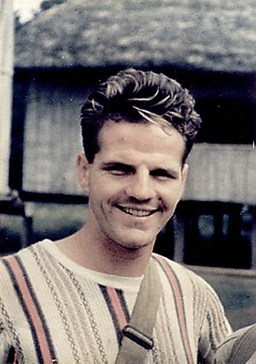
“HE IS NO FOOL WHO GIVES UP WHAT HE CANNOT KEEP TO GAIN WHAT HE CANNOT LOSE.”
JIM ELLIOTT

Slide 16
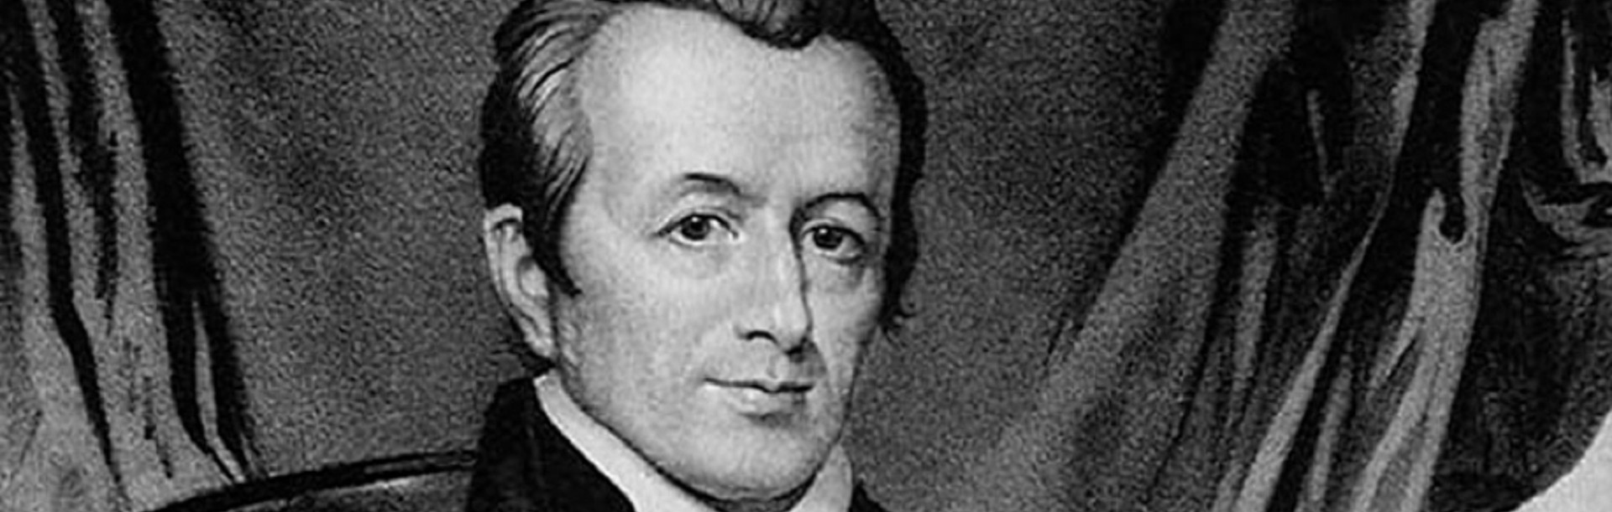
CONSIDER THE EXAMPLE OF ADONIRAM JUDSON, WHOSE BIOGRAPHY IS IN OUR BOOKSTALL. WHEN HE WAS IN BURMA, HE LOST 2 WIVES AND 7 OUT OF 13 CHILDREN, IN ADDITION TO COLLEAGUE AFTER COLLEAGUE.
"IF I HAD NOT FELT CERTAIN THAT EVERY ADDITIONAL TRIAL WAS ORDERED BY INFINITE LOVE AND MERCY, I COULD NOT HAVE SURVIVED MY ACCUMULATED SUFFERING."
ADONIRAM JUDSON

Slide 17
JOHN 15:20: “REMEMBER THE WORD THAT I SAID TO YOU: ‘A SERVANT IS NOT GREATER THAN HIS MASTER.’ IF THEY PERSECUTED ME, THEY WILL ALSO PERSECUTE YOU. IF THEY KEPT MY WORD, THEY WILL ALSO KEEP YOURS.”
1 PETER 4:1 & 12: "SINCE THEREFORE CHRIST SUFFERED IN THE FLESH, ARM YOURSELVES WITH THE SAME WAY OF THINKING, FOR WHOEVER HAS SUFFERED IN THE FLESH HAS CEASED FROM SIN… BELOVED, DO NOT BE SURPRISED AT THE FIERY TRIAL WHEN IT COMES UPON YOU TO TEST YOU, AS THOUGH SOMETHING STRANGE WERE HAPPENING TO YOU."
“FOR I WILL SHOW HIM HOW MUCH HE MUST SUFFER FOR THE SAKE OF MY NAME.”
ACTS 9:16

Slide 18
“ARE THEY SERVANTS OF CHRIST? I AM A BETTER ONE – I AM TALKING LIKE MADMAN – WITH FAR GREATER LABORS, FAR MORE IMPRISONMENTS, WITH COUNTLESS BEATINGS, AND OFTEN NEAR DEATH. FIVE TIMES I RECEIVED AT THE HANDS OF THE JEWS THE FORTY LASHES LESS ONE. THREE TIMES I WAS BEATEN WITH RODS. ONCE I WAS STONED. THREE TIMES I WAS SHIPWRECKED; A NIGHT AND A DAY I WAS ADRIFT AT SEA; ON FREQUENT JOURNEYS, IN DANGER FROM RIVERS, DANGER FROM ROBBERS, DANGER FROM MY OWN PEOPLE, DANGER FROM THE GENTILES, DANGER IN THE CITY, DANGER IN THE WILDERNESS, DANGER AT SEA, DANGER FROM FALSE BROTHERS; IN TOIL AND HARDSHIPS THROUGH MANY A SLEEPLESS NIGHT, IN HUNGER AND THIRST, OFTEN WITHOUT FOOD, IN COLD AND EXPOSURE. AND APART FROM OTHER THINGS THERE IS THE DAILY PRESSURE ON ME OF MY ANXIETY FOR ALL THE CHURCHES. WHO IS WEAK, AND I AM NOT WEAK? WHO IS MADE TO FALL, AND I AM NOT INDIGNANT?” IF I MUST BOAST, I MUST BOAST OF THE THINGS THAT SHOW MY WEAKNESS.”
2 CORINTHIANS 11:23-30

Slide 19

WHY DOES GOD ALLOW SUFFERING TO HAPPEN

Slide 20

SUFFERING LEADS TO DEEPER FAITH AND GREATER HOLINESS (JAMES 1:2-4).
“SUFFERING SO UNBOLTS THE DOOR OF THE HEART, THAT THE WORD HATH EASIER ENTRANCE.”
RICHARD BAXTER

Slide 21

SUFFERING LOOSENS OUR AFFECTIONS IN THIS WORLD, FOCUS THEM ON HIM AND HEAVEN (2 CORINTHIANS 4:17-18; 1:8B-9).

Slide 22

SUFFERING MAGNIFIES THE POWER AND WORTH OF CHRIST (2 CORINTHIANS 12:9-10).

Slide 23

SUFFERING SHOWCASES THE ETERNAL, AMAZING HOPE OF THE GOSPEL (1 PETER 3:14-15).

Slide 24
‘MR. DICKSON, YOU ARE ADVANCED IN YEARS NOW, AND YOUR OWN PROSPECT IS SOON TO BE LAID IN THE GRAVE, THERE TO BE EATEN BY WORMS; I CONFESS TO YOU, THAT IF I CAN LIVE AND DIE SERVING AND HONORING THE LORD JESUS, IT WILL MAKE NO DIFFERENCE TO ME WHETHER I AM EATEN BY CANNIBALS OR WORMS; AND IN THE GREAT DAY MY RESURRECTION BODY WILL ARISE AS FAIR AS YOURS IN THE LIKENESS OF OUR RISEN REDEEMER.”
JOHN G. PATON, MISSIONARY TO THE SOUTH SEA ISLANDS

Slide 25

SUFFERING ENCOURAGES AND EMBOLDENS OTHER CHRISTIANS (PHILIPPIANS 1:14).
SUFFERING MOVES CHRISTIANS TO THE PLACES HE WANTS THEM TO GO (ACTS 8:1; ACTS 11:19).
WHY DOES GOD ALLOW SUFFERING TO HAPPEN?
SUFFERING PURIFIES AND REFINES THE CHRISTIAN (ROMANS 8:28-29; 1 PETER 1:6-7)
SUFFERING DISPLAYS THE VALUE OF KNOWING CHRIST TO A WATCHING WORLD (PHILIPPIANS 2:14-16).

Slide 26





ALMOST THERE
SUFFERING
WORSHIP
PRAYER
PREACHING/MISSIONS

Slide 27
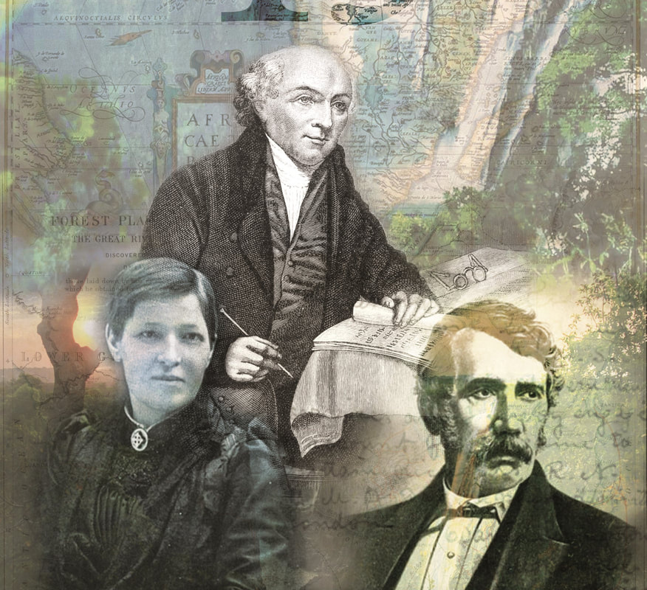
HISTORY OF MODERN MISSIONS

