Slide 1


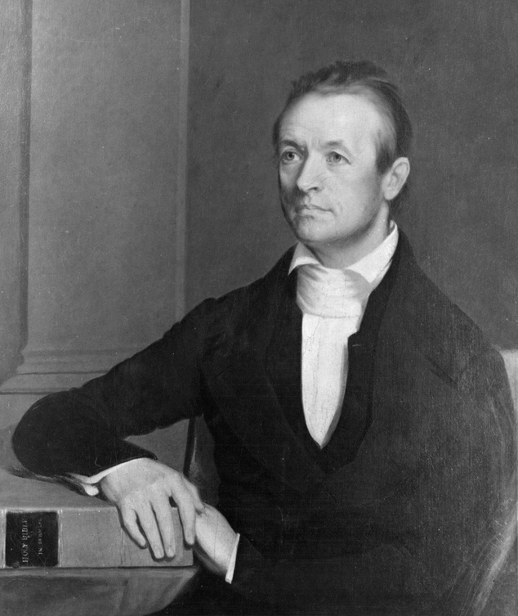
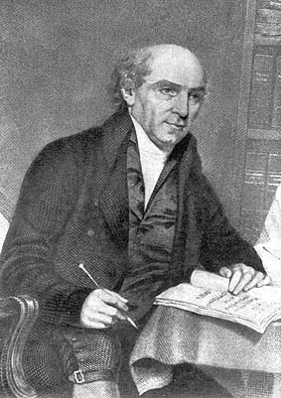
HISTORY OF MODERN MISSIONS
With Pastor Keith Waweru

Slide 2
“And they conquered him by the blood of the Lamb and by the word of their testimony, for they loved not their lives even unto death.”
Revelation 12:11

Slide 3
TODAY WILL DISCUSS
  WILLIAM CAREY
  ADONIRAM JUDSON
  MARY SLESSOR
  JIM ELLIOT

Slide 4
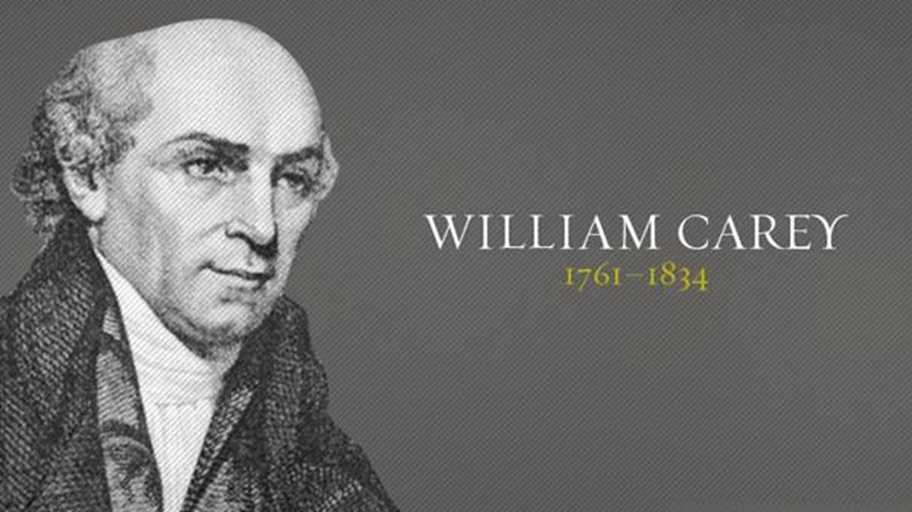
ATTEMPT GREAT THINGS FOR GOD

Slide 5
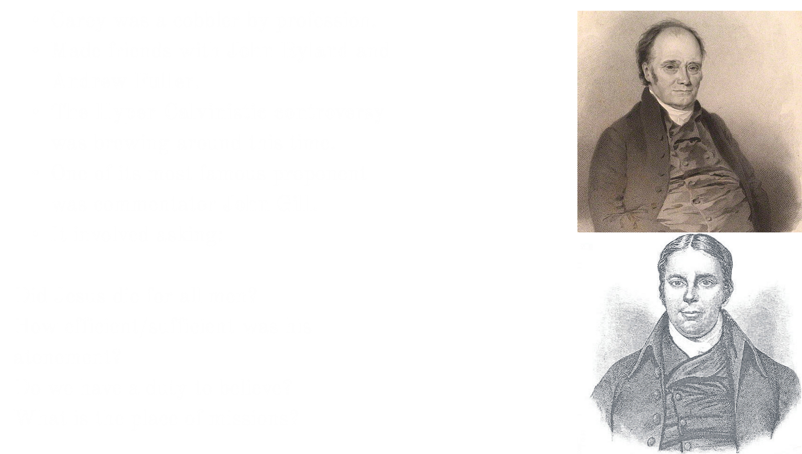

Slide 6
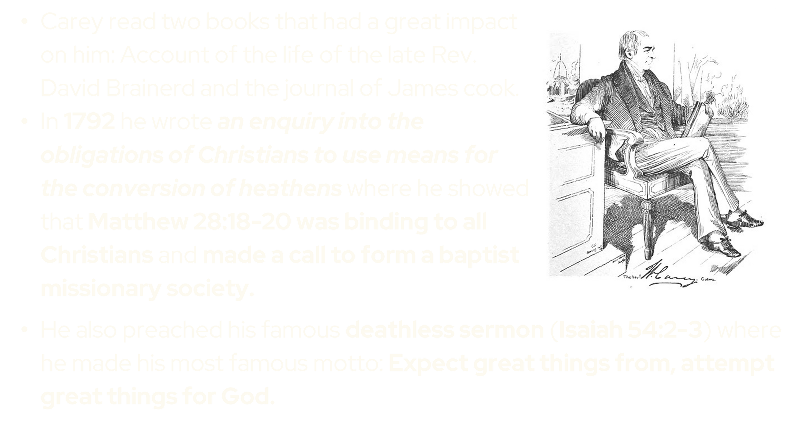

Slide 7
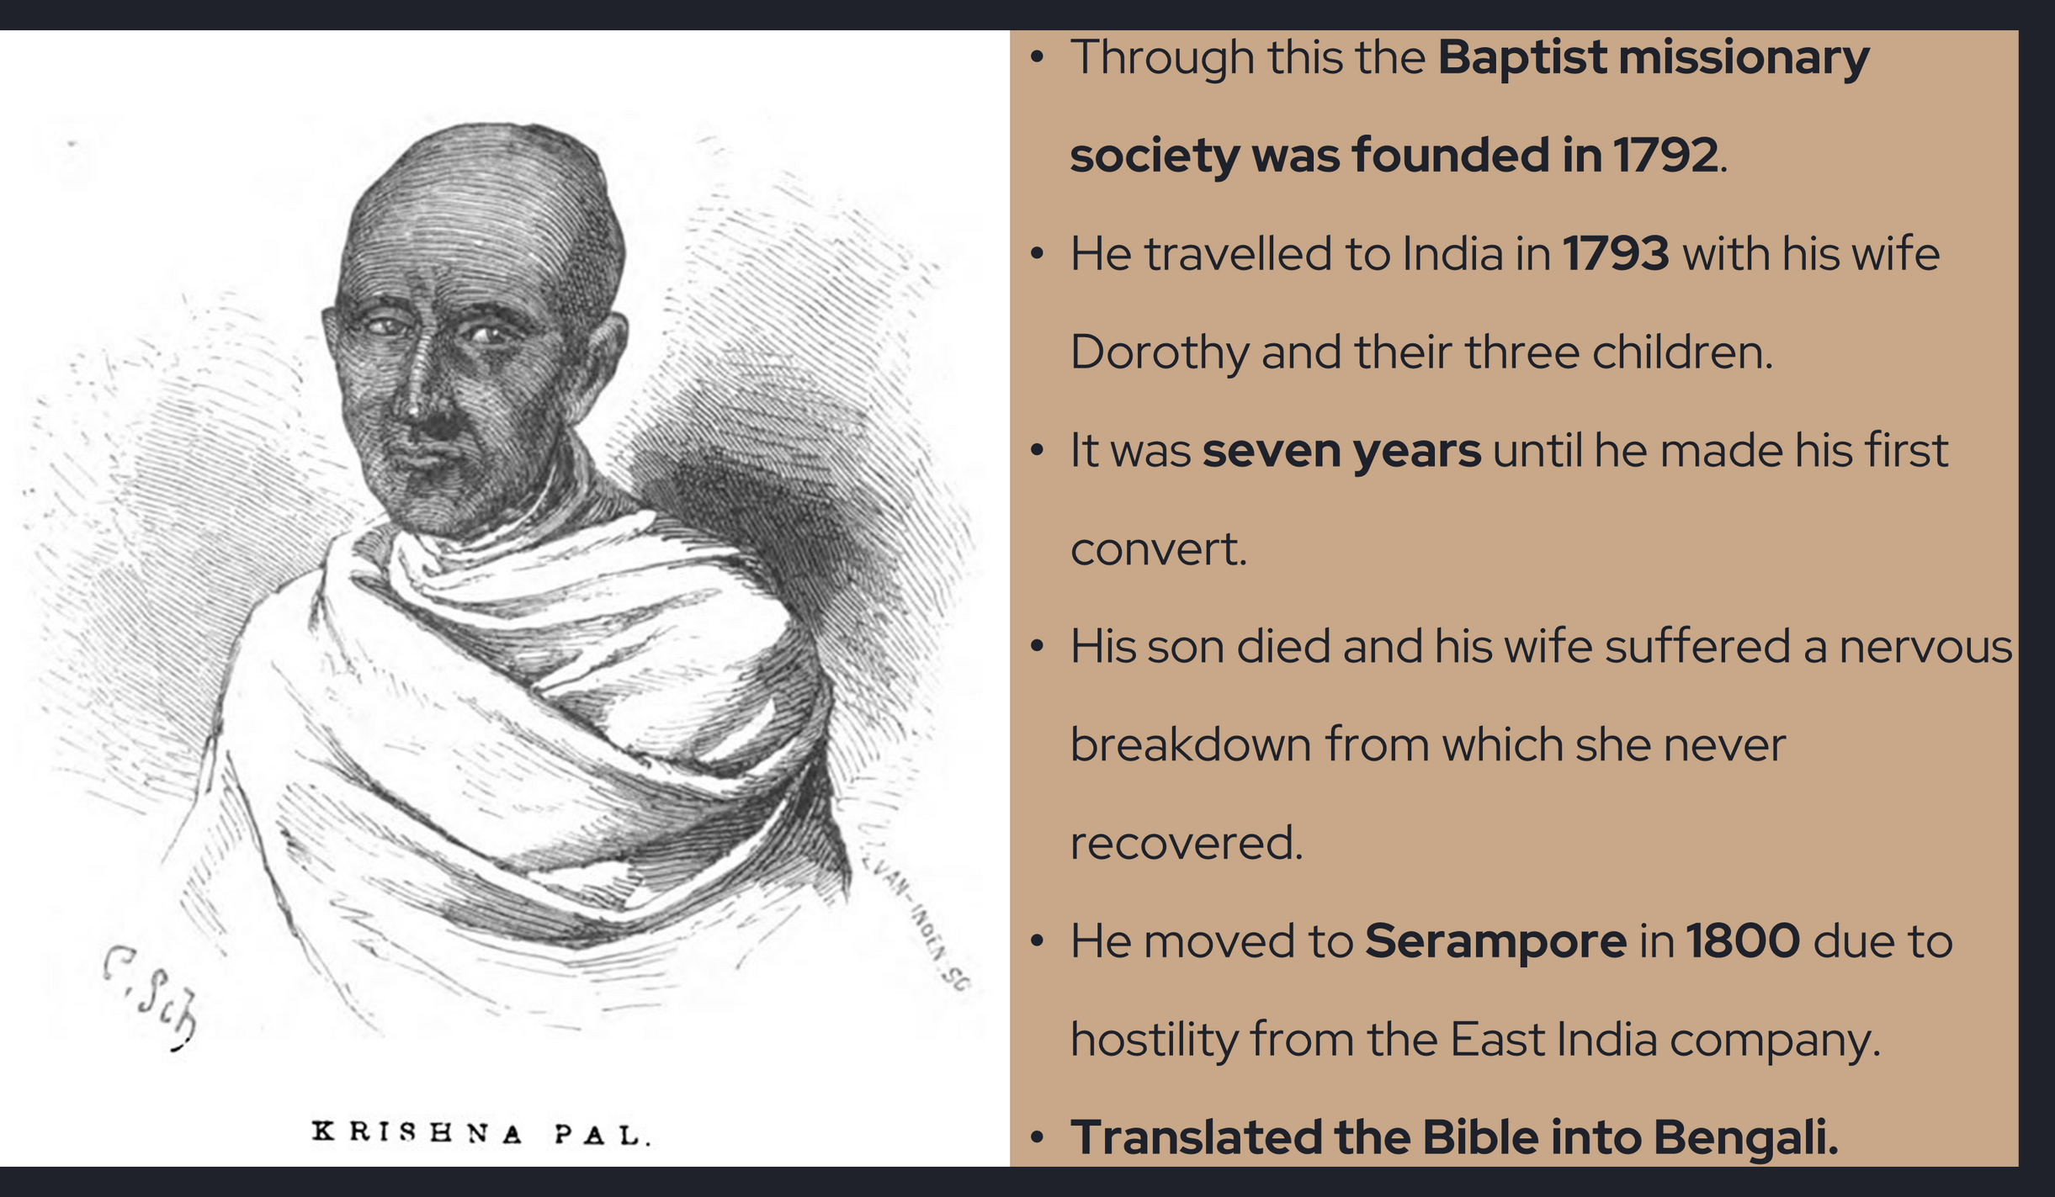

Slide 8
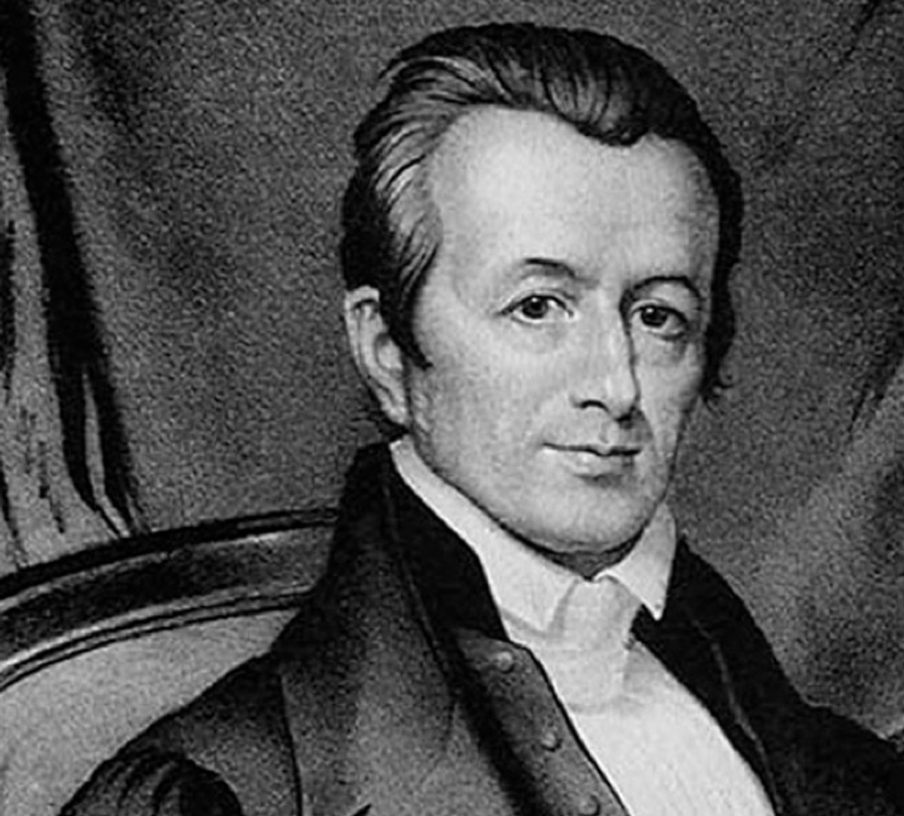
ADONIRAM JUDSON
SUFFERING FOR THE SAKE OF CHRIST

Slide 9
  JUDSON WAS BORN ON AUGUST 9, 1788 IN MALDEN, MA TO ADONIRAM JUDSON, SR., A CONGREGATIONAL MINISTER.
  RAISED IN A GODLY AND PIOUS HOME, JUDSON WAS A BRILLIANT YOUNG MAN, ENTERING BROWN UNIVERSITY AT AGE SEVENTEEN.
  HOWEVER, IN COLLEGE, HE ABANDONED HIS GODLY ROOTS AND EMBRACED SKEPTICISM AND DEISM UNDER THE INFLUENCE OF HIS CLOSE FRIEND, JACOB EAMES.
  WHO WERE DEISTS? DEISTS ADMITTED THE EXISTENCE OF GOD BUT DENIED HIS REVELATION IN THE SCRIPTURES.
  DEEPLY SHAKEN BY THE DEATH OF HIS FRIEND, JACOB EAMES.
  IN HIS SECOND YEAR OF SEMINARY, JUDSON BECAME AWARE OF THE NEED FOR WORLD MISSIONS. HE READ ABOUT WILLIAM CAREY WHO HAD BROUGHT THE GOSPEL TO SERAMPORE, INDIA, AND BEGUN TRANSLATING THE BIBLE INTO BENGALI. AS HE STUDIED GEOGRAPHY AND THE NATIONS OF THE EAST, JUDSON SOON RESOLVED TO BECOME A MISSIONARY TO THE KINGDOM OF BURMA: A COMPLETELY UNREACHED BUDDHIST COUNTRY.

Slide 10
I HAVE NOW TO ASK, WHETHER YOU CAN CONSENT TO PART WITH YOUR DAUGHTER EARLY NEXT SPRING, TO SEE HER NO MORE IN THIS WORLD; WHETHER YOU CAN CONSENT TO HER DEPARTURE, AND HER SUBJECTION TO THE HARDSHIPS AND SUFFERINGS OF A MISSIONARY LIFE; WHETHER YOU CAN CONSENT TO HER EXPOSURE TO THE DANGERS OF THE OCEAN; TO THE FATAL INFLUENCE OF THE SOUTHERN CLIMATE OF INDIA; TO EVERY KIND OF WANT AND DISTRESS; TO DEGRADATION, INSULT, PERSECUTION, AND PERHAPS A VIOLENT DEATH. CAN YOU CONSENT TO ALL THIS, FOR THE SAKE OF HIM WHO LEFT HIS HEAVENLY HOME, AND DIED FOR HER AND FOR YOU; FOR THE SAKE OF PERISHING, IMMORTAL SOULS; FOR THE SAKE OF ZION, AND THE GLORY OF GOD? CAN YOU CONSENT TO ALL THIS, IN HOPE OF SOON MEETING YOUR DAUGHTER IN THE WORLD OF GLORY, WITH THE CROWN OF RIGHTEOUSNESS, BRIGHTENED WITH THE ACCLAMATIONS OF PRAISE WHICH SHALL REDOUND TO HER SAVIOUR FROM HEATHENS SAVED, THROUGH HER MEANS, FROM ETERNAL WOE AND DESPAIR?

Slide 11
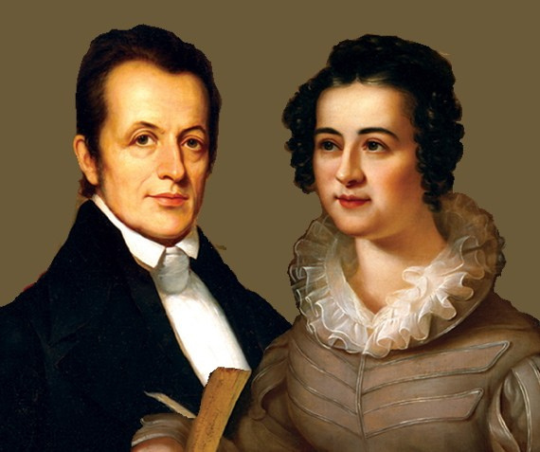
  HIS DAUGHTER MARIA WAS BORN WHILE HE WAS STILL IN PRISON.
  HIS WIFE FELL ILL AND JUDSON HAD TO TAKE HIS BABY DAUGHTER MARIA AROUND THE VILLAGE, BEGGING MOTHERS TO HAVE COMPASSION AND NURSE HIS LITTLE GIRL.

Slide 12
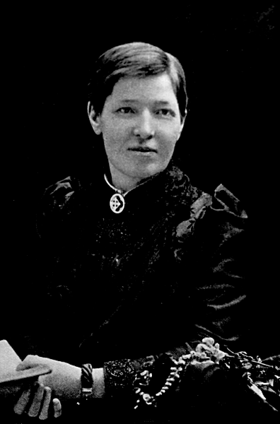
MARY SLESSOR
CALABAR FOR CHRIST

Slide 13
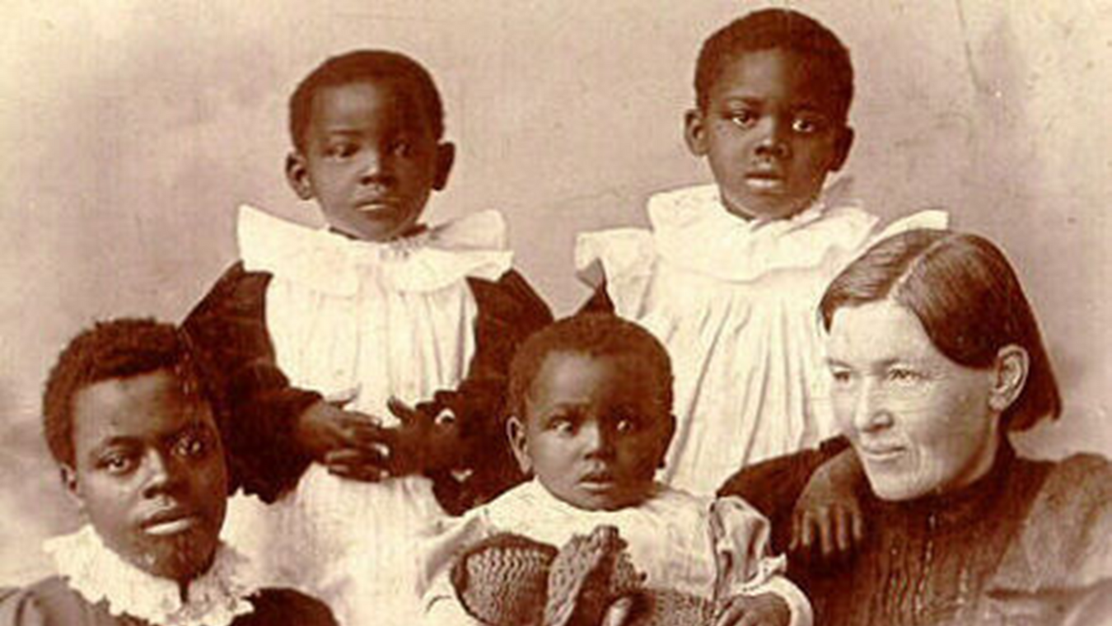
- SHE WAS BORN INTO A POOR FAMILY IN SCOTLAND.
-HER FAMILY WAS TROUBLED. HER FATHER WAS A DRUNKARD WHO BROUGHT THE FAMILY TO ABJECT POVERTY, FEAR AND MISERY.
-THEIR ONE-ROOMED HOME HAD NO WATER, LIGHTING OR TOILET AND HARDLY ANY FURNITURE. SHE SLEPT ON THE FLOOR.
-AT AGE 10, SHE STARTED WORK AS A HALF-TIMER, SPENDING HALF HER DAY AT SCHOOL AND HALF OF IT AT THE MILL.

Slide 14
- SHE LIVED A LIFE OF POVERTY IN NIGERIA, LIVING JUST LIKE THE LOCAL PEOPLE WHILE PREACHING THE GOSPEL (SHE CUT HER HAIR SHORT, ABANDONED ALL WESTERN COMFORTS AND WESTERN FOOD AND WALKED BAREFOOT.
-SHE IS KNOWN FOR SAVING AND ADOPTING BABIES WHO WERE BORN AS TWINS.
“A WOMAN WHO GAVE BIRTH TO TWINS WAS REGARDED WITH HORROR. THE BELIEF WAS THAT THE FATHER OF ONE OF THE INFANTS WAS AN EVIL SPIRIT, AND THAT THE MOTHER HAD BEEN GUILTY OF A GREAT SIN TO BEAR TWINS. AL LEAST ONE OF THE CHILDREN WAS BELIEVED TO BE A MONSTER, AND SO TWINS WERE SEIZED, THEIR BACKS WERE BROKEN, THEY WERE CRUSHED INTO A CALABASH OR WATER POT AND TAKEN OUT – NOT BY THE DOORWAY, BUT BY A HOLE BROKEN IN THE BACK WALL, WHICH WAS AT ONCE BUILT UP AGAIN, AND THROWN INTO THE BUSH, WHERE THEY WERE LEFT TO BE EATEN BY INSECTS AND WILD BEASTS.”
Thank You!

Slide 15
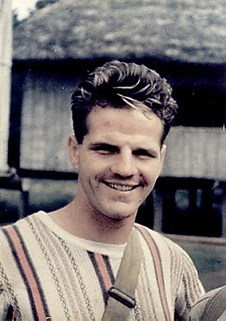
JIM ELLIOT
LOVING NOT YOUR LIFE EVEN UNTO DEATH

Slide 16
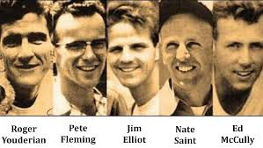
- JIM ELLIOT WAS BORN ON OCTOBER 8, 1927.
-ELLIOT PROFESSED FAITH IN JESUS AT THE AGE OF SIX AND GREW UP IN A HOME WHERE OBEDIENCE AND HONESTY WERE ENFORCED. THE ELLIOT PARENTS ENCOURAGED THEIR CHILDREN TO BE ADVENTUROUS, AND ENCOURAGED THEM TO "LIVE FOR CHRIST".
- JIM ELLIOT WAS A MAN OF PRAYER. HE GAVE HIMSELF TO PRAY FOR THE MISSIONS THAT WERE TO COME.
-WHILE IN COLLEGE HE ORGANIZED A GROUP OF YOUNG MEN AND WOMEN TO PRAY EVERY 15 MINUTES ROUND THE CLOCK FOR MISSIONS. HE LED TEAM OF STUDENTS TO PRAY AT 6:30 AM EVERY MORNING.

Slide 17
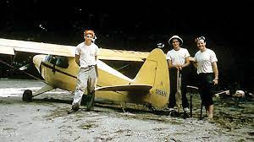
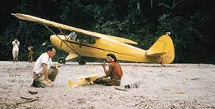
  ELLIOT AND HIS GROUP (ED MCCULLY, ROGER YOUDERIAN, PETE FLEMING, AND THEIR PILOT, NATE SAINT) MADE CONTACT FROM THEIR PIPER PA-14AIRPLANE WITH THE HUAORANI USING A LOUDSPEAKER AND A BASKET TO PASS DOWN GIFTS. AFTER SEVERAL MONTHS, THE MEN DECIDED TO BUILD A BASE ASHORT DISTANCE FROM THE AMERINDIAN VILLAGE, ALONG THE CURARAY RIVER.
  THE HOUARANI WARRIORS KILLED ELLIOT AND HIS FOUR COMPANIONS ON JANUARY 8, 1956.

Slide 18

CHALLENGES OF MISSIONS

