Slide 1
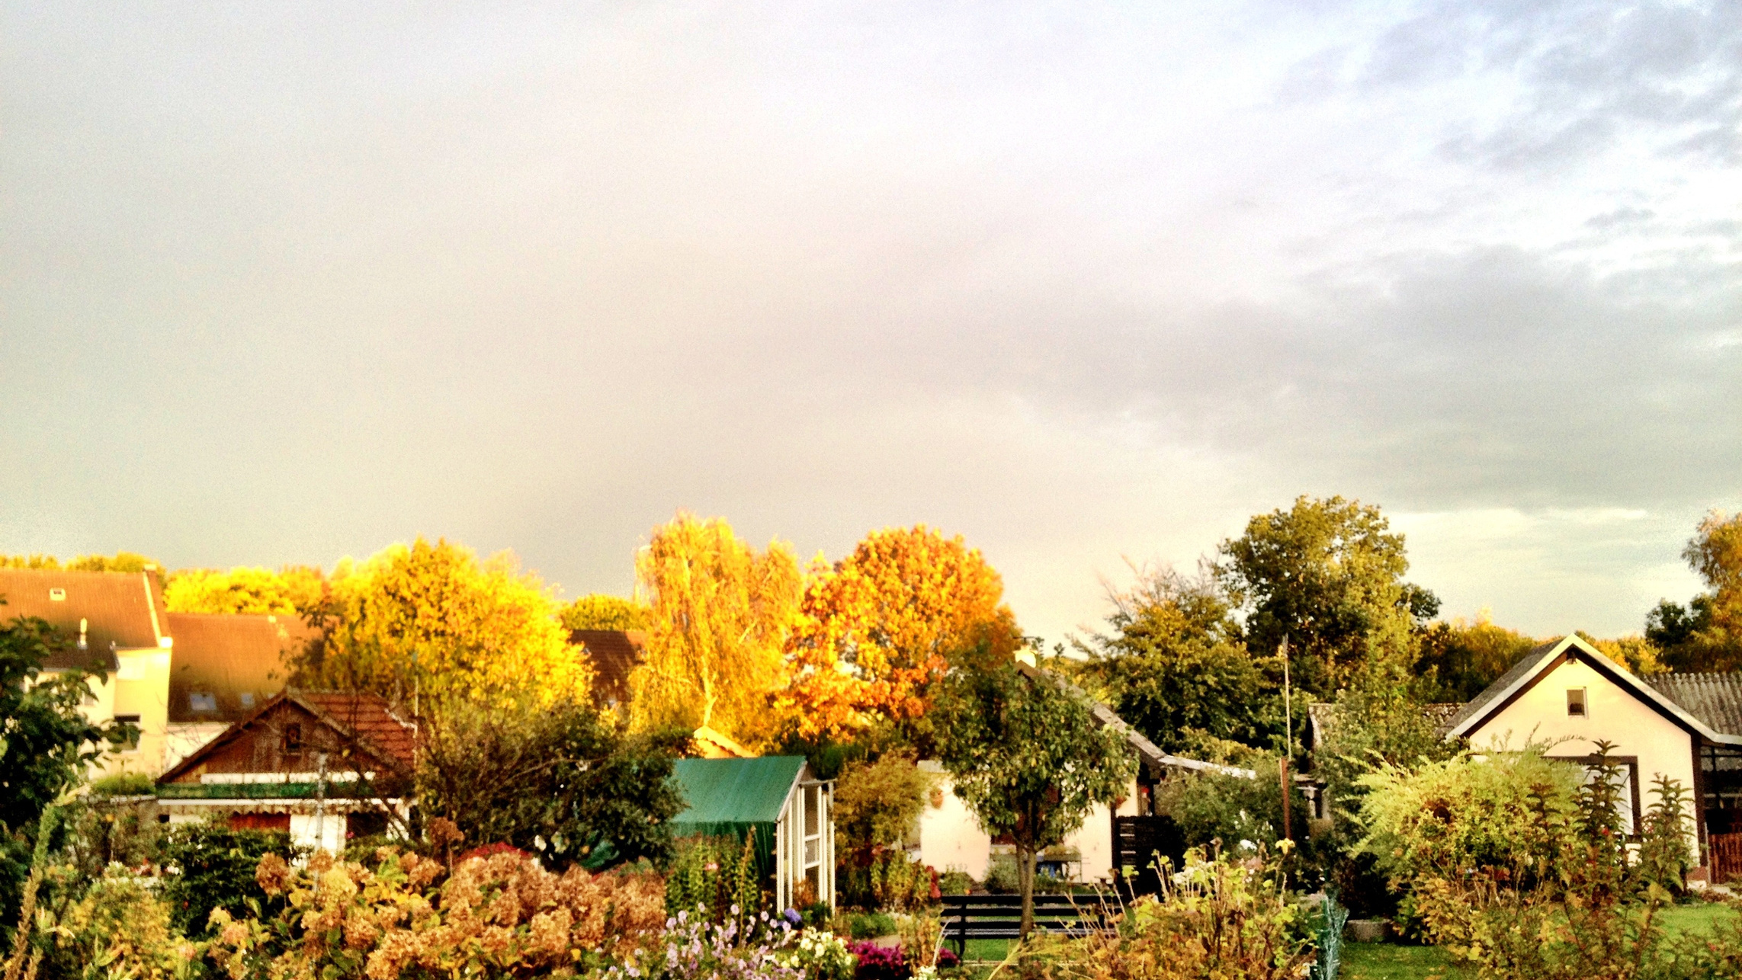
Neighboring
Presented by Victor Oduru
Covenant Baptist Church
26/2/23

Slide 2
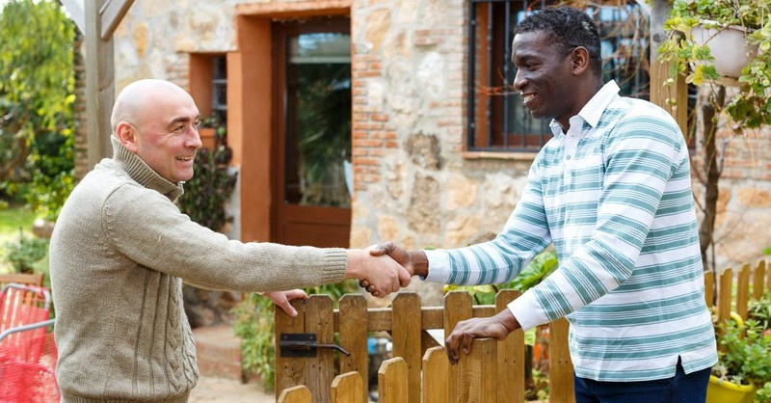
Who is my neighbor?

Slide 3
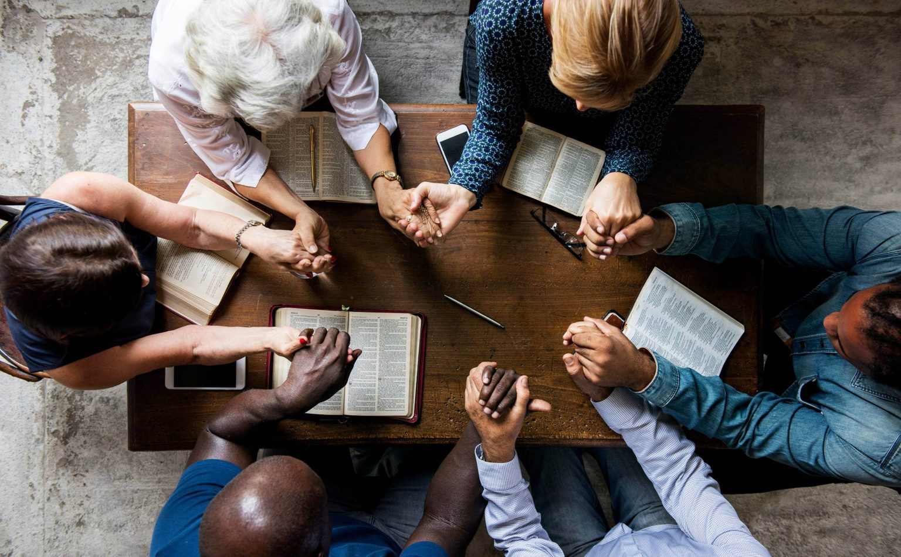
Human beings, created in the image of God, are given a commandment to love God and to love others by being good neighbours. Neighbours are not determined by race, class, education, religion, ethnicity, creed or gender; neighbours consist of anyone in need who is made in the image of God.

Slide 4
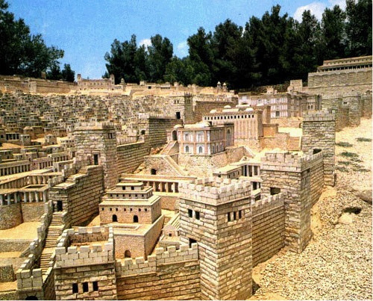
The word ‘neighbour’ can be divided into two different Old English words “neah” and “gabur.” The word “neah” means near and the word “gabur” means dweller. Together this creates the word neighbor, someone who dwells near.

Slide 5
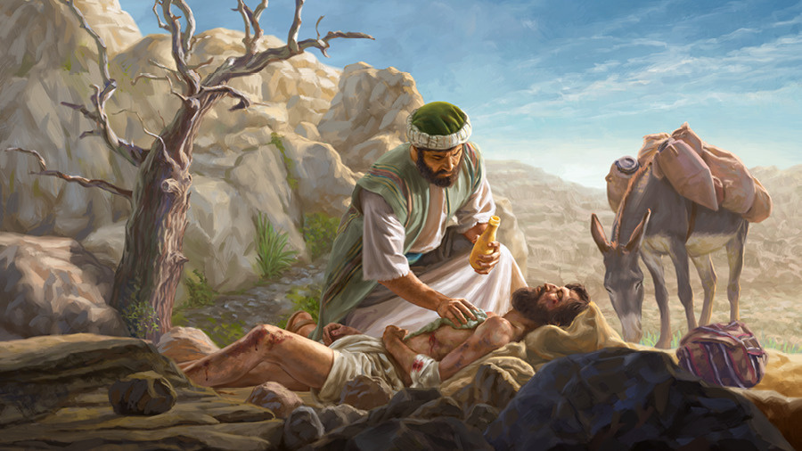
Better still, let’s look further and define who our neighbor is according to the Bible. The New Testament Greek word is an adverb used as a noun, plēsion. The literal meaning is “the (one) near.” The Old Testament word for neighbor is rēaʿ, a noun that means “friend, companion, fellow,” or simply, “another person.”

Slide 6
This study series will establish the doctrinal basis of ‘neighbouring’ and explore biblical means by which the christian and by extension christian families and local churches can love and act well towards those in need around them. To love God means to show mercy to those in need thus an authentic life is found in serving God and caring for others. This is a central tenet of discipleship. Much more, loving those who even hate you is a high expression of salvation and biblical ethics.
MAIN SCRIPTURES
LUKE 10:25-37
ADDITIONAL SCRIPTURES
Luke 6:27–36, Matthew 7:9-12

Slide 7
PRAYER
A Short Prayer for yourself and your neighbors…
My dearest Lord Jesus, thank you for the opportunity to love one another. Allowing us to love our neighbours for a season or for a lifetime is a gift that we do not deserve. We can only love because you have first loved us, Oh Lord. We ask you to open our eyes to the needs of those around us and grant us courage to serve in ways that seem hard and costly. Thank you for teaching us through the parable of the good Samaritan that you have called us to love all people and not just those that look, act, and think like we do. Mold our hearts oh Lord to do your will. You have been kind to us. You’ve given us life, faith, this church, and your Word. “Oh, to grace how great a debtor…” is our hearts’ refrain. We ask you as debtors for even more of your grace, that we might learn, grow, believe, and change. We pray this in Christ’s name, Amen.

