Slide 1
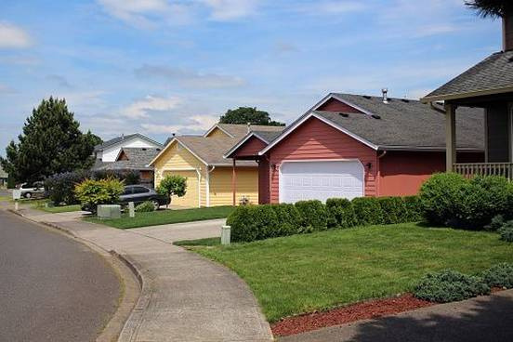
COVENANT BAPTIST CHURCH
NEIGHBORING
WITH VICTOR ODURU
4/3/2023

Slide 2

The Gospel as the root of neighboring

Slide 3

In the last lesson, we briefly elucidated who our neighbor was, through the examples given in the Old and New Testaments, thus we can focus now on what it means to be a good neighbor. The Lord’s desire is not for us to simply learn what it means to be a good neighbor, but to act upon that knowledge and put it into practice in our lives. To bring the Lord glory, we must act upon the teachings He has given us.

Slide 4
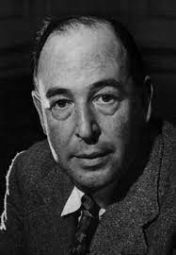
QUOTABLE QUOTES
“Love is not affectionate feeling, but a steady wish for the loved person’s ultimate good as far as it can be obtained.” ― C.S. Lewis
“Love, a term almost indefinable, is an unconditional regard for a person that prompts and shapes behaviors in order to help that person to become what God desires.”

Slide 5
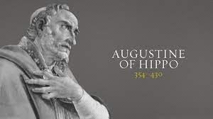
“Love is hard to define because it lies at the basis of things. God is love. But love is more than sentiment. It leads to action. Love is tied to the ultimate good for a person (not the ultimate want/what we want might not be good). Therefore love is ultimately a moral because it is linked to good.” Augustine of Hippo: Selected Writings Psalm 121: The Ecstasy of Love

Slide 6

“Just as impure love inflames the soul and brings it to desire those earthly and perishable goods which make it also perish, plunging it into the abyss, so holy love raises us to heavenly things, inflames it with the desire of eternal good, urges it toward those goods which will neither pass away nor perish, and from the abyss of hell raises it to heaven. All love has its own power nor can love in the soul of the lover be idle; it necessarily urges on. Do you wish to know the quality of love? See where it leads.” Anon

Slide 7
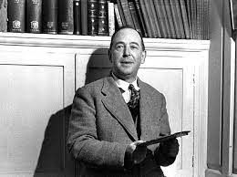
“The Christian does not think God will love us because we are good, but that God will make us good because He loves us.” C.S. Lewis

Slide 8
Gratefully, Lord, we ask You to fill our hearts and lives with immense gratitude for the wonderful privilege and the precious gift of the Holy Spirit who convicted us of sin, righteousness and judgment, enabling us to recognize the bankruptcy and futility of our own condition before You. It’s so much harder for religious people to see their spiritual bankruptcy even so. Thank You for leading us to that conviction so that the gospel came as good news, great news, glorious news of forgiveness and righteousness through faith in Christ. Cause us thus to be restless as long as we have unbelieving neighbours who foremost need your saving grace more than even their physical needs met. Cause us Lord to act intentionally on this by confronting them with the gospel message and that Your Spirit would draw sinners to Yourself and give them the gift of eternal life. We ask of these in Jesus’ great Name, Amen!
PRAYER

Slide 9
THANK YOU

