Slide 1
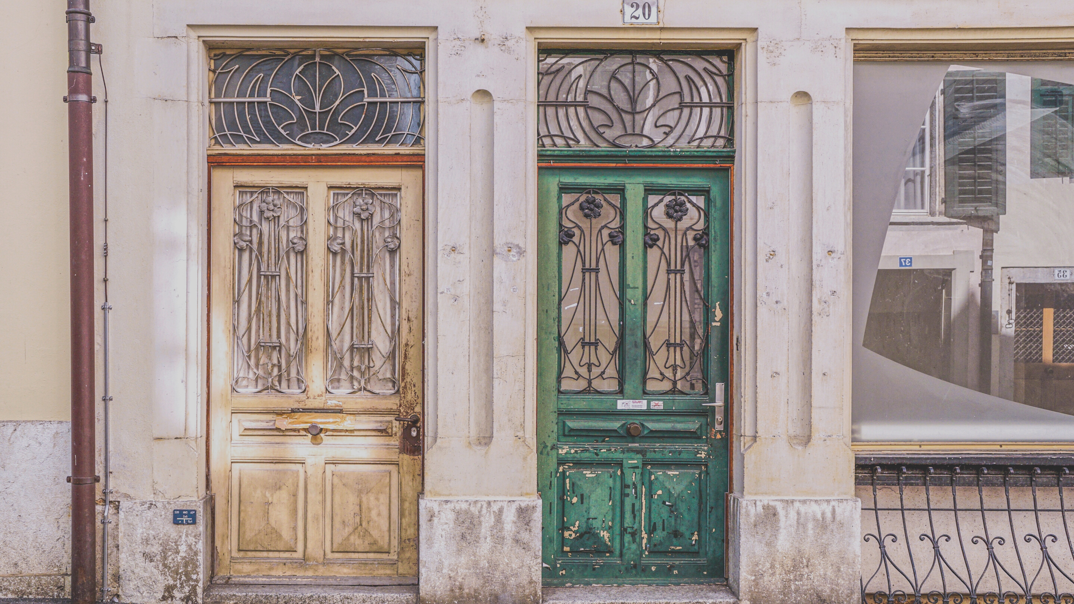

NEIGHBORING
WITH VICTOR ODURU
12TH MARCH 2023

Slide 2

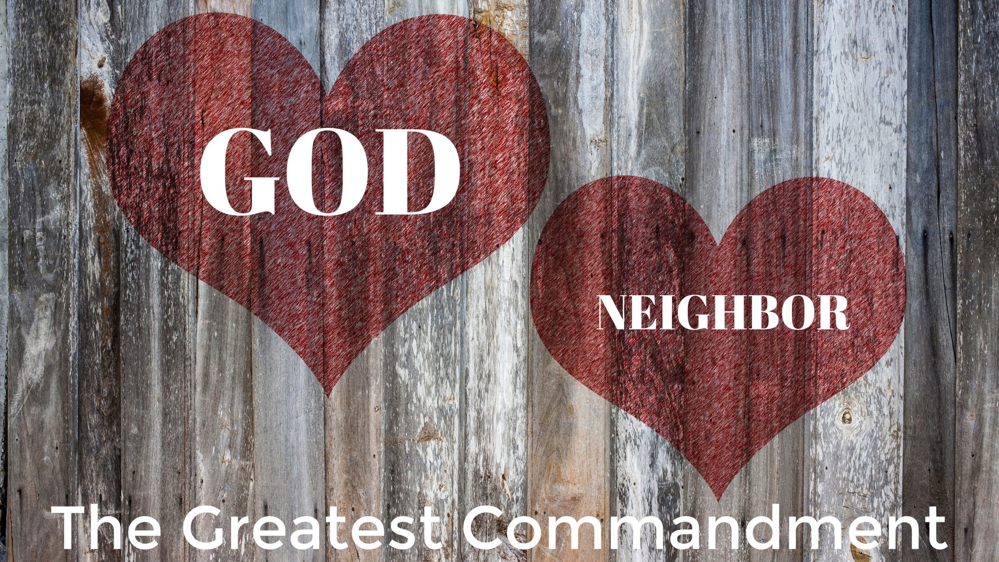

The Golden Rule

Slide 3
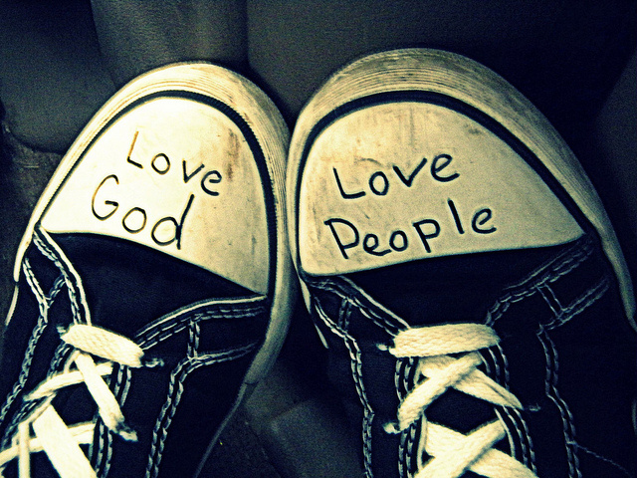
Key Verses
Proverbs 12:26 – “The righteous person is a guide to his neighbor, but the way of the wicked leads them astray.”
1 Corinthians 10:24 – “No one is to seek his own advantage, but rather that of his neighbor.”
1 John 4:7–12; Colossians 4:5–6; 1 Peter 3:15–16

Slide 4

To love others well we have to be filled with the love of God first. Our hearts, souls, and minds must be transformed and focused on the Lord before we can ever love our neighbors selflessly and intentionally. It delights the Lord when we strive to love our neighbors, His children. It is in mimicking God’s character that our own godly character is developed. If we love others as we love ourselves, we are displaying the Lord’s work of sanctification in our lives.
God commands us to love Him with all of our heart, soul, mind, and strength. In other words, we are to love Him with everything we are – body (physical), soul (mind, will, emotions), and spirit (our inner man that connects with the Spirit of God). This gives us a good foundation for how we love other people, recognizing them as individuals in need of the overflowing, abundance of our love for God.

Slide 5
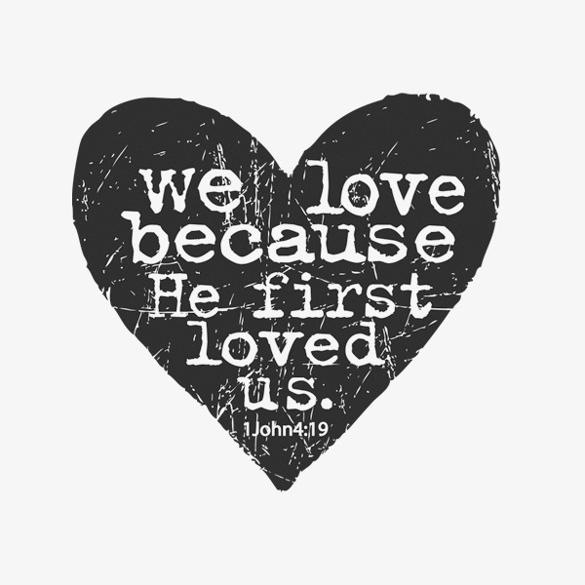
It is important to understand what true love is. We love people by genuinely seeking what is best for them. Loving others does not mean agreeing with everything they say or do, nor does it mean acting in ways that always gain their approval. Loving our neighbors means attending to their needs—both physical and spiritual. We love our neighbors when we, like the Samaritan in Jesus’ parable, have compassion for them and help meet their needs as we are able. We love our neighbors best when we share God’s truth with them. Jesus alone can save (John 14:6; Acts 4:12), and He alone can meet people’s every need.
We love our neighbors, including our neighbors who seem like enemies to us, when we act toward them with a heart that first loves God. We love our neighbors out of an overflow of God’s love for us and as a way of demonstrating our love toward God

Slide 6

With thanks Lord, we ask You to fill our hearts with immense gratitude for the wonderful privilege of the Holy Spirit convicting us of sin, righteousness, judgment that led us to see our own bankruptcy and hopelessness before You. It’s so much harder for religious people to see their spiritual bankruptcy. And so we ask that you save us from such self-righteousness! Thank You for leading us to that conviction so that the gospel came as good news, great news, glorious news of forgiveness and righteousness through faith in Christ. And would we also seek that first for our un-believing neighbours, as we seek to meet their physical needs!
Indeed Father, we ask that you would draw to Yourself, sinners and give them the gift of eternal life. We pray in Christ’s great name. Amen.
PRAYER

